Slide 1
Technology Industry /
Finnish Economic Outlook
October 2016

Slide 2
The Finnish Technology Industry Is Comprised of Five Sub-Sectors
ELEKTRONICS AND ELECTROTECHNICAL
INDUSTRY
ABB, Ensto, Microsoft Mobile,
Murata Electronics, Nokia, Planmeca,
Polar Electro, Suunto, Vacon, Vaisala…
METALS INDUSTRY
Boliden, Componenta, Kuusakoski, Luvata, Outokumpu, Outotec,
Ovako, Sacotec, SSAB …
MECHANICAL ENGINEERING
Abloy, Cargotec, Finn-Power, Fiskars, Glaston, Kone, Konecranes, Metso,
Meyer Turku, Normet, Oras, Patria, Pemamek, Ponsse, Stala, Valmet,
Valtra, Wärtsilä…
INFORMATION TECHNOLOGY
Affecto, Basware, Bilot, CGI, Comptel, Digia, Efecte, Enfo, F-Secure, Fujitsu Finland, IBM, Innofactor, Knowit,
Microsoft, Nixu, Tieto…
CONSULTING ENGINEERING
A-Insinöörit, Citec, Elomatic, Etteplan, FCG,
Granlund, Neste Jacobs, Pöyry, Ramboll,
Rejlers, SITO, SWECO, WSP…

Slide 3
The Finnish Technology Industry Is Comprised of Five Sub-Sectors
ELEKTRONICS AND ELECTROTECHNICAL
INDUSTRY
Data communications equipment, electrical machinery, medical technology
Turnover (2015): 14.6 billion euros
Personnel (2015): 40,600
METALS INDUSTRY
Steel products, non-ferrous metals, castings, metallic minerals
Turnover (2015): 9.1 billion euros
Personnel (2015): 15,800
MECHANICAL ENGINEERING
Machinery, metal products, vehicles
Turnover (2015): 28 billion euros
Personnel (2015): 124,600
INFORMATION TECHNOLOGY
IT services, applications and programming
Turnover (2015): 11 billion euros
Personnel (2015): 59,300
CONSULTING ENGINEERING
Expertise for construction industry and infrastructure
Turnover (2015): 5.5 billion euros
Personnel (2015): 48,200

Slide 4

The Technology Industry –
the Largest Export Sector in Finland
50 % of total Finnish exports.
Companies invest about EUR 5.5 billion annually in Finland.
75 % of private-sector R&D investment.
Almost 280,000 employed directly in the sector, 700,000 employed in total, equalling about 30% of the entire Finnish labour force.
Technology Industries of Finland has over 1,600 member companies.

Slide 5
Turnover of the Technology Industry in Finland
Source: Macrobond, Statistics Finland

Slide 6

Export of Technology Industry Goods from Finland by Area in 2015
Total goods exports 26.7 billion euros*
Central and Eastern Europe
3.8 billion €
14.6 %
Western Europe
14.4 billion €
53.7 %
North America
2.6 billion €
Asia
3.8 billion €
14.4 %
Middle and Central East
0.7 billion €
2.5 %
South and Middle America
0.9 billion €
3.3 %
Africa
0.5 billion €
1.9 %
*) In addition to goods exports the sector exported services worth some 11 billion euros.
Source: National Board of Customs, Statistics Finland

Slide 7
Turnover of the Industry and Technology Industry in Finland
Source: Macrobond, Statistics Finland

Slide 8
Turnover of the Technology Industry in Finland
Source: Macrobond, Statistics Finland

Slide 9
Value of New Orders in the Technology Industry* in Finland
Million euros, at current prices
2005 | 2006 | 2007 | 2008 | 2009 | 2010 | 2011 | 2012 | 2013 | 2014 | 2015 | 2016
Change: | II,2016 / II,2015 | II,2016 / I,2016
Export: | -27 % | -2 %
Domestic: | -17 % | -6 %
Combined: | -24 % | -3 %
*) Excluding metals industry and game industry companies
Source: The Federation of Finnish Technology Industries’ order book survey’s respondent companies, latest information April-June 2016

Slide 10
Value of Order Books in the Technology Industry* in Finland
Million euros, at current prices
Combined
2005 | 2006 | 2007 | 2008 | 2009 | 2010 | 2011 | 2012 | 2013 | 2014 | 2015 | 2016
Change: | 30.6.2016 / 30.6.2015 | 30.6.2016 / 31.3.2016
Export: | +5 % | -6 %
Domestic: | -1 % | -4 %
Combined: | +4 % | -6 %
*) Excluding metals industry and game industry companies
Source: The Federation of Finnish Technology Industries’ order book survey’s respondent companies, latest information 30.6.2016

Slide 11
Tender Requests* Received by Technology Industry Companies in Finland
2005 | 2006 | 2007 | 2008 | 2009 | 2010 | 2011 | 2012 | 2013 | 2014 | 2015 | 2016
” “Have you experienced a notable increase or decrease in the number of requests for tenders in recent weeks in comparison to the situation three months ago?”. Balance figure = the number of companies receiving more requests - the number of companies receiving less requests.
Source:The Federation of Finnish Technology Industries’ order book survey,
latest information July 2016.

Slide 12
Value of New Orders in the Electronics and Electrotechnical Industry in Finland
Million euros, at current prices
2005 | 2006 | 2007 | 2008 | 2009 | 2010 | 2011 | 2012 | 2013 | 2014 | 2015 | 2016
Change: | II,2016 / II,2015 | II,2016 / I,2016
Export: | +2 % | -2 %
Domestic: | +3 % | -4 %
Combined: | +2 % | -2 %
Source: The Federation of Finnish Technology Industries’ order book survey’s respondent companies, latest information April-June 2016

Slide 13
Value of Order Books in the Electronics and Electrotechnical Industry in Finland
Million euros, at current prices
Combined
2005 | 2006 | 2007 | 2008 | 2009 | 2010 | 2011 | 2012 | 2013 | 2014 | 2015 | 2016
Ghange: | 30.6.2016 / 30.6.2015 | 30.6.2016 / 31.3.2016
Export: | +7 % | +2 %
Domestic: | +12 % | 0 %
Combined: | +8 % | +1 %
Source: The Federation of Finnish Technology Industries’ order book survey’s respondent companies, latest information 30.6.2016

Slide 14
Value of New Orders in the Mechanical Engineering in Finland
Million euros, at current prices
2005 | 2006 | 2007 | 2008 | 2009 | 2010 | 2011 | 2012 | 2013 | 2014 | 2015 | 2016
Change: | II,2016 / II,2015 | II,2016 / I,2016
Export: | -44 % | -2 %
Domestic: | -25 % | -11 %
Combined: | -40 % | -5 %
Source: The Federation of Finnish Technology Industries’ order book survey’s respondent companies, latest information April-June 2016

Slide 15
Value of Order Books in the Mechanical Engineering in Finland
Million euros, at current prices
Combined
2005 | 2006 | 2007 | 2008 | 2009 | 2010 | 2011 | 2012 | 2013 | 2014 | 2015 | 2016
Change: | 30.6.2016 / 30.6.2015 | 30.6.2016 / 31.3.2016
Export: | +5 % | -9 %
Domestic: | -8 % | -5 %
Combined: | +2 % | -8 %
Source: The Federation of Finnish Technology Industries’ order book survey’s respondent companies, latest information 30.6.2016

Slide 16
Value of New Orders in the Consulting Engineering in Finland
Million euros, at current prices
2005 | 2006 | 2007 | 2008 | 2009 | 2010 | 2011 | 2012 | 2013 | 2014 | 2015 | 2016
Change: | II,2016 / II,2015 | II,2016 / I,2016
Export: | -22 % | -19 %
Domestic: | -1 % | 0 %
Combined: | -4 % | -2 %
Source: The Federation of Finnish Technology Industries’ order book survey’s respondent companies, latest information April-June 2016

Slide 17
Value of Order Books in the Consulting Engineering in Finland
Million euros, at current prices
Combined
2005 | 2006 | 2007 | 2008 | 2009 | 2010 | 2011 | 2012 | 2013 | 2014 | 2015 | 2016
Change: | 30.6.2016 / 30.6.2015 | 30.6.2016 / 31.3.2016
Export: | -3 % | -2 %
Domestic: | +13 % | -1 %
Combined: | +10 % | -1 %
Source: The Federation of Finnish Technology Industries’ order book survey’s respondent companies, latest information 30.6.2016

Slide 18
Value of New Orders in the Information Technology in Finland
Million euros, at current prices
2005 | 2006 | 2007 | 2008 | 2009 | 2010 | 2011 | 2012 | 2013 | 2014 | 2015 | 2016
Change: | II,2016 / II,2015 | II,2016 / I,2016
Combined: | -21 % | -1 %
Source: The Federation of Finnish Technology Industries’ order book survey’s respondent companies, latest information April-June 2016

Slide 19
Value of Order Books in the Information Technology* in Finland
Million euros, at current prices
2005 | 2006 | 2007 | 2008 | 2009 | 2010 | 2011 | 2012 | 2013 | 2014 | 2015 | 2016
Change: | 30.6.2016 / 30.6.2015 | 30.6.2016 / 31.3.2016
Combined: | +1 % | -4 %
*) Excluding game industry companies
Source: The Federation of Finnish Technology Industries’ order book survey’s respondent companies, latest information 30.6.2016

Slide 20
Technology Industry Personnel
Some 16,000 of personnel
affected by temporary or part-time lay-offs 30.6.2016
(30.6)
Source: Statistics Finland, The Federation of Finnish Technology Industries’ labour force survey

Slide 21
Technology Industry Personnel in Finland by Branch
Source: Statistics Finland, The Federation of Finnish Technology Industries’ labour force survey

Slide 22
Technology Industry Personnel in Subsidiaries Abroad by Branch
Source: The Federation of Finnish Technology Industries’ labour force survey

Slide 23
Retirement of Technology Industry Personnel in Finland
Individuals per year
Salaried employees
Blue collar employees
Source: Wage inquiry of the Techonology Industries of Finland, Finnish Centre for Pensions, Statistics Finland

Slide 24
Retirement of Technology Industry Blue Collar Employees in Finland
Individuals per year
Source: Wage inquiry of the Techonology Industries of Finland, Finnish Centre for Pensions, Statistics Finland

Slide 25
Overview of the Situation in the Technology Industry and Outlook for Autumn 2016
- Finland is in the grip of structural change. Development remains uneven between companies.
- Turnover in Finland increased slihtly in 2015 compared to the year 2014. Turnover totalled EUR 68.2 billion. In the pre-crisis year 2008 it was EUR 86 billion.
- The monetary value of new orders reported between April-June 2016 was 24 % lower than in the corresponding period in 2015, and three per cent lower than in the preceding quarter. The 2015 comparison period included a major ship order.
- At the end of June, the value of order books was four per cent higher year-on-year, but six per cent below the value reported at the end of March.
- The turnover of technology industry companies is expected to remain at the same or a slightly lower level in the autumn of 2016 than in the corresponding period last year.
- Since 2008, personnel numbers in Finland have shrunk by 40,000 employees, totalling on average 286,000 at the end of June 2016.
l

Slide 26
World Economic Outlook
- Finland as a Part of Global Economy

Slide 27
GDP Has Grown in Europe and the USA, but only Slightly in Finland
Lähde: Macrobond

Slide 28
Growth is Lowering in China, Remaining Fast in India, Recession Continues in Russia and in Brazil Share of global GDP in China, Brazil and Russia is 23%, in China 16% (adjusted for PP)
Lähde: Macrobond

Slide 29
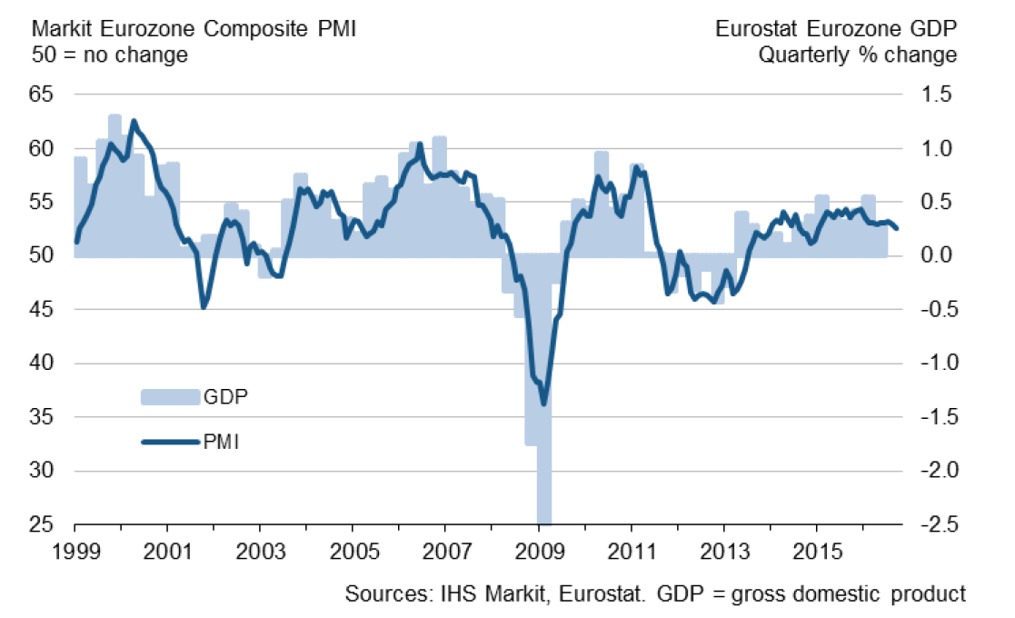
GDP Growth Has Continued in Eurozone in September, but at the Slower Rate
Purchase Managers’ Index (PMI), 50 = no change from previous month
Latest information September 2016
Source: Markit

Slide 30
Industrial Production Volume
Source: Macrobond

Slide 31
Industrial Production Volume in the EU Countries
Source: Macrobond

Slide 32
Global Industrial Production Growth Continues at a Slow Rate
Source: Macrobond, The CPB Netherlands Bureau for Economic Policy Analysis

Slide 33
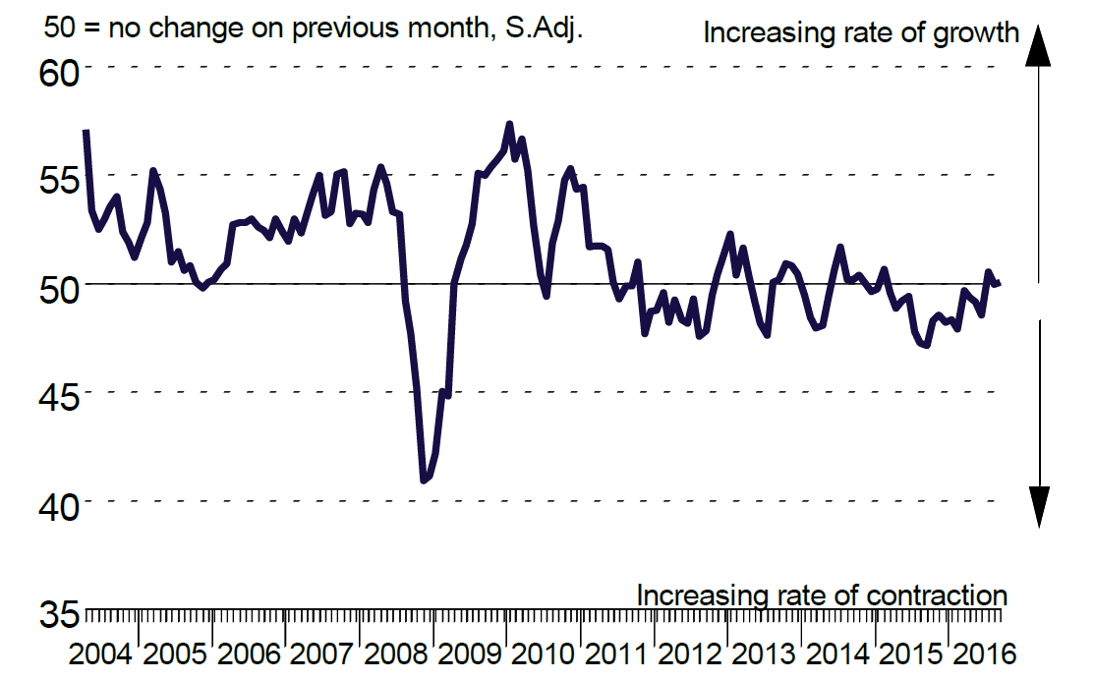
Industrial Production in China is Unchanged
Purchase Managers’ Index (PMI) in manufacturing industry in China
Latest information September 2016
Source: Markit

Slide 34
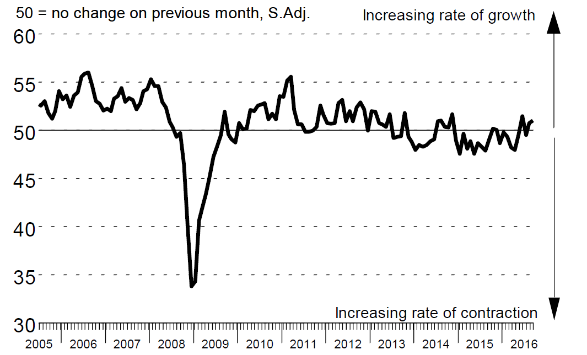
Industrial Production in Russia is Slightly Growing
Purchase Managers’ Index (PMI) in manufacturing industry in China
Latest information September 2016
Source: Markit

Slide 35
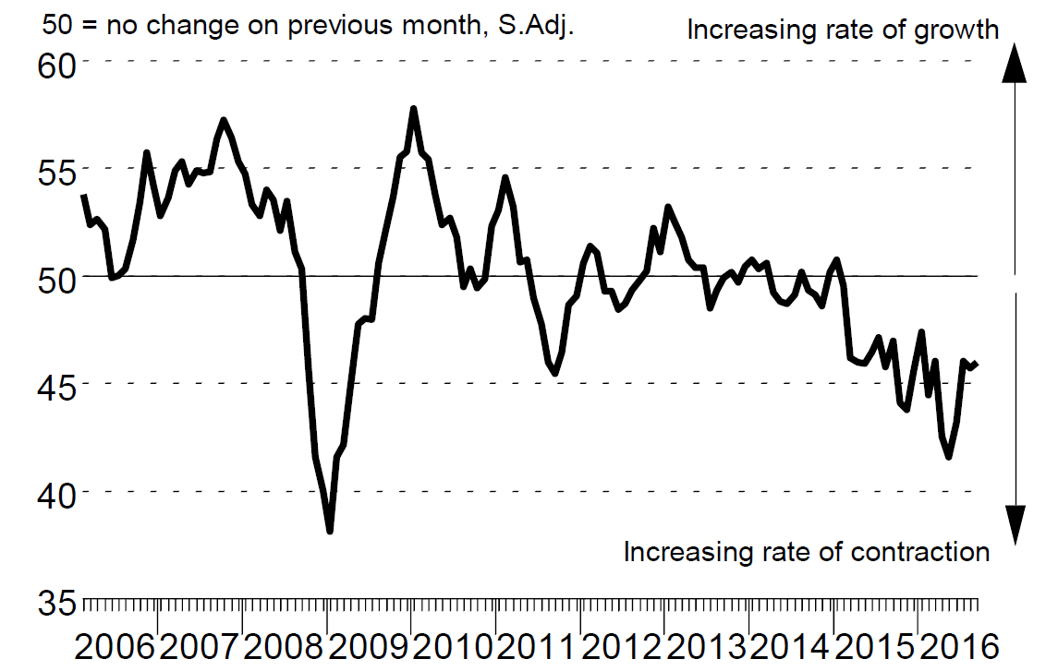
Industrial Production in Brazil is Dropping
Purchase Managers’ Index (PMI) in manufacturing industry in China
Latest information September 2016
Source: Markit

Slide 36
Industrial Production in USA is Slightly Increasing
Purchase Managers’ Index (PMI) in manufacturing industry
50 = no change from previous month
Source: Macrobond

Slide 37
Growth of Residence Construction Has Lowered in China
Share of China in Asian GDP is 42% (adjusted for PP)
Source: Macrobond

Slide 38
Fixed Investments in Russia and Brazil are Falling
Share of Russia in European GDP is 13 % (adjusted for PP)
Share of Brazil in Latin American GDP is 35 % (adjusted for PP)
Souce: Macrobond

Slide 39
Global Trade is Developing Sluggish Import volume development
Source: Macrobond, The CPB Netherlands Bureau for Economic Policy Analysis

Slide 40
Import to China Has Reduced from Several Countries
Source: Macrobond

Slide 41
Exports from EU Countries to Russia Have Fallen, but Stabilized
Source: Macrobond

Slide 42
Russia’s Share* of Technology Industry Exports from Finland Has Lowered by Five Per Cent
*) Soviet Union up to 1991
Source: Finnish Customs

Slide 43
Global Economy is Expected to Grow by 3.1 % in 2016 GDP growth in 2016, %
India
China
Rest of
Eastern Europe
Rest of
Latin America
Average growth:
+3,1 %
Mexico
Middle East
and Africa
Rest of
Asia
North America
Russia
Western Europe
Japan
Brazil
The width of the bar indicates the share of global GDP in 2015 (adjusted for purchasing power parity), %
Lähde: IMF (July 2016)

Slide 44
Export Demand for Technology Industry in Finland Will Grow by 2.0 % in 2016
GDP growth 2016 / 2015, %
India
Mexico
Rest of
Eastern Europe
China
Rest of Latin America
Middle East and Africa
Average growth:
+2.0 %
Rest
of Asia
North America
Russia
Brazil
Western Europe
Japan
The width of the bar indicates the export share of technology industry from Finland in 2015, %
Source: IMF (July 2016), Board of Customs

Slide 45
Finland’s Economic Growth Relies on Exports and Investments

Slide 46
Technology-, Forest- and Chemical Industry Cover 80 % of Finnish Export Revenues
Goods and services exports: billion euros and the shares of Finnish exports 2015
Source: Board of Customs, Statistics Finland (National Accounts, Foreign Trade of Services)

Slide 47
Finnish Exports up to EUR 30 Billion Short of Annual Target Level
Source: Macrobond, Eurostat

Slide 48
Finnish Exports Lagging Behind Competitors
Source: Macrobond, Eurostat

Slide 49
Finland’s Industrial Production and Exports Will Not Regain the Level of 2008 with the Present Production Capacity
Finland’s production capacity has decreased by 20 %
-22 %
2008 | 2009 | 2010 | 2011 | 2012 | 2013 | 2014 | 2015 | 2016
Source: Statistics Finland / National Accounts, Industrial volume index

Slide 50
Growth of Public Expenditures, Debt and Tax Ratio in Finland
Increased cost burden requires cuts to public sector
Source: Macrobond, Eurostat

Slide 51
Upswing of Investments Recuired in Finland of Investments Required in Finland
Source: OECD, Economic Outlook

Slide 52
Industrial and Technology Industry Companies’ Investment Plans Indicate a Weak Economic Growth
Industrial fixed and R&D investments in Finland
Million euros, at current prices
Source: Statistics Finland (National Accounts, Confederation of Finnish Industries’ Investment Survey (June 2016)

Slide 53
Investments and productivity* are Decisive for Finland’s Success
Productivity of export sector is 10 % lower than in 2007-2008, productivity of entire national economy is 3 % lower
*) Productivity is measured as real value added per hours worked. When productivity grows (the curve rises) value added grows more than hours worked. Value added = turnover – purchasing of materials and services
Value added = labour costs + rents + depreciations + profits
Source: Statistics Finland / National Accounts

Slide 54
The Competitiveness Pact in the Labour Market was an Essential Achievement Unit labour costs in the whole economy = labour costs / productivity, including the influence of effective exchange rates
2005,I =100
Finland’s cost competitiveness declines
Finland’s cost competitiveness improves
2005 | 2006 | 2007 | 2008 | 2009 | 2010 | 2011 | 2012 | 2013 | 2014 | 2015 | 2016 | 2017 | 2018 | 2019
*) In the ECB Harmonised Competitiveness Index, the average effective exchange rate of each country is calculated vis-à-vis 20 to 30 main trade partners, as well as the development of unit labour costs for the total economy.
Latest information I/2016. Source: European Central Bank

Slide 55
What Should Be Done in Finland?
Support the renewal of the industry.
Taxes should support growth and investment in Finland.
Support decision making in companies related to compensation and working time
No new European nor national burdens on companies, which are deteriorating the competitiveness.

Slide 56
Long-Term Outlook and Challenges
Global Structural Change Set to Continue Apace
  Industrial production and services will relocate to rapidly developing economic areas
  Strong growth, large markets, cheap labour and increasing expertise will increase the attractiveness of these regions.
Competition over Skills and Raw Materials Set to Increase
  Due to an increase in retirement, the sector’s annual recruitment need in Finland will rise considerably in the coming years.
  The availability of reasonably-priced energy also threatens to become an investment bottleneck in Finland
Combating Climate Change
  A challenge as costs are set to grow faster than in competitor countries
  An opportunity for new environmental and energy technologies

Slide 57
Technology Industries of Finland

Slide 58
The Federation’s Member Companies 2014
Number of enteprises / 1 583
Number of personnel / 183 772
1–249 employees
500–999 employees
250–499 employees
1000– employees

Slide 59
The Federation’s SME Member Companies 2014
Number of enterprises / 1 439
Number of personnel / 71 069
1–19 employees
50–99 employees
20–49 employees
100–249 employees

