Slide 1
Growth of World trade has been Stagnated Almost Two Years Allready
Export volume
Source: Macrobond, The CPB Netherlands Bureau for Economic Policy Analysis

Slide 2
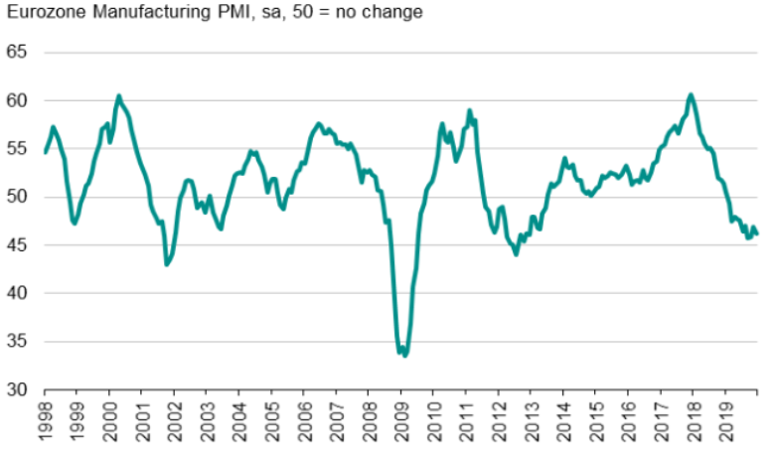
Eurozone Manufacturing Purchasing Managers’ Index Indicates that Production is Contracting in Near Future
Source: IHS Markit

Slide 3
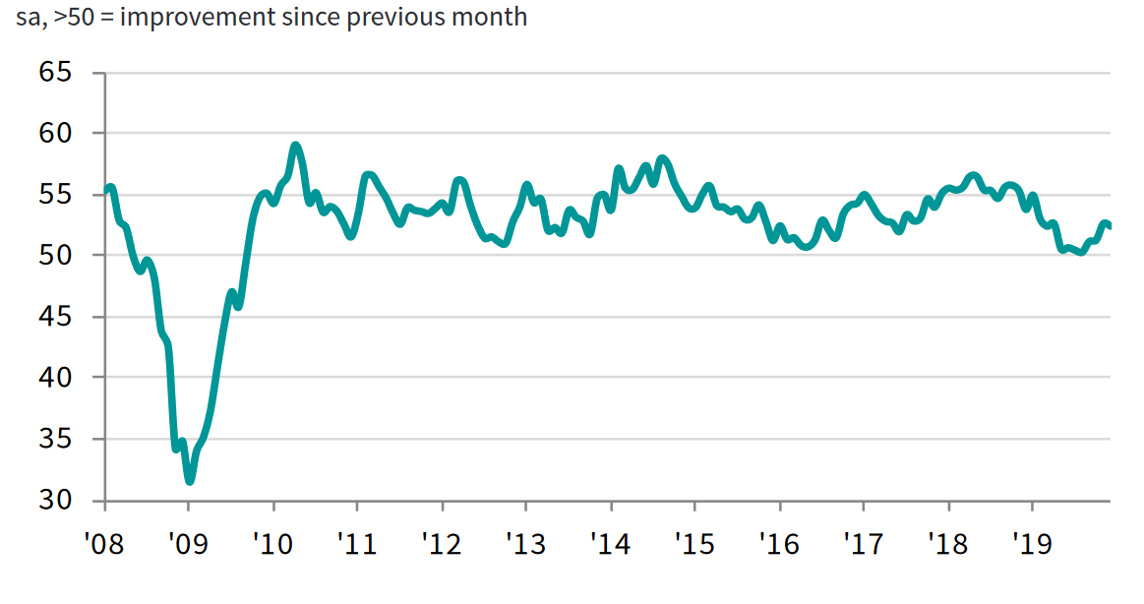
Based on Purchasing Managers’ Index Outlook in US Manufacturing has Improved Sligthly
Source: IHS Markit

Slide 4
Economic Forecasts for Finland
Forecaster | Date | Change in GDP, % |  |  | Change in private Consumption, % |  | Change in Exports, % |  | Change in Investments, % |  | Inflation, % * |  | Unemployment rate, %
 |  | 2018 | 2019 | 2020 | 2019 | 2020 | 2019 | 2020 | 2019 | 2020 | 2019 | 2020 | 2019 | 2020
Danske Bank | 24.9.2019 | 1,7 | 1,2 | 0,8 | 0,8 | 1,0 | 3,5 | 1,5 | 0,5 | 0,6 | 1,1 | 1,4 | 6,6 | 6,6
Nordea | 4.9.2019 | 1,7 | 1,2 | 1,0 | 1,0 | 1,4 | 3,0 | 1,0 | 0,5 | 0,1 | 1,1 | 1,3 | 6,4 | 6,4
OP-Pohjola | 19.11.2019 | 1,7 | 1,4 | 0,5 | 1,0 | 0,8 | 3,0 | 0,5 | 1,5 | 0,6 | 1,0 | 1,2 | 6,5 | 6,5
Ministry of Finance | 7.10.2019 | 1,7 | 1,5 | 1,0 | 1,7 | 1,4 | 2,4 | 2,4 | 0,4 | -0,3 | 1,1 | 1,4 | 6,5 | 6,3
Bank of Finland | 17.12.2019 | 1,7 | 1,3 | 0,9 | 0,7 | 1,3 | 4,0 | 0,9 | 1,1 | 0,7 | 1,1 | 1,2 | 6,7 | 6,7
ETLA | 16.9.2019 | 1,7 | 1,1 | 0,9 | 0,7 | 1,1 | 3,8 | 1,3 | 1,4 | 0,8 | 1,1 | 1,1 | 6,5 | 6,3
PTT | 12.9.2019 | 1,7 | 1,3 | 1,2 | 1,2 | 1,0 | 2,5 | 1,5 | 0,6 | 0,5 | 1,0 | 1,0 | 6,6 | 6,9
PT | 17.9.2019 | 1,7 | 1,3 | 1,1 | 1,0 | 0,9 | 4,0 | 2,0 | 1,4 | -1,0 | 1,1 | 1,0 | 6,6 | 6,7
European commission | 7.11.2019 | 1,7 | 1,4 | 1,1 | 0,6 | 1,1 | 1,9 | 2,2 | 0,7 | 0,4 | 1,2 | 1,4 | 6,7 | 6,5
IMF | 15.10.2019 | 1,7 | 1,2 | 1,5 |  |  | 3,1 | 2,2 |  |  | 1,2 | 1,3 | 6,5 | 6,4
Average |  | 1,7 | 1,3 | 1,0 | 1,0 | 1,1 | 3,1 | 1,6 | 0,9 | 0,3 | 1,1 | 1,2 | 6,6 | 6,5
*) European commission and IMF report Harmonized Index of Consumer Prices
Updated 22.1.2020

Slide 5
Improvement of Employment has been Sluggish
Employment rate, trend, %
Unemployment rate, trend, %
2010 | 2011 | 2012 | 2013 | 2014 | 2015 | 2016 | 2017 | 2018 | 2019
Source: Statistics Finland

Slide 6
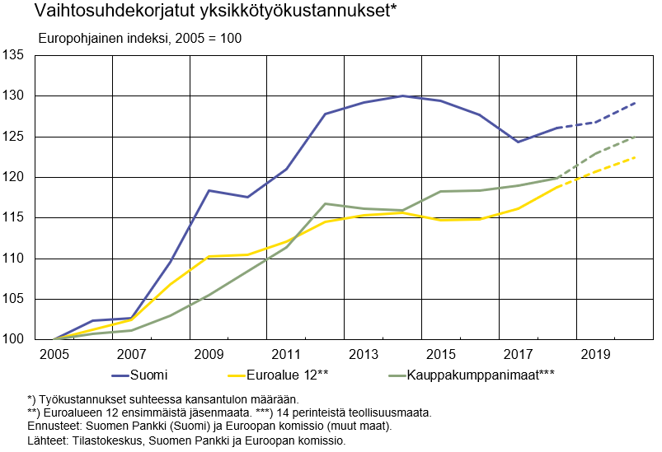
Cost Competitiveness has Improved in Finland but We are Still Lagging Behind Competitors
Unit labour costs adjusted for the terms of trade*
Eurobased Index, 2005=100
Finland
Euro area 12**
Trading partners***
*) Labour compensation relative to real national income.
**) First 12 euro area member states. ***) 14 traditional industrial countries.
Forecasts: Bank of Finland (Finland) and European Commission (other countries)
Sources: Statistics Finland, Bank of Finland and European Commission

Slide 7
Turnover of the Technology Industry in Finland
Seasonally adjusted turnover index
Shares of turnover in 2018: mechanical engineering 40 %, electronics and electrotechnical industry
20 %, information technology 18 %, metals industry 14 %, consulting engineering 8 %
Source: Macrobond, Statistics Finland

Slide 8
Value of New Orders in the Technology Industry* in Finland
Million euros, at current prices
2008 | 2009 | 2010 | 2011 | 2012 | 2013 | 2014 | 2015 | 2016 | 2017 | 2018 | 2019
Change: | IV/2019 / IV,2018 | IV,2019 / III,2019
Export: | +26 % | +25 %
Domestic: | -8 % | -14 %
Combined: | +17 % | +15 %
*) Excl. metals industry, game industry and data center companies
Source: The Federation of Finnish Technology Industries’ order book survey’s respondent companies, latest observation October-December 2019.

Slide 9
Value of Order Books in the Technology Industry* in Finland
Million euros, at current prices
Combined
2008 | 2009 | 2010 | 2011 | 2012 | 2013 | 2014 | 2015 | 2016 | 2017 | 2018 | 2019
Change: | 31.12.2019 / 31.12.2018 | 31.12.2019 / 30.9.2019
Export: | +8 % | +3 %
Domestic: | +13 % | 0 %
Combined: | +9 % | +2 %
*) Excl. metals industry, game industry and data center companies
Source: The Federation of Finnish Technology Industries’ order book survey’s respondent companies, latest observation 30th September 2019.

Slide 10
Tender Requests* Received by the Technology Industry Companies in Finland
2008 | 2009 | 2010 | 2011 | 2012 | 2013 | 2014 | 2015 | 2016 | 2017 | 2018 | 2019 | 2020
*) ”Have you experienced a notable increase or decrease in the number of requests for tenders in recent weeks in comparison to the situation three months ago?”. Balance figure = the number of companies receiving more requests - the number of companies receiving less requests.”
Source: The Federation of Finnish Technology Industries’ order book survey’s respondent companies, the last questionnaire in January 2020.

Slide 11
Number of Personnel in Finnish Technology Industry Declined for the Time since Q3 2016
Source: The Federation of Finnish Technology Industries’ labour force survey

Slide 12
Value of New Orders in the Electronics and Electrotechnical Industry in Finland
Million euros, at current prices
2008 | 2009 | 2010 | 2011 | 2012 | 2013 | 2014 | 2015 | 2016 | 2017 | 2018 | 2019
Change: | IV,2019 / IV,2018 | IV,2019 / III,2019
Export: | +42 % | +9 %
Domestic: | +1 % | +10 %
Combined: | +34 % | +9 %
Source: The Federation of Finnish Technology Industries’ order book survey’s respondent companies, latest observation October-December 2019.

Slide 13
Value of Order Books in the Electronics and Electrotechnical Industry in Finland
Million euros, at current prices
Combined
2008 | 2009 | 2010 | 2011 | 2012 | 2013 | 2014 | 2015 | 2016 | 2017 | 2018 | 2019
Change: | 31.12.2019 / 31.12.2018 | 31.12.2019 / 30.9.2019
Export: | +35 % | +6 %
Domestic: | -2 % | +5 %
Combined: | +28 % | +6 %
Source: The Federation of Finnish Technology Industries’ order book survey’s respondent companies, latest observation 31st December 2019.

Slide 14
Value of New Orders in the Mechanical Engineering in Finland
Million euros, at current prices
2008 | 2009 | 2010 | 2011 | 2012 | 2013 | 2014 | 2015 | 2016 | 2017 | 2018 | 2019
Change: | IV,2019 / IV,2018 | IV,2019 / III,2019
Export: | +13 % | +47 %
Domestic: | -19 % | -42 %
Combined: | +7 % | +21 %
Source: The Federation of Finnish Technology Industries’ order book survey’s respondent companies, latest observation October-December 2019.

Slide 15
Value of Order Books in the Mechanical Engineering in Finland
Million euros, at current prices
Combined
2008 | 2009 | 2010 | 2011 | 2012 | 2013 | 2014 | 2015 | 2016 | 2017 | 2018 | 2019
Change: | 31.12.2019 / 31.12.2018 | 31.12.2019 / 30.9.2019
Export: | +1 % | +2 %
Domestic: | +36 % | -3 %
Combined: | +5 % | +1 %
Source: The Federation of Finnish Technology Industries’ order book survey’s respondent companies, latest observation 31st December 2019.

Slide 16
Turnover of the Metals Industry in Finland
Seasonal adjusted turnover index
Source: Statistics Finland

Slide 17
Production Volume of the Metals Industry in Finland
Seasonal adjusted volume index
Source: Statistics Finland

Slide 18
Value of New Orders in the Consulting Engineering in Finland
Million euros, at current prices
2008 | 2009 | 2010 | 2011 | 2012 | 2013 | 2014 | 2015 | 2016 | 2017 | 2018 | 2019
Change: | IV,2019 / IV,2018 | IV,2019 / III,2019
Export: | +5 % | -13 %
Domestic: | +1 % | +25 %
Combined: | 0 % | +21 %
Source: The Federation of Finnish Technology Industries’ order book survey’s respondent companies, latest observation October-December 2019.

Slide 19
Value of Order Books in the Consulting Engineering in Finland
Million euros, at current prices
Combined
2008 | 2009 | 2010 | 2011 | 2012 | 2013 | 2014 | 2015 | 2016 | 2017 | 2018 | 2019
Change: | 31.12.2019 / 31.12.2018 | 31.12.2019 / 30.9.2019
Export: | -18 % | -8 %
Domestic: | -2 % | +2 %
Combined: | -4 % | +1 %
Source: The Federation of Finnish Technology Industries’ order book survey’s respondent companies, latest observation 31st December 2019.

Slide 20
Value of New Orders in the Information Technology* in Finland
Million euros, at current prices
2008 | 2009 | 2010 | 2011 | 2012 | 2013 | 2014 | 2015 | 2016 | 2017 | 2018 | 2019
Change: | IV,2019 / IV,2018 | IV,2019 / III,2019
Combined: | -1 % | +30 %
*) Excl. game industry and data center companies
Source: The Federation of Finnish Technology Industries’ order book survey’s respondent companies, latest observation October-December 2019.

Slide 21
Value of Order Books in the Information Technology* in Finland
Million euros, at current prices
2008 | 2009 | 2010 | 2011 | 2012 | 2013 | 2014 | 2015 | 2016 | 2017 | 2018 | 2019
Change: | 31.12.2019 / 31.12.2018 | 31.12.2019 / 30.9.2019
Combined: | +1 % | +1 %
*) Excl. game industry and data center companies
Source: The Federation of Finnish Technology Industries’ order book survey’s respondent companies, latest observation 31st December 2019.

