Slide 1
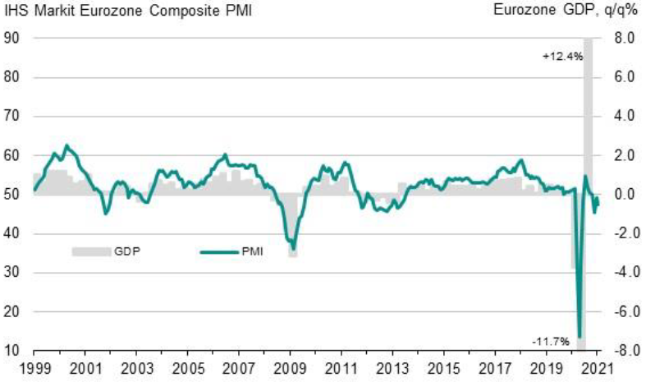
Zero growth or a slight contraction in the European economy at the turn of the year
Source: IHS Markit, Eurostat
Latest information January 2021

Slide 2
Industrial production has continued to recover worldwide
Source: Eurostat, Macrobond

Slide 3
According to the companies' estimates, the difficulties are starting to fall behind, at least for the time being
Share of companies, %
Source: The Federation of Finnish Technology Industries’ Corona questionnaire
23rd October 2020 n=496, 7th December 2020 n=532, 4th February 2021 n=523.

Slide 4
Weak demand worries companies far less than before
The share of companies that responded that the problem makes operating very difficult
Source: The Federation of Finnish Technology Industries’ Corona questionnaire
7th December 2020 n=532, 4th February 2021 n=523.

Slide 5
Business expectations for the whole of 2021 have improved, but still relatively little
How do you estimate your company's turnover to develop in 2021 compared to 2020? Share of companies,%
Source: The Federation of Finnish Technology Industries’ Corona questionnaire
23rd October 2020 n=496, 7th December 2020 n=532, 4th February 2021 n=523.

Slide 6
Turnover of the Technology Industry in Finland
Seasonally adjusted turnover index
Shares of turnover in 2019: mechanical engineering 40 %, electronics and electrotechnical industry 22 %,
information technology 17 %, metals industry 12 %, consulting engineering 8 %
Source: Macrobond, Statistics Finland

Slide 7
Tender requests* received by the technology industry companies in Finland
2008 | 2009 | 2010 | 2011 | 2012 | 2013 | 2014 | 2015 | 2016 | 2017 | 2018 | 2019 | 2020 | 2021
*) ”Have you experienced a notable increase or decrease in the number of requests for tenders in recent weeks in comparison to the situation three months ago”. Balance figure = the share of companies receiving more requests - the share of companies receiving less requests. Negative balance figure indicates that demand has weakened when compared to a situation three months ago.
Source: The Federation of Finnish Technology Industries’ order book survey’s respondent companies
The last questionnaire in January 2021
.

Slide 8
Value of new orders in the technology industry* in Finland
Million euros, at current prices
2008 | 2009 | 2010 | 2011 | 2012 | 2013 | 2014 | 2015 | 2016 | 2017 | 2018 | 2019 | 2020
Change: | IV/2020 / IV,2019 | IV,2020 / III,2020
Export: | +11 % | +52 %
Domestic: | +63 % | +90 %
Combined: | +21 % | +60 %
*) Excl. metals industry, game industry and data center companies
Source: The Federation of Finnish Technology Industries’ order book survey’s respondent companies, latest observation October-December 2020.

Slide 9
Number of personnel in Finnish technology industry continued to decrease in Q4 2020
28,000 employees affected by temporary lay-offs 31st December 2020
Source: The Federation of Finnish Technology Industries’ labour force survey

Slide 10
Value of order books in the technology industry* in Finland
Million euros, at current prices
Combined
2008 | 2009 | 2010 | 2011 | 2012 | 2013 | 2014 | 2015 | 2016 | 2017 | 2018 | 2019 | 2020
Change: | 31.12.2020 / 31.12.2019 | 31.12.2020 / 30.9.2020
Export: | +2 % | +10 %
Domestic: | +11 % | +14 %
Combined: | +4 % | +10 %
*) Excl. metals industry, game industry and data center companies
Source: The Federation of Finnish Technology Industries’ order book survey’s respondent companies, latest observation 31st December 2020.

Slide 11
Value of new orders in the electronics and electrotechnical industry in Finland
Million euros, at current prices
2008 | 2009 | 2010 | 2011 | 2012 | 2013 | 2014 | 2015 | 2016 | 2017 | 2018 | 2019 | 2020
Change: | IV,2020 / IV,2019 | IV,2020 / III,2020
Export: | +41 % | +61 %
Domestic: | +2 % | +17 %
Combined: | +35 % | +54 %
Source: The Federation of Finnish Technology Industries’ order book survey’s respondent companies, latest observation October-December 2020.

Slide 12
Value of order books in the electronics and electrotechnical industry in Finland
Million euros, at current prices
Combined
2008 | 2009 | 2010 | 2011 | 2012 | 2013 | 2014 | 2015 | 2016 | 2017 | 2018 | 2019 | 2020
Change: | 31.12.2020 / 31.12.2019 | 31.12.2020 / 30.9.2020
Export: | +32 % | +45 %
Domestic: | -5 % | +2 %
Combined: | +26 % | +38 %
Source: The Federation of Finnish Technology Industries’ order book survey’s respondent companies, latest observation 31st December 2020.

Slide 13
Value of new orders in the mechanical engineering in Finland
Million euros, at current prices
2008 | 2009 | 2010 | 2011 | 2012 | 2013 | 2014 | 2015 | 2016 | 2017 | 2018 | 2019 | 2020
Change: | IV,2020 / IV,2019 | IV,2020 / III,2020
Export: | -17 % | +40 %
Domestic: | +156 % | +186 %
Combined: | +10 % | +71 %
Source: The Federation of Finnish Technology Industries’ order book survey’s respondent companies, latest observation October-December 2020.

Slide 14
Value of order books in the mechanical engineering in Finland
Million euros, at current prices
Combined
2008 | 2009 | 2010 | 2011 | 2012 | 2013 | 2014 | 2015 | 2016 | 2017 | 2018 | 2019 | 2020
Change: | 31.12.2020 / 31.12.2019 | 31.12.2020 / 30.9.2020
Export: | -8 % | -2 %
Domestic: | +20 % | +27 %
Combined: | -3 % | +3 %
Source: The Federation of Finnish Technology Industries’ order book survey’s respondent companies, latest observation 31st December 2020.

Slide 15
Turnover of the metals industry in Finland
Seasonal adjusted turnover index
Shares of turnover 2019: iron and steel products, non-ferrous metals and castings 89 %, mining of metal ores 11 %
Source: Statistics Finland

Slide 16
Production volume of the metals industry in Finland
Seasonal adjusted volume index
Shares of turnover 2019: iron and steel products, non-ferrous metals and castings 89 %, mining of metal ores 11 %
Source: Statistics Finland

Slide 17
Value of new orders in the consulting engineering in Finland
Million euros, at current prices
2008 | 2009 | 2010 | 2011 | 2012 | 2013 | 2014 | 2015 | 2016 | 2017 | 2018 | 2019 | 2020
Change: | IV,2020 / IV,2019 | IV,2020 / III,2020
Export: | -46 % | +22 %
Domestic: | +8 % | +33 %
Combined: | -3 % | +31 %
Source: The Federation of Finnish Technology Industries’ order book survey’s respondent companies, latest observation October-December 2020.

Slide 18
Value of order books in the consulting engineering in Finland
Million euros, at current prices
Combined
2008 | 2009 | 2010 | 2011 | 2012 | 2013 | 2014 | 2015 | 2016 | 2017 | 2018 | 2019 | 2020
Change: | 31.12.2020 / 31.12.2019 | 31.12.2020 / 30.9.2020
Export: | -6 % | -2 %
Domestic: | +6 % | -1 %
Combined: | +4 % | -1 %
Source: The Federation of Finnish Technology Industries’ order book survey’s respondent companies, latest observation 31st December 2020.

Slide 19
Value of new orders in the information technology* in Finland
Million euros, at current prices
2008 | 2009 | 2010 | 2011 | 2012 | 2013 | 2014 | 2015 | 2016 | 2017 | 2018 | 2019 | 2020
Change: | IV,2020 / IV,2019 | IV,2020 / III,2020
Combined: | +13 % | +43 %
*) Excl. game industry and data center companies
Source: The Federation of Finnish Technology Industries’ order book survey’s respondent companies, latest observation October-December 2020.

Slide 20
Value of Order Books in the Information Technology* in Finland
Million euros, at current prices
2008 | 2009 | 2010 | 2011 | 2012 | 2013 | 2014 | 2015 | 2016 | 2017 | 2018 | 2019 | 2020
Change: | 31.12.2020 / 31.12.2019 | 31.12.2020 / 30.9.2020
Combined: | +5 % | +3 %
*) Excl. game industry and data center companies
Source: The Federation of Finnish Technology Industries’ order book survey’s respondent companies, latest observation 31st December 2020.

