Slide 1
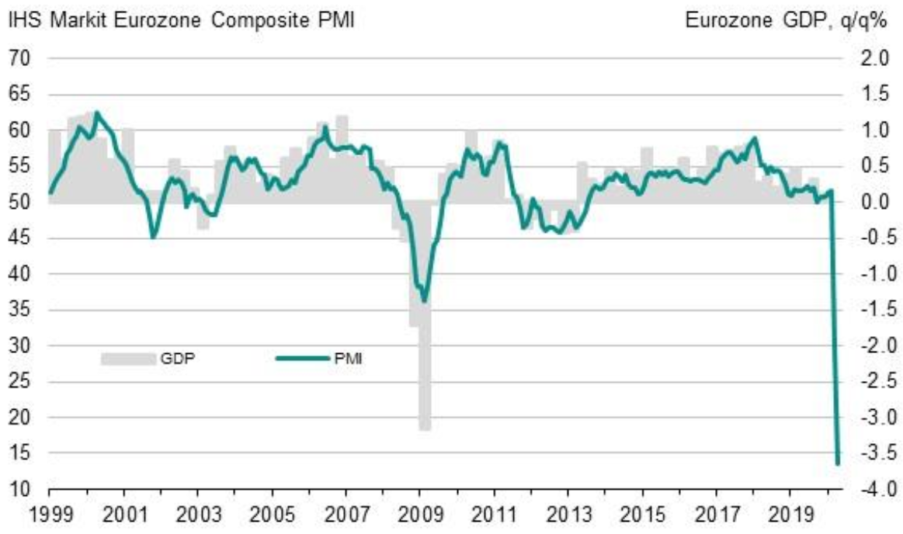
Eurozone Purchasing Managers’ Index Dropped to a Record low level
Source: IHS Markit

Slide 2
According to Companies the situation will continue to deteriorate over the next three months
Share of companies, %
Souce: The Federation of Finnish Technology Industries’ Corona questionaire
28.4.2020 n=640

Slide 3
Corona crisis causes multiple difficulties to the companies, deteriorating demand is a big concern
The share of companies that responded that the problem makes operating very difficult
Souce: The Federation of Finnish Technology Industries’ Corona questionaire
28.4.2020 n=640

Slide 4
The biggest drop in turnover is expected not until the end of the year
Share of companies, %
Change in turnover, %
Souce: The Federation of Finnish Technology Industries’ Corona questionaire
28.4.2020 n=640

Slide 5
A large number of temporary layoffs are still ahead
Share of companies, %
Souce: The Federation of Finnish Technology Industries’ Corona questionaire
28.4.2020 n=640

Slide 6
Less than a fifth of companies estimate that they have to lay off their staff
Share of companies, %
Souce: The Federation of Finnish Technology Industries’ Corona questionaire
28.4.2020 n=640

Slide 7
Turnover of the Technology Industry in Finland
Seasonally adjusted turnover index
Shares of turnover in 2018: mechanical engineering 40 %, electronics and electrotechnical industry
20 %, information technology 18 %, metals industry 14 %, consulting engineering 8 %
Source: Macrobond, Statistics Finland

Slide 8
Value of New Orders in the Technology Industry* in Finland
Million euros, at current prices
2008 | 2009 | 2010 | 2011 | 2012 | 2013 | 2014 | 2015 | 2016 | 2017 | 2018 | 2019 | 2020
Change: | I/2020 / I,2019 | I,2020 / IV,2019
Export: | -13 % | -29 %
Domestic: | -11 % | -2 %
Combined: | -12 % | -24 %
*) Excl. metals industry, game industry and data center companies
Source: The Federation of Finnish Technology Industries’ order book survey’s respondent companies, latest observation January-March 2020.

Slide 9
Tender Requests* Received by the Technology Industry Companies in Finland
2008 | 2009 | 2010 | 2011 | 2012 | 2013 | 2014 | 2015 | 2016 | 2017 | 2018 | 2019 | 2020
*) ”Have you experienced a notable increase or decrease in the number of requests for tenders in recent weeks in comparison to the situation three months ago?”. Balance figure = the number of companies receiving more requests - the number of companies receiving less requests.”
Source: The Federation of Finnish Technology Industries’ order book survey’s respondent companies, the last questionnaire in April 2020.

Slide 10
Value of Order Books in the Technology Industry* in Finland
Million euros, at current prices
Combined
2008 | 2009 | 2010 | 2011 | 2012 | 2013 | 2014 | 2015 | 2016 | 2017 | 2018 | 2019 | 2020
Change: | 31.3.2020 / 31.3.2019 | 31.3.2020 / 31.12.2019
Export: | -5 % | -7 %
Domestic: | +6 % | 0 %
Combined: | -2 % | -5 %
*) Excl. metals industry, game industry and data center companies
Source: The Federation of Finnish Technology Industries’ order book survey’s respondent companies, latest observation 31st March 2020.

Slide 11
Value of New Orders in the Electronics and Electrotechnical Industry in Finland
Million euros, at current prices
2008 | 2009 | 2010 | 2011 | 2012 | 2013 | 2014 | 2015 | 2016 | 2017 | 2018 | 2019 | 2020
Change: | I,2020 / I,2019 | I,2020 / IV,2019
Export: | -4 % | -30 %
Domestic: | +8 % | -1 %
Combined: | -2 % | -26 %
Source: The Federation of Finnish Technology Industries’ order book survey’s respondent companies, latest observation January-March 2020.

Slide 12
Value of Order Books in the Electronics and Electrotechnical Industry in Finland
Million euros, at current prices
Combined
2008 | 2009 | 2010 | 2011 | 2012 | 2013 | 2014 | 2015 | 2016 | 2017 | 2018 | 2019 | 2020
Change: | 31.3.2020 / 31.3.2019 | 31.3.2020 / 31.12.2019
Export: | 0 % | -24 %
Domestic: | +3 % | +1 %
Combined: | 0 % | -20 %
Source: The Federation of Finnish Technology Industries’ order book survey’s respondent companies, latest observation 31st March 2020.

Slide 13
Value of New Orders in the Mechanical Engineering in Finland
Million euros, at current prices
2008 | 2009 | 2010 | 2011 | 2012 | 2013 | 2014 | 2015 | 2016 | 2017 | 2018 | 2019 | 2020
Change: | I,2020 / I,2019 | I,2020 / IV,2019
Export: | -21 % | -29 %
Domestic: | -28 % | -11 %
Combined: | -22 % | -26 %
Source: The Federation of Finnish Technology Industries’ order book survey’s respondent companies, latest observation January-March 2020.

Slide 14
Value of Order Books in the Mechanical Engineering in Finland
Million euros, at current prices
Combined
2008 | 2009 | 2010 | 2011 | 2012 | 2013 | 2014 | 2015 | 2016 | 2017 | 2018 | 2019 | 2020
Change: | 31.3.2020 / 31.3.2019 | 31.3.2020 / 31.12.2019
Export: | -6 % | -1 %
Domestic: | +16 % | -2 %
Combined: | -3 % | -1 %
Source: The Federation of Finnish Technology Industries’ order book survey’s respondent companies, latest observation 31st March 2020.

Slide 15
Turnover of the Metals Industry in Finland
Seasonal adjusted turnover index
Source: Statistics Finland

Slide 16
Production Volume of the Metals Industry in Finland
Seasonal adjusted volume index
Source: Statistics Finland

Slide 17
Value of New Orders in the Consulting Engineering in Finland
Million euros, at current prices
2008 | 2009 | 2010 | 2011 | 2012 | 2013 | 2014 | 2015 | 2016 | 2017 | 2018 | 2019 | 2020
Change: | I,2020 / I,2019 | I,2020 / IV,2019
Export: | +111 % | +44 %
Domestic: | +11 % | +6 %
Combined: | +21 % | +11 %
Source: The Federation of Finnish Technology Industries’ order book survey’s respondent companies, latest observation January-March 2020.

Slide 18
Value of Order Books in the Consulting Engineering in Finland
Million euros, at current prices
Combined
2008 | 2009 | 2010 | 2011 | 2012 | 2013 | 2014 | 2015 | 2016 | 2017 | 2018 | 2019 | 2020
Change: | 31.3.2020 / 31.3.2019 | 31.3.2020 / 31.12.2019
Export: | +31 % | +32 %
Domestic: | 0 % | +4 %
Combined: | +3 % | +7 %
Source: The Federation of Finnish Technology Industries’ order book survey’s respondent companies, latest observation 31st March 2020.

Slide 19
Value of New Orders in the Information Technology* in Finland
Million euros, at current prices
2008 | 2009 | 2010 | 2011 | 2012 | 2013 | 2014 | 2015 | 2016 | 2017 | 2018 | 2019 | 2020
Change: | I,2020 / I,2019 | I,2020 / IV,2019
Combined: | -3 % | +13 %
*) Excl. game industry and data center companies
Source: The Federation of Finnish Technology Industries’ order book survey’s respondent companies, latest observation January-March 2020.

Slide 20
Value of Order Books in the Information Technology* in Finland
Million euros, at current prices
2008 | 2009 | 2010 | 2011 | 2012 | 2013 | 2014 | 2015 | 2016 | 2017 | 2018 | 2019 | 2020
Change: | 31.3.2020 / 31.3.2019 | 31.3.2020 / 31.12.2019
Combined: | -3 % | +1 %
*) Excl. game industry and data center companies
Source: The Federation of Finnish Technology Industries’ order book survey’s respondent companies, latest observation 31st March 2020.

Slide 21
Technology Industry Personnel
25,000 employees affected by temporary or part-time lay-offs 31st March 2020
31st Mar
Source: Statistics Finland, The Federation of Finnish Technology Industries’ labour force survey, Macrobond

Slide 22
Number of Personnel in Finnish Technology Industry Continued to Decrease in Q1 2020
Source: The Federation of Finnish Technology Industries’ labour force survey

Slide 23
Technology Industry Personnel in Subsidiaries Abroad by Industry
Source: The Federation of Finnish Technology Industries’ labour force survey

Slide 24
Technology Industry Personnel in Subsidiaries Abroad by Country
Information from year 2019
Source: The Federation of Finnish Technology Industries’ labour force survey

