Slide 1
The global economy is forecasted to grow by 6 % in 2021, after shrinking by 3.3% in 2020
GDP growth 2021/2020, %
India
Growth an average:
+6,0 %
China
Rest of Latin America
North America
Rest of Eastern Europe
Middle East and Africa
Mexico
Western Europe
Russia
Rest of Asia
Brazil
Japan
The width of the bar indicates the share of global GDP in 2020 (adjusted for purchasing power parity), %
Source: IMF April 2021

Slide 2
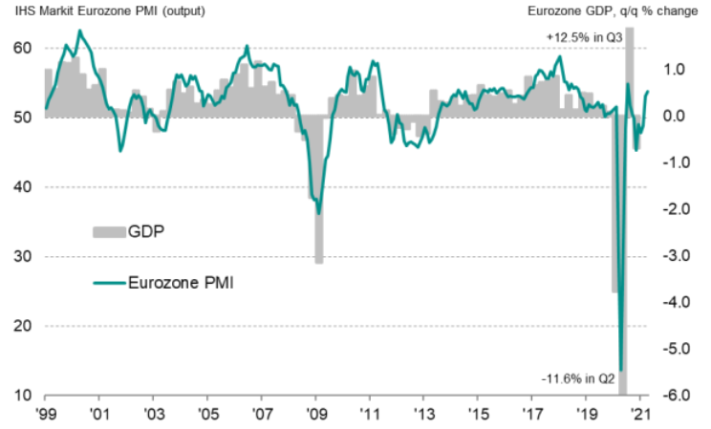
The European economy turned to growth in March-April
Source: IHS Markit, Eurostat
Latest information April 2021

Slide 3
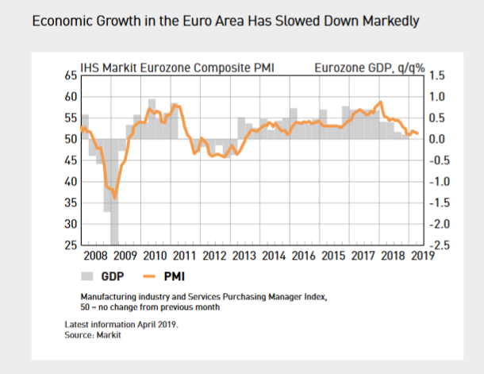
The European economy turned to growth in March-April
OHJE TAITTOON
Eli sama kuin aikaisemmilla kerroilla. Yritä lisäksi laittaa jälleen vaakaviika tuohon linjalle 50-0
HUOM! tee kuva kuten tässä eli vuodesta 2008
Tekstit taittoon (asettelu kuten edellisen kerran ostopäällikköindeksikuvassa):
Eurozone Manufacturing and Services Purchasing Managers’ Index,
50 = no change from previous month
Source: IHS Markit, Eurostat
Latest information April 2021

Slide 4
Industrial production in the world has recovered to pre-corona levels
Volume of industrial production
Source: Eurostat, Macrobond

Slide 5
The companies estimate that the situation will develop positively in the coming months
According to your estimation the next three months will be in your company?
Share of companies, %
Source: The Federation of Finnish Technology Industries’ Corona questionnaire
7th December 2020 n=532, 4th February 2021 n=523, 29th April 2021 n=449.

Slide 6
The biggest challenge now is availability of components, intermediates and raw materials
The share of companies that responded that the problem makes operating very difficult
Source: The Federation of Finnish Technology Industries’ Corona questionnaire
7th December 2020 n=532, 4th February 2021 n=523, 29th April 2021 n=449.

Slide 7
Business expectations for 2021 have continued to improve, but concerns remain
How do you estimate your company's turnover to develop in 2021 compared to 2020?
Share of companies,%
Source: The Federation of Finnish Technology Industries’ Corona questionnaire
23rd October 2020 n=496, 7th December 2020 n=532, 4th February 2021 n=523, 29th April 2021 n=449.

Slide 8
Tender requests* received by the technology industry companies in Finland
2008 | 2009 | 2010 | 2011 | 2012 | 2013 | 2014 | 2015 | 2016 | 2017 | 2018 | 2019 | 2020 | 2021
*) ”Have you experienced a notable increase or decrease in the number of requests for tenders in recent weeks in comparison to the situation three months ago”. Balance figure = the share of companies receiving more requests - the share of companies receiving less requests. Negative balance figure indicates that demand has weakened when compared to a situation three months ago.
Source: The Federation of Finnish Technology Industries’ order book survey’s respondent companies
The last questionnaire in April 2021.

Slide 9
Value of new orders in the technology industry* in Finland
Million euros, at current prices
2010 | 2011 | 2012 | 2013 | 2014 | 2015 | 2016 | 2017 | 2018 | 2019 | 2020 | 2021
Change: | I,2021 / I,2020 | I,2021 / IV,2020
Export: | +6 % | -31 %
Domestic: | +1 % | -26 %
Combined: | +5 % | -29 %
*) Excl. metals industry, game industry and data center companies
Source: The Federation of Finnish Technology Industries’ order book survey’s respondent companies, latest observation January-March 2021.

Slide 10
Turnover of the Technology Industry in Finland
Seasonally adjusted turnover index
Shares of turnover in 2019: mechanical engineering 40 %, electronics and electrotechnical industry 22 %,
information technology 17 %, metals industry 12 %, consulting engineering 8 %
Source: Macrobond, Statistics Finland

Slide 11
Value of order books in the technology industry* in Finland
Million euros, at current prices
Combined
2010 | 2011 | 2012 | 2013 | 2014 | 2015 | 2016 | 2017 | 2018 | 2019 | 2020 | 2021
Change: | 31.3.2021 / 31.3.2020 | 31.3.2021 / 31.12.2020
Export: | +2 % | -8 %
Domestic: | +15 % | +10 %
Combined: | +5 % | -4 %
*) Excl. metals industry, game industry and data center companies
Source: The Federation of Finnish Technology Industries’ order book survey’s respondent companies, latest observation 31st March 2021.

Slide 12
Value of new orders in the electronics and electrotechnical industry in Finland
Million euros, at current prices
2010 | 2011 | 2012 | 2013 | 2014 | 2015 | 2016 | 2017 | 2018 | 2019 | 2020 | 2021
Change: | I,2021 / I,2020 | I,2021 / IV,2020
Export: | +5 % | -48 %
Domestic: | +14 % | +10 %
Combined: | +7 % | -42 %
Source: The Federation of Finnish Technology Industries’ order book survey’s respondent companies, latest observation January-March 2021.

Slide 13
Value of order books in the electronics and electrotechnical industry in Finland
Million euros, at current prices
Combined
2010 | 2011 | 2012 | 2013 | 2014 | 2015 | 2016 | 2017 | 2018 | 2019 | 2020 | 2021
Change: | 31.3.2021 / 31.3.2020 | 31.3.2021 / 31.12.2020
Export: | +8 % | -38 %
Domestic: | +10 % | +19 %
Combined: | +8 % | -31 %
Source: The Federation of Finnish Technology Industries’ order book survey’s respondent companies, latest observation 31st March 2021.

Slide 14
Value of new orders in the mechanical engineering in Finland
Million euros, at current prices
2010 | 2011 | 2012 | 2013 | 2014 | 2015 | 2016 | 2017 | 2018 | 2019 | 2020 | 2021
Change: | I,2021 / I,2020 | I,2021 / IV,2020
Export: | +9 % | -4 %
Domestic: | -5 % | -46 %
Combined: | +5 % | -19 %
Source: The Federation of Finnish Technology Industries’ order book survey’s respondent companies, latest observation January-March 2021.

Slide 15
Value of order books in the mechanical engineering in Finland
Million euros, at current prices
Combined
2010 | 2011 | 2012 | 2013 | 2014 | 2015 | 2016 | 2017 | 2018 | 2019 | 2020 | 2021
Change: | 31.3.2021 / 31.3.2020 | 31.3.2021 / 31.12.2020
Export: | +1 % | +5 %
Domestic: | +22 % | +12 %
Combined: | +4 % | +6 %
Source: The Federation of Finnish Technology Industries’ order book survey’s respondent companies, latest observation 31st March 2021.

Slide 16
Turnover of the metals industry in Finland
Seasonal adjusted turnover index
Shares of turnover 2019: iron and steel products, non-ferrous metals and castings 89 %, mining of metal ores 11 %
Source: Statistics Finland

Slide 17
Production volume of the metals industry in Finland
Seasonal adjusted volume index
Shares of turnover 2019: iron and steel products, non-ferrous metals and castings 89 %, mining of metal ores 11 %
Source: Statistics Finland

Slide 18
Value of new orders in the consulting engineering in Finland
Million euros, at current prices
2010 | 2011 | 2012 | 2013 | 2014 | 2015 | 2016 | 2017 | 2018 | 2019 | 2020 | 2021
Change: | I,2021 / I,2020 | I,2021 / IV,2020
Export: | -39 % | +112 %
Domestic: | +6 % | +6 %
Combined: | -5 % | +14 %
Source: The Federation of Finnish Technology Industries’ order book survey’s respondent companies, latest observation January-March 2021.

Slide 19
Value of order books in the consulting engineering in Finland
Million euros, at current prices
Combined
2010 | 2011 | 2012 | 2013 | 2014 | 2015 | 2016 | 2017 | 2018 | 2019 | 2020 | 2021
Change: | 31.3.2021 / 31.3.2020 | 31.3.2021 / 31.12.2020
Export: | -41 % | -14 %
Domestic: | +10 % | +9 %
Combined: | +3 % | +7 %
Source: The Federation of Finnish Technology Industries’ order book survey’s respondent companies, latest observation 31st March 2021.

Slide 20
Value of new orders in the information technology* in Finland
Million euros, at current prices
2010 | 2011 | 2012 | 2013 | 2014 | 2015 | 2016 | 2017 | 2018 | 2019 | 2020 | 2021
Change: | I,2021 / I,2020 | I,2021 / IV,2020
Combined: | -2 % | -1 %
*) Excl. game industry and data center companies
Source: The Federation of Finnish Technology Industries’ order book survey’s respondent companies, latest observation January-March 2021.

Slide 21
Value of Order Books in the Information Technology* in Finland
Million euros, at current prices
2010 | 2011 | 2012 | 2013 | 2014 | 2015 | 2016 | 2017 | 2018 | 2019 | 2020 | 2021
Change: | 31.3.2021 / 31.3.2020 | 31.3.2021 / 31.12.2020
Combined: | +6 % | +2 %
*) Excl. game industry and data center companies
Source: The Federation of Finnish Technology Industries’ order book survey’s respondent companies, latest observation 31st March 2021.

Slide 22
At the end of March, the number of employees in the technology industry was slightly lower than last year's average
10,000 employees affected by temporary or part-time lay-offs 31st March 2021
Source: Statistics Finland, The Federation of Finnish Technology Industries’ labour force survey.

Slide 23
The number of employees in the technology industry in Finland turned to growth at the turn of the year
Source: The Federation of Finnish Technology Industries’ labour force survey

Slide 24
Technology Industry Personnel in Subsidiaries Abroad by Industry
Source: The Federation of Finnish Technology Industries’ labour force survey

Slide 25
Technology Industry Personnel in Subsidiaries Abroad by Country
Information from year 2020
Source: The Federation of Finnish Technology Industries’ labour force survey

