Slide 1
GDP Growth Forecasts for 2019 Have Been Weakened in Recent Months
Forecast period
Source: Consensus Economics

Slide 2
Growth of World trade has Stagnated
Export volume
Source: Macrobond, The CPB Netherlands Bureau for Economic Policy Analysis

Slide 3
In Finland Growth of GDP Slowed Down already Last Year
Lähde: Macrobond

Slide 4
Performance at Industrial Production Sligthly better in Finland than on Average in EU

Slide 5
Improvement in Employment rate has Stagnated
Employment rate, trend, %
2010 | 2011 | 2012 | 2013 | 2014 | 2015 | 2016 | 2017 | 2018 | 2019
Source: Statistics Finland

Slide 6
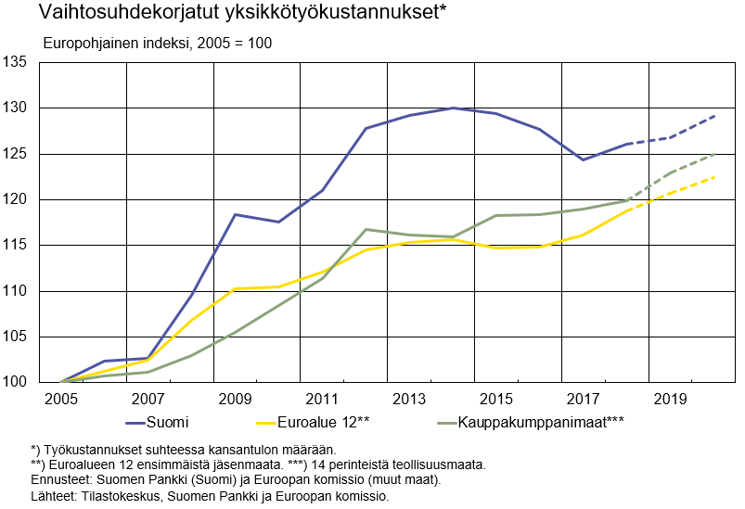
Cost Competitiveness has Improved in Finland but We are Still Lagging Behind Competitors
Unit labour costs adjusted for the terms of trade*
Eurobased Index, 2005=100
Finland
Euro area 12**
Trading partners***
*) Labour compensation relative to real national income.
**) First 12 euro area member states. ***) 14 traditional industrial countries.
Forecasts: Bank of Finland (Finland) and European Commission (other countries)
Sources: Statistics Finland, Bank of Finland and European Commission

Slide 7
Turnover of Finnish Technology Industry was 79 billion Euros in Year 2018
Seasonally adjusted turnover index
Source: Macrobond, Statistics Finland

Slide 8
Value of New Orders in the Technology Industry* in Finland
Million euros, at current prices
2008 | 2009 | 2010 | 2011 | 2012 | 2013 | 2014 | 2015 | 2016 | 2017 | 2018 | 2019
Change: | II,2019 / II,2018 | II,2019 / I,2019
Export: | +7 % | -7 %
Domestic: | +25 % | +4 %
Combined: | +10 % | -4 %
*) Excl. metals industry, game industry and data center companies
Source: The Federation of Finnish Technology Industries’ order book survey’s respondent companies, latest observation April-June 2019

Slide 9
Tender Requests* Received by the Technology Industry Companies in Finland
2008 | 2009 | 2010 | 2011 | 2012 | 2013 | 2014 | 2015 | 2016 | 2017 | 2018 | 2019
*) ”Have you experienced a notable increase or decrease in the number of requests for tenders in recent weeks in comparison to the situation three months ago?”. Balance figure = the number of companies receiving more requests - the number of companies receiving less requests.”
Source: The Federation of Finnish Technology Industries’ order book survey’s respondent companies, the last questionnaire in July 2019.

Slide 10
Value of Order Books in the Technology Industry* in Finland
Million euros, at current prices
Combined
2008 | 2009 | 2010 | 2011 | 2012 | 2013 | 2014 | 2015 | 2016 | 2017 | 2018 | 2019
Change: | 30.6.2019 / 30.6.2018 | 30.6.2019 / 31.3.2019
Export: | +17 % | 0 %
Domestic: | +11 % | +2 %
Combined: | +15 % | 0 %
*) Excl. metals industry, game industry and data center companies
Source: The Federation of Finnish Technology Industries’ order book survey’s respondent companies, latest observation 30th June 2019.

Slide 11
Value of New Orders in the Electronics and Electrotechnical Industry in Finland
Million euros, at current prices
2008 | 2009 | 2010 | 2011 | 2012 | 2013 | 2014 | 2015 | 2016 | 2017 | 2018 | 2019
Change: | II,2019 / II,2018 | II,2019 / I,2019
Export: | +21 % | +1 %
Domestic: | +9 % | +4 %
Combined: | +18 % | +2 %
Source: The Federation of Finnish Technology Industries’ order book survey’s respondent companies, latest observation April-June 2019

Slide 12
Value of Order Books in the Electronics and Electrotechnical Industry in Finland
Million euros, at current prices
Combined
2008 | 2009 | 2010 | 2011 | 2012 | 2013 | 2014 | 2015 | 2016 | 2017 | 2018 | 2019
Change: | 30.6.2019 / 30.6.2018 | 30.6.2019 / 31.3.2019
Export: | +15 % | +2 %
Domestic: | +10 % | +2 %
Combined: | +14 % | +2 %
Source: The Federation of Finnish Technology Industries’ order book survey’s respondent companies, latest observation 30th June 2019.

Slide 13
Value of New Orders in the Mechanical Engineering in Finland
Million euros, at current prices
2008 | 2009 | 2010 | 2011 | 2012 | 2013 | 2014 | 2015 | 2016 | 2017 | 2018 | 2019
Change: | II,2019 / II,2018 | II,2019 / I,2019
Export: | -4 % | -12 %
Domestic: | +39 % | +1 %
Combined: | +3 % | -10 %
Source: The Federation of Finnish Technology Industries’ order book survey’s respondent companies, latest observation April-June 2019

Slide 14
Value of Order Books in the Mechanical Engineering in Finland
Million euros, at current prices
Combined
2008 | 2009 | 2010 | 2011 | 2012 | 2013 | 2014 | 2015 | 2016 | 2017 | 2018 | 2019
Change: | 30.6.2019 / 30.6.2018 | 30.6.2019 / 31.3.2019
Export: | +17 % | -1 %
Domestic: | +14 % | +4 %
Combined: | +17 % | 0 %
Source: The Federation of Finnish Technology Industries’ order book survey’s respondent companies, latest observation 30th June 2019.

Slide 15
Turnover of the Metals Industry in Finland
Seasonal adjusted turnover index
Source: Statistics Finland

Slide 16
Production Volume of the Metals Industry in Finland
Seasonal adjusted volume index
Source: Statistics Finland

Slide 17
Value of New Orders in the Consulting Engineering in Finland
Million euros, at current prices
2008 | 2009 | 2010 | 2011 | 2012 | 2013 | 2014 | 2015 | 2016 | 2017 | 2018 | 2019
Change: | II,2019 / II,2018 | II,2019 / I,2019
Export: | +49 % | -16 %
Domestic: | +4 % | -10 %
Combined: | +8 % | -11 %
Source: The Federation of Finnish Technology Industries’ order book survey’s respondent companies, latest observation April-June 2019.

Slide 18
Value of Order Books in the Consulting Engineering in Finland
Million euros, at current prices
Combined
2008 | 2009 | 2010 | 2011 | 2012 | 2013 | 2014 | 2015 | 2016 | 2017 | 2018 | 2019
Change: | 30.6.2019 / 30.6.2018 | 30.6.2019 / 31.3.2019
Export: | -15 % | -9 %
Domestic: | +9 % | -7 %
Combined: | +6 % | -8 %
Source: The Federation of Finnish Technology Industries’ order book survey’s respondent companies, latest observation 30th June 2019.

Slide 19
Value of New Orders in the Information Technology* in Finland
Million euros, at current prices
2008 | 2009 | 2010 | 2011 | 2012 | 2013 | 2014 | 2015 | 2016 | 2017 | 2018 | 2019
Change: | II,2019 / II,2018 | II,2019 / I,2019
Combined: | +26 % | +5 %
*) Excl. game industry and data center companies
Source: The Federation of Finnish Technology Industries’ order book survey’s respondent companies, latest observation April-June 2019.

Slide 20
Value of Order Books in the Information Technology* in Finland
Million euros, at current prices
2008 | 2009 | 2010 | 2011 | 2012 | 2013 | 2014 | 2015 | 2016 | 2017 | 2018 | 2019
Change: | 30.6.2019 / 30.6.2018 | 30.6.2019 / 31.3.2019
Combined: | +10 % | +4 %
*) Excl. game industry and data center companies
Source: The Federation of Finnish Technology Industries’ order book survey’s respondent companies, latest observation 30th June 2019.

