Slide 1
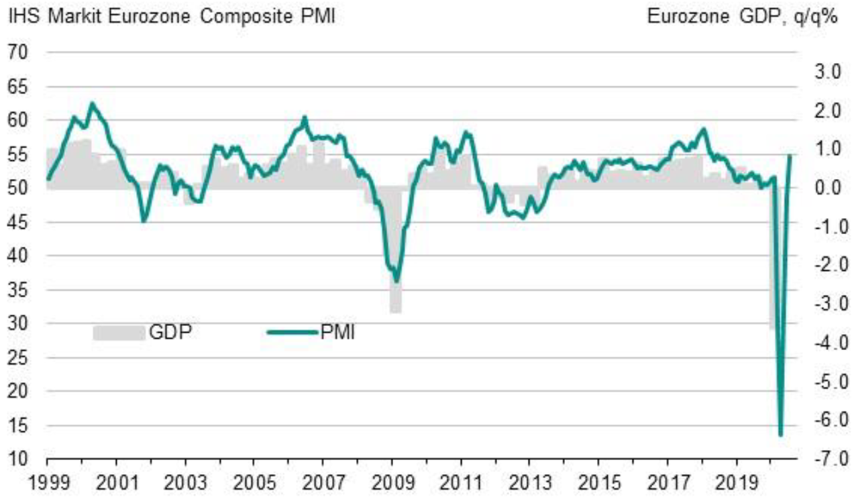
Outlook in the Eurozone has improved, but only slighty
Source: IHS Markit, Eurostat
Latest information July 2020

Slide 2
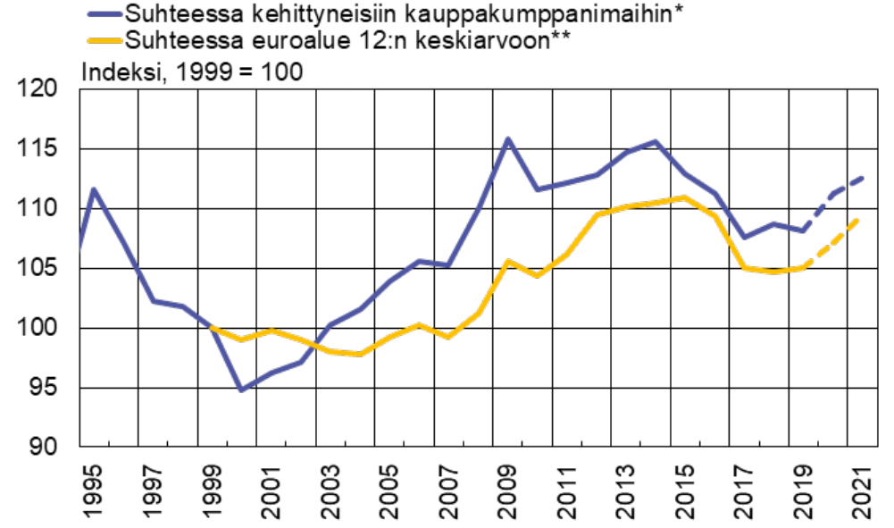
According to economic forecasts Finland’s cost competitiveness will deteriorate again
Unit labour costs adjusted for the terms of trade***
In relative to developed trading partners*
In relative to eurozone 12 average**
Index, 1999=100
*) 14 traditional industrial countries **) First 12 euro area member states.
***) Labour compensation relative to real national income, whole economy
Forecast: European Commission
Sources: European Commission, OECD, Macrobond and Bank of Finland calculations

Slide 3
In the technology industries manufacturing sector the worst is yet to come, in the service sectors the outlook is slightly brighter
Companies estimation of their situation after three months time, share of companies, %
Souce: The Federation of Finnish Technology Industries’ Corona questionaire
Manufacturing companies n=328, Service companies n=100

Slide 4
Corona crisis causes multiple difficulties to the companies, continuing weak demand is concerning
The share of companies that responded that the problem makes operating very difficult
Souce: The Federation of Finnish Technology Industries’ Corona questionaire
n=428.

Slide 5
A large number of temporary lay-offs are still ahead. Situation in service companies is better than in manufacturing
Share of companies, %
Souce: The Federation of Finnish Technology Industries’ Corona questionaire
Manufacturing companies n=328, Service companies n=100

Slide 6
In manufacturing companies almost one third of companies are cutting down personnel
Share of companies, %
Souce: The Federation of Finnish Technology Industries’ Corona questionaire
Manufacturing companies n=328, Service companies n=100

Slide 7
Tender Requests* Received by the Technology Industry Companies in Finland
2008 | 2009 | 2010 | 2011 | 2012 | 2013 | 2014 | 2015 | 2016 | 2017 | 2018 | 2019 | 2020
*) ”Have you experienced a notable increase or decrease in the number of requests for tenders in recent weeks in comparison to the situation three months ago?”. Balance figure = the number of companies receiving more requests - the number of companies receiving less requests.”
Source: The Federation of Finnish Technology Industries’ order book survey’s respondent companies
The last questionnaire in July 2020.

Slide 8
Value of New Orders in the Technology Industry* in Finland
Million euros, at current prices
2008 | 2009 | 2010 | 2011 | 2012 | 2013 | 2014 | 2015 | 2016 | 2017 | 2018 | 2019 | 2020
Change: | II/2020 / II,2019 | II,2020 / I,2020
Export: | -13 % | -8 %
Domestic: | -18 % | -6 %
Combined: | -14 % | -8 %
*) Excl. metals industry, game industry and data center companies
Source: The Federation of Finnish Technology Industries’ order book survey’s respondent companies, latest observation April-June 2020.

Slide 9
Number of Personnel in Finnish Technology Industry Decreased clearly in Q2 2020
Source: The Federation of Finnish Technology Industries’ labour force survey

Slide 10
Value of Order Books in the Technology Industry* in Finland
Million euros, at current prices
Combined
2008 | 2009 | 2010 | 2011 | 2012 | 2013 | 2014 | 2015 | 2016 | 2017 | 2018 | 2019 | 2020
Change: | 30.6.2020 / 30.6.2019 | 30.6.2020 / 31.3.2020
Export: | -4 % | +1 %
Domestic: | +3 % | -2 %
Combined: | -2 % | 0 %
*) Excl. metals industry, game industry and data center companies
Source: The Federation of Finnish Technology Industries’ order book survey’s respondent companies, latest observation 30th June 2020.

Slide 11
Value of New Orders in the Electronics and Electrotechnical Industry in Finland
Million euros, at current prices
2008 | 2009 | 2010 | 2011 | 2012 | 2013 | 2014 | 2015 | 2016 | 2017 | 2018 | 2019 | 2020
Change: | II,2020 / II,2019 | II,2020 / I,2020
Export: | +13 % | +19 %
Domestic: | +1 % | -1 %
Combined: | +11 % | +15 %
Source: The Federation of Finnish Technology Industries’ order book survey’s respondent companies, latest observation April-June 2020.

Slide 12
Value of Order Books in the Electronics and Electrotechnical Industry in Finland
Million euros, at current prices
Combined
2008 | 2009 | 2010 | 2011 | 2012 | 2013 | 2014 | 2015 | 2016 | 2017 | 2018 | 2019 | 2020
Change: | 30.6.2020 / 30.6.2019 | 30.6.2020 / 31.3.2020
Export: | +13 % | +16 %
Domestic: | +2 % | 0 %
Combined: | +11 % | +13 %
Source: The Federation of Finnish Technology Industries’ order book survey’s respondent companies, latest observation 30th June 2020.

Slide 13
Value of New Orders in the Mechanical Engineering in Finland
Million euros, at current prices
2008 | 2009 | 2010 | 2011 | 2012 | 2013 | 2014 | 2015 | 2016 | 2017 | 2018 | 2019 | 2020
Change: | II,2020 / II,2019 | II,2020 / I,2020
Export: | -37 % | -32 %
Domestic: | -26 % | -1 %
Combined: | -34 % | -26 %
Source: The Federation of Finnish Technology Industries’ order book survey’s respondent companies, latest observation April-June 2020.

Slide 14
Value of Order Books in the Mechanical Engineering in Finland
Million euros, at current prices
Combined
2008 | 2009 | 2010 | 2011 | 2012 | 2013 | 2014 | 2015 | 2016 | 2017 | 2018 | 2019 | 2020
Change: | 30.6.2020 / 30.6.2019 | 30.6.2020 / 31.3.2020
Export: | -8 % | -3 %
Domestic: | +13 % | -2 %
Combined: | -5 % | -3 %
Source: The Federation of Finnish Technology Industries’ order book survey’s respondent companies, latest observation 30th June 2020.

Slide 15
Turnover of the Metals Industry in Finland
Seasonal adjusted turnover index
Source: Statistics Finland

Slide 16
Production Volume of the Metals Industry in Finland
Seasonal adjusted volume index
Source: Statistics Finland

Slide 17
Value of New Orders in the Consulting Engineering in Finland
Million euros, at current prices
2008 | 2009 | 2010 | 2011 | 2012 | 2013 | 2014 | 2015 | 2016 | 2017 | 2018 | 2019 | 2020
Change: | II,2020 / II,2019 | II,2020 / I,2020
Export: | -7 % | -63 %
Domestic: | +5 % | -13 %
Combined: | +4 % | -22 %
Source: The Federation of Finnish Technology Industries’ order book survey’s respondent companies, latest observation April-June 2020.

Slide 18
Value of Order Books in the Consulting Engineering in Finland
Million euros, at current prices
Combined
2008 | 2009 | 2010 | 2011 | 2012 | 2013 | 2014 | 2015 | 2016 | 2017 | 2018 | 2019 | 2020
Change: | 30.6.2020 / 30.6.2019 | 30.6.2020 / 31.3.2020
Export: | +14 % | -21 %
Domestic: | +4 % | -3 %
Combined: | +5 % | -5 %
Source: The Federation of Finnish Technology Industries’ order book survey’s respondent companies, latest observation 30th June 2020.

Slide 19
Value of New Orders in the Information Technology* in Finland
Million euros, at current prices
2008 | 2009 | 2010 | 2011 | 2012 | 2013 | 2014 | 2015 | 2016 | 2017 | 2018 | 2019 | 2020
Change: | II,2020 / II,2019 | II,2020 / I,2020
Combined: | -27 % | -21 %
*) Excl. game industry and data center companies
Source: The Federation of Finnish Technology Industries’ order book survey’s respondent companies, latest observation April-June 2020.

Slide 20
Value of Order Books in the Information Technology* in Finland
Million euros, at current prices
2008 | 2009 | 2010 | 2011 | 2012 | 2013 | 2014 | 2015 | 2016 | 2017 | 2018 | 2019 | 2020
Change: | 30.6.2020 / 30.6.2019 | 30.6.2020 / 31.3.2020
Combined: | -8 % | -2 %
*) Excl. game industry and data center companies
Source: The Federation of Finnish Technology Industries’ order book survey’s respondent companies, latest observation 30th June 2020.

