Slide 1
Growth of World trade has been Stagnated Already for One and Half Years
Export volume
Source: Macrobond, The CPB Netherlands Bureau for Economic Policy Analysis

Slide 2
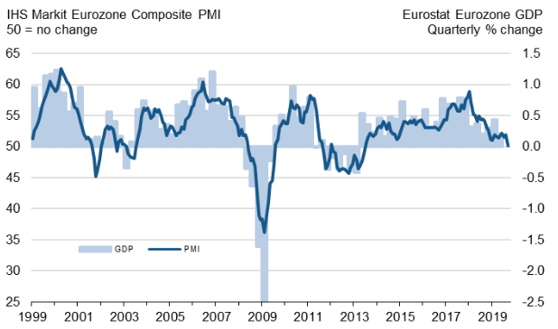
Purchasing Managers’ Index Indicates that Growth has Stopped in Eurozone
Source: IHS Markit

Slide 3
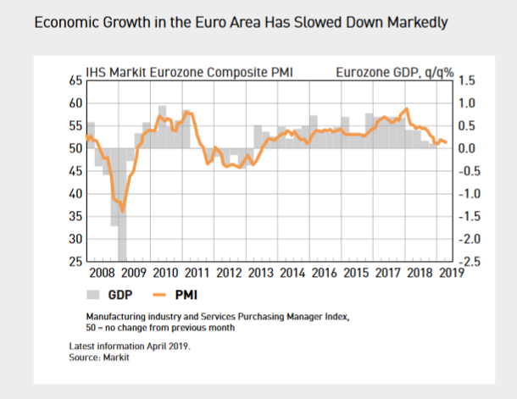
EDELLISEN KUVAN TAITTO KUIN TÄSSÄ 2/2019 RAPORTISSA (TAITTOON VUODESTA 2008 ALKAEN)

Slide 4
Downturn in German Manufacturing Industry Still Deepens
Leading Indicators for German Manufacturing Industry
Balance Figure
Balance Figure
Source: European Commission, Macrobond

Slide 5
Economic Forecasts for Finland
Forecaster | Date | Change in GDP, % |  |  | Change in private Consumption, % |  | Change in Exports, % |  | Change in Investments, % |  | Inflation, % * |  | Unemployment rate, %
 |  | 2018 | 2019 | 2020 | 2019 | 2020 | 2019 | 2020 | 2019 | 2020 | 2019 | 2020 | 2019 | 2020
Danske Bank | 24.9.2019 | 1,7 | 1,2 | 0,8 | 0,8 | 1,0 | 3,5 | 1,5 | 0,5 | 0,6 | 1,1 | 1,4 | 6,6 | 6,6
Nordea | 4.9.2019 | 1,7 | 1,2 | 1,0 | 1,0 | 1,4 | 3,0 | 1,0 | 0,5 | 0,1 | 1,1 | 1,3 | 6,4 | 6,4
OP-Pohjola | 19.8.2019 | 1,7 | 1,2 | 0,5 | 1,0 | 0,8 | 2,0 | 0,8 | 1,5 | 0,6 | 1,0 | 1,1 | 6,5 | 6,5
Ministry of Finance | 7.10.2019 | 1,7 | 1,5 | 1,0 | 1,7 | 1,4 | 2,4 | 2,4 | 0,4 | -0,3 | 1,1 | 1,4 | 6,5 | 6,3
Bank of Finland | 11.6.2019 | 2,3 | 1,6 | 1,5 | 1,3 | 1,4 | 2,8 | 2,1 | 1,8 | 1,6 | 1,2 | 1,3 | 6,5 | 6,4
ETLA | 16.9.2019 | 1,7 | 1,1 | 0,9 | 0,7 | 1,1 | 3,8 | 1,3 | 1,4 | 0,8 | 1,1 | 1,1 | 6,5 | 6,3
PTT | 12.9.2019 | 1,7 | 1,3 | 1,2 | 1,2 | 1,0 | 2,5 | 1,5 | 0,6 | 0,5 | 1,0 | 1,0 | 6,6 | 6,9
PT | 17.9.2019 | 1,7 | 1,3 | 1,1 | 1,0 | 0,9 | 4,0 | 2,0 | 1,4 | -1,0 | 1,1 | 1,0 | 6,6 | 6,7
European commission | 2.7.2019 | 1,7 | 1,5 | 1,2 | 1,6 | 1,4 | 3,2 | 3,4 | 1,6 | 1,3 | 1,4 | 1,8 | 6,7 | 6,0
IMF | 15.10.2019 | 1,7 | 1,2 | 1,5 |  |  | 3,1 | 2,2 |  |  | 1,2 | 1,3 | 6,5 | 6,4
Average |  | 1,8 | 1,3 | 1,1 | 1,1 | 1,2 | 3,0 | 1,8 | 1,1 | 0,5 | 1,1 | 1,3 | 6,5 | 6,5
*) European commission and IMF report Harmonized Index of Consumer Prices
Updated 23.10.2019

Slide 6
Growth of Finnish Economy and Performance of Export Sector Goes in Hand in Hand
Source: Statistics Finland, Macrobond

Slide 7
Turnover of Finnish Technology Industry was 79 billion Euros in Year 2018
Seasonally adjusted turnover index
Source: Macrobond, Statistics Finland

Slide 8
Value of New Orders in the Technology Industry* in Finland
Million euros, at current prices
2008 | 2009 | 2010 | 2011 | 2012 | 2013 | 2014 | 2015 | 2016 | 2017 | 2018 | 2019
Change: | III,2019 / III,2018 | III,2019 / II,2019
Export: | +11 % | +10 %
Domestic: | +39 % | +5 %
Combined: | +16 % | +8 %
*) Excl. metals industry, game industry and data center companies
Source: The Federation of Finnish Technology Industries’ order book survey’s respondent companies, latest observation July-September 2019

Slide 9
Tender Requests* Received by the Technology Industry Companies in Finland
2008 | 2009 | 2010 | 2011 | 2012 | 2013 | 2014 | 2015 | 2016 | 2017 | 2018 | 2019 | 2020
*) ”Have you experienced a notable increase or decrease in the number of requests for tenders in recent weeks in comparison to the situation three months ago?”. Balance figure = the number of companies receiving more requests - the number of companies receiving less requests.”
Source: The Federation of Finnish Technology Industries’ order book survey’s respondent companies, the last questionnaire in October 2019.

Slide 10
Value of Order Books in the Technology Industry* in Finland
Million euros, at current prices
Combined
2008 | 2009 | 2010 | 2011 | 2012 | 2013 | 2014 | 2015 | 2016 | 2017 | 2018 | 2019
Change: | 30.9.2019 / 30.9.2018 | 30.9.2019 / 30.6.2019
Export: | +8 % | 0 %
Domestic: | +19 % | +7 %
Combined: | +10 % | +1 %
*) Excl. metals industry, game industry and data center companies
Source: The Federation of Finnish Technology Industries’ order book survey’s respondent companies, latest observation 30th September 2019.

Slide 11
Value of New Orders in the Electronics and Electrotechnical Industry in Finland
Million euros, at current prices
2008 | 2009 | 2010 | 2011 | 2012 | 2013 | 2014 | 2015 | 2016 | 2017 | 2018 | 2019
Change: | III,2019 / III,2018 | III,2019 / II,2019
Export: | +46 % | +25 %
Domestic: | -3 % | -7 %
Combined: | +36 % | +19 %
Source: The Federation of Finnish Technology Industries’ order book survey’s respondent companies, latest observation July-September 2019

Slide 12
Value of Order Books in the Electronics and Electrotechnical Industry in Finland
Million euros, at current prices
Combined
2008 | 2009 | 2010 | 2011 | 2012 | 2013 | 2014 | 2015 | 2016 | 2017 | 2018 | 2019
Change: | 30.9.2019 / 30.9.2018 | 30.9.2019 / 30.6.2019
Export: | +33 % | +20 %
Domestic: | +2 % | -4 %
Combined: | +27 % | +15 %
Source: The Federation of Finnish Technology Industries’ order book survey’s respondent companies, latest observation 30th September 2019.

Slide 13
Value of New Orders in the Mechanical Engineering in Finland
Million euros, at current prices
2008 | 2009 | 2010 | 2011 | 2012 | 2013 | 2014 | 2015 | 2016 | 2017 | 2018 | 2019
Change: | III,2019 / III,2018 | III,2019 / II,2019
Export: | -19 % | -7 %
Domestic: | +128 % | +50 %
Combined: | +1 % | +5 %
Source: The Federation of Finnish Technology Industries’ order book survey’s respondent companies, latest observation July-September 2019

Slide 14
Value of Order Books in the Mechanical Engineering in Finland
Million euros, at current prices
Combined
2008 | 2009 | 2010 | 2011 | 2012 | 2013 | 2014 | 2015 | 2016 | 2017 | 2018 | 2019
Change: | 30.9.2019 / 30.9.2018 | 30.9.2019 / 30.6.2019
Export: | +1 % | -6 %
Domestic: | +45 % | +23 %
Combined: | +6 % | -2 %
Source: The Federation of Finnish Technology Industries’ order book survey’s respondent companies, latest observation 30th September 2019.

Slide 15
Turnover of the Metals Industry in Finland
Seasonal adjusted turnover index
Source: Statistics Finland

Slide 16
Production Volume of the Metals Industry in Finland
Seasonal adjusted volume index
Source: Statistics Finland

Slide 17
Value of New Orders in the Consulting Engineering in Finland
Million euros, at current prices
2008 | 2009 | 2010 | 2011 | 2012 | 2013 | 2014 | 2015 | 2016 | 2017 | 2018 | 2019
Change: | III,2019 / III,2018 | III,2019 / II,2019
Export: | -32 % | -22 %
Domestic: | +9 % | -10 %
Combined: | +3 % | -11 %
Source: The Federation of Finnish Technology Industries’ order book survey’s respondent companies, latest observation July-September 2019.

Slide 18
Value of Order Books in the Consulting Engineering in Finland
Million euros, at current prices
Combined
2008 | 2009 | 2010 | 2011 | 2012 | 2013 | 2014 | 2015 | 2016 | 2017 | 2018 | 2019
Change: | 30.9.2019 / 30.9.2018 | 30.9.2019 / 30.6.2019
Export: | -40 % | -17 %
Domestic: | -7 % | -1 %
Combined: | -11 % | -3 %
Source: The Federation of Finnish Technology Industries’ order book survey’s respondent companies, latest observation 30th September 2019.

Slide 19
Value of New Orders in the Information Technology* in Finland
Million euros, at current prices
2008 | 2009 | 2010 | 2011 | 2012 | 2013 | 2014 | 2015 | 2016 | 2017 | 2018 | 2019
Change: | III,2019 / III,2018 | III,2019 / II,2019
Combined: | 0 % | -37 %
*) Excl. game industry and data center companies
Source: The Federation of Finnish Technology Industries’ order book survey’s respondent companies, latest observation July-September 2019.

Slide 20
Value of Order Books in the Information Technology* in Finland
Million euros, at current prices
2008 | 2009 | 2010 | 2011 | 2012 | 2013 | 2014 | 2015 | 2016 | 2017 | 2018 | 2019
Change: | 30.9.2019 / 30.9.2018 | 30.9.2019 / 30.6.2019
Combined: | +9 % | -3 %
*) Excl. game industry and data center companies
Source: The Federation of Finnish Technology Industries’ order book survey’s respondent companies, latest observation 30th September 2019.

