Slide 1
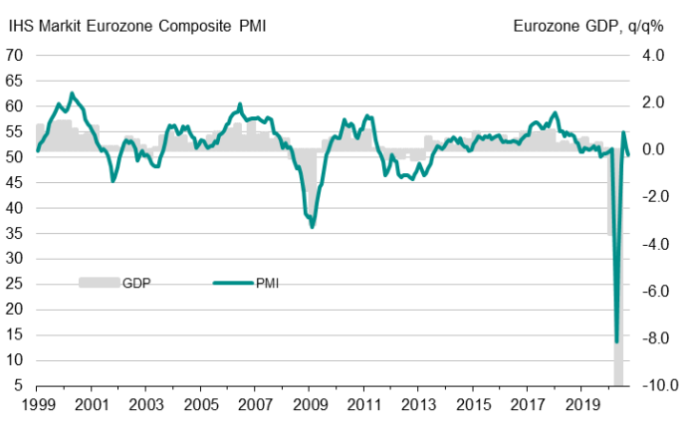
Europe’s economic recovery is stalling
Source: IHS Markit, Eurostat
Latest information September 2020

Slide 2
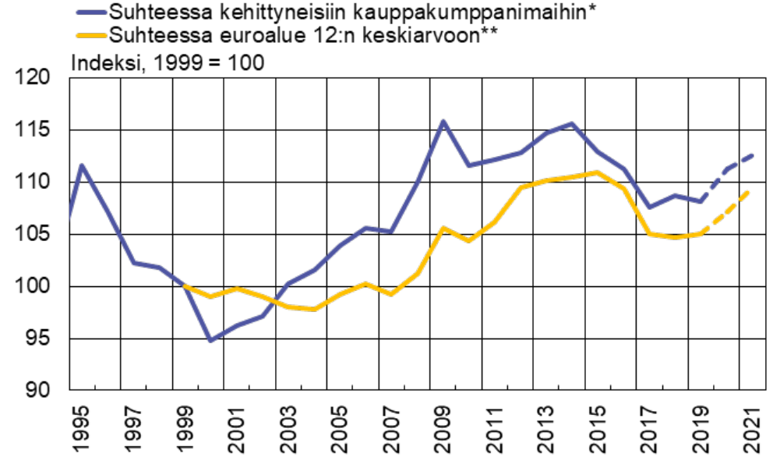
According to economic forecasts Finland’s cost competitiveness will deteriorate again
Unit labour costs adjusted for the terms of trade***
In relative to developed trading partners*
In relative to eurozone 12 average**
Index, 1999=100
*) 14 traditional industrial countries **) First 12 euro area member states.
***) Labour compensation relative to real national income, whole economy
Forecast: European Commission
Sources: European Commission, OECD, Macrobond and Bank of Finland calculations

Slide 3
Majority of companies estimate that production volumes are still going down
Share of companies, %
Source: The Federation of Finnish Technology Industries’ Corona questionnaire
23rd October 2020 n=496.

Slide 4
Weak demand continues to bother companies to a very large extent
The share of companies that responded that the problem makes operating very difficult
Source: The Federation of Finnish Technology Industries’ Corona questionnaire
23rd October 2020 n=496.

Slide 5
Companies expectations are not high for next year’s growth
How do you estimate your company's turnover to develop in 2021 compared to 2020? Share of companies,%
Source: The Federation of Finnish Technology Industries’ Corona questionnaire
23rd October 2020 n=496.

Slide 6
For larger companies, weak demand is not as big problem as it was before
Source: The Federation of Finnish Technology Industries’ Corona questionnaire, companies with personnel over 250
2.4.2020 n=49, 9.4.2020 n=49, 28.4.2020 n=53, 11.5.2020 n=52, 26.5.2020 n=52, 15.6.2020 n=52, 6.8.2020 n=37, 7.9.2020 n=56, 23.10.2020 n=52.

Slide 7
Tender requests* received by the technology industry companies in Finland
2008 | 2009 | 2010 | 2011 | 2012 | 2013 | 2014 | 2015 | 2016 | 2017 | 2018 | 2019 | 2020 | 2021
*) ”Have you experienced a notable increase or decrease in the number of requests for tenders in recent weeks in comparison to the situation three months ago”. Balance figure = the share of companies receiving more requests - the share of companies receiving less requests. Negative balance figure indicates that demand has weakened when compared to a situation three months ago.
Source: The Federation of Finnish Technology Industries’ order book survey’s respondent companies
The last questionnaire in October 2020.

Slide 8
Value of new orders in the technology industry* in Finland
Million euros, at current prices
2008 | 2009 | 2010 | 2011 | 2012 | 2013 | 2014 | 2015 | 2016 | 2017 | 2018 | 2019 | 2020
Change: | III/2020 / III,2019 | III,2020 / II,2020
Export: | -8 % | +13 %
Domestic: | -24 % | -4 %
Combined: | -12 % | +8 %
*) Excl. metals industry, game industry and data center companies
Source: The Federation of Finnish Technology Industries’ order book survey’s respondent companies, latest observation July-September 2020.

Slide 9
Number of personnel in Finnish technology industry continued to decrease in Q3 2020
Almost 40,000 employees affected by temporary lay-offs 30th September 2020
Source: The Federation of Finnish Technology Industries’ labour force survey

Slide 10
Value of order books in the technology industry* in Finland
Million euros, at current prices
Combined
2008 | 2009 | 2010 | 2011 | 2012 | 2013 | 2014 | 2015 | 2016 | 2017 | 2018 | 2019 | 2020
Change: | 30.9.2020 / 30.9.2019 | 30.9.2020 / 30.6.2020
Export: | -4 % | -1 %
Domestic: | -3 % | -1 %
Combined: | -4 % | -1 %
*) Excl. metals industry, game industry and data center companies
Source: The Federation of Finnish Technology Industries’ order book survey’s respondent companies, latest observation 30th September 2020.

Slide 11
Value of new orders in the electronics and electrotechnical industry in Finland
Million euros, at current prices
2008 | 2009 | 2010 | 2011 | 2012 | 2013 | 2014 | 2015 | 2016 | 2017 | 2018 | 2019 | 2020
Change: | III,2020 / III,2019 | III,2020 / II,2020
Export: | -5 % | +6 %
Domestic: | -4 % | -10 %
Combined: | -5 % | +3 %
Source: The Federation of Finnish Technology Industries’ order book survey’s respondent companies, latest observation July-September 2020.

Slide 12
Value of order books in the electronics and electrotechnical industry in Finland
Million euros, at current prices
Combined
2008 | 2009 | 2010 | 2011 | 2012 | 2013 | 2014 | 2015 | 2016 | 2017 | 2018 | 2019 | 2020
Change: | 30.9.2020 / 30.9.2019 | 30.9.2020 / 30.6.2020
Export: | -4 % | +3 %
Domestic: | -2 % | -8 %
Combined: | -4 % | +1 %
Source: The Federation of Finnish Technology Industries’ order book survey’s respondent companies, latest observation 30th September 2020.

Slide 13
Value of new orders in the mechanical engineering in Finland
Million euros, at current prices
2008 | 2009 | 2010 | 2011 | 2012 | 2013 | 2014 | 2015 | 2016 | 2017 | 2018 | 2019 | 2020
Change: | III,2020 / III,2019 | III,2020 / II,2020
Export: | -12 % | +27 %
Domestic: | -44 % | +10 %
Combined: | -21 % | +23 %
Source: The Federation of Finnish Technology Industries’ order book survey’s respondent companies, latest observation July-September 2020.

Slide 14
Value of order books in the mechanical engineering in Finland
Million euros, at current prices
Combined
2008 | 2009 | 2010 | 2011 | 2012 | 2013 | 2014 | 2015 | 2016 | 2017 | 2018 | 2019 | 2020
Change: | 30.9.2020 / 30.9.2019 | 30.9.2020 / 30.6.2020
Export: | -4 % | -2 %
Domestic: | -8 % | -2 %
Combined: | -5 % | -2 %
Source: The Federation of Finnish Technology Industries’ order book survey’s respondent companies, latest observation 30th September 2020.

Slide 15
Turnover of the metals industry in Finland
Seasonal adjusted turnover index
Shares of turnover 2019: iron and steel products, non-ferrous metals and castings 89 %, mining of metal ores 11 %
Source: Statistics Finland

Slide 16
Production volume of the metals industry in Finland
Seasonal adjusted volume index
Shares of turnover 2019: iron and steel products, non-ferrous metals and castings 89 %, mining of metal ores 11 %
Source: Statistics Finland

Slide 17
Value of new orders in the consulting engineering in Finland
Million euros, at current prices
2008 | 2009 | 2010 | 2011 | 2012 | 2013 | 2014 | 2015 | 2016 | 2017 | 2018 | 2019 | 2020
Change: | III,2020 / III,2019 | III,2020 / II,2020
Export: | -30 % | +10 %
Domestic: | +5 % | -22 %
Combined: | -2 % | -19 %
Source: The Federation of Finnish Technology Industries’ order book survey’s respondent companies, latest observation July-September 2020.

Slide 18
Value of order books in the consulting engineering in Finland
Million euros, at current prices
Combined
2008 | 2009 | 2010 | 2011 | 2012 | 2013 | 2014 | 2015 | 2016 | 2017 | 2018 | 2019 | 2020
Change: | 30.9.2020 / 30.9.2019 | 30.9.2020 / 30.6.2020
Export: | -3 % | -8 %
Domestic: | +12 % | -1 %
Combined: | +10 % | -2 %
Source: The Federation of Finnish Technology Industries’ order book survey’s respondent companies, latest observation 30th September 2020.

Slide 19
Value of new orders in the information technology* in Finland
Million euros, at current prices
2008 | 2009 | 2010 | 2011 | 2012 | 2013 | 2014 | 2015 | 2016 | 2017 | 2018 | 2019 | 2020
Change: | III,2020 / III,2019 | III,2020 / II,2020
Combined: | -1 % | -14 %
*) Excl. game industry and data center companies
Source: The Federation of Finnish Technology Industries’ order book survey’s respondent companies, latest observation July-September 2020.

Slide 20
Value of Order Books in the Information Technology* in Finland
Million euros, at current prices
2008 | 2009 | 2010 | 2011 | 2012 | 2013 | 2014 | 2015 | 2016 | 2017 | 2018 | 2019 | 2020
Change: | 30.9.2020 / 30.9.2019 | 30.9.2020 / 30.6.2020
Combined: | +2 % | +2 %
*) Excl. game industry and data center companies
Source: The Federation of Finnish Technology Industries’ order book survey’s respondent companies, latest observation 30th September 2020.

