Slide 1
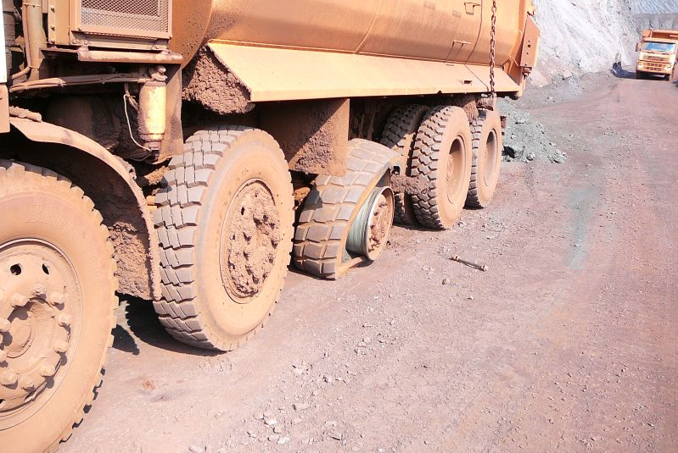
Sisu Axles: Predictive axle maintenance
Company description
Sisu Axles is an independent axle manufacturer for heavy duty truck, military, container handling and industrial applications. The company specializes in heavy duty rigid planetary reduction axles and independent suspension systems.
Sisu Axles serves its international customers from its assembly plant located in the southern part of Finland, the town of Hämeenlinna. The majority of its products end-up being exported to various locations around the globe. The company’s axles can be found on virtually every continent, from the United States to Australia and Russia to Antarctica.
The circular opportunity
The products of Sisu Axles are often used in applications where the operators are selling availability or a certain output per operating hours. In this type of operations it is crucial to be able to minimize vehicle downtime and especially eliminate unexpected maintenance needs.
To help its customers in their continuous effort to increase productivity and availability, Sisu Axles is now exploring opportunities of predictive maintenance.
Benefits
Typically, customers of Sisu Axles are doing preventive maintenance based on a predefined maintenance regime. With predictive maintenance, operators can call vehicles into service only on a need to service basis, reducing unnecessary maintenance and allowing the vehicle to continue in operations. Furthermore, the operators can get early warning messages of commencing component problems, preventing potential catastrophic failures. As a result, vehicles have higher availability, and they can be kept longer in use.
Applied business model
Circular Supply Chain
Sharing Platform
Product Life Extension
Recovery & Recycling
Product as a Service
✓

