Slide 1
Technology Industry /
Finnish Economic Outlook
March 2018

Slide 2
The Finnish Technology Industry Is Comprised of Five Sub-Sectors
ELEKTRONICS AND ELECTROTECHNICAL
INDUSTRY
ABB, Ensto, Microsoft Mobile,
Murata Electronics, Nokia, Planmeca,
Polar Electro, Suunto, Vacon, Vaisala…
METALS INDUSTRY
Boliden, Componenta, Kuusakoski, Luvata, Outokumpu, Outotec,
Ovako, Sacotec, SSAB …
MECHANICAL ENGINEERING
Abloy, Cargotec, Finn-Power, Fiskars, Glaston, Kone, Konecranes, Metso,
Meyer Turku, Normet, Oras, Patria, Pemamek, Ponsse, Stala, Valmet,
Valtra, Wärtsilä…
INFORMATION TECHNOLOGY
Affecto, Basware, Bilot, CGI, Comptel, Digia, Efecte, Enfo, F-Secure, Fujitsu Finland, IBM, Innofactor, Knowit,
Microsoft, Nixu, Tieto…
CONSULTING ENGINEERING
A-Insinöörit, Citec, Elomatic, Etteplan, FCG,
Granlund, Neste Jacobs, Pöyry, Ramboll,
Rejlers, SITO, SWECO, WSP…

Slide 3
The Finnish Technology Industry Is Comprised of Five Sub-Sectors
ELEKTRONICS AND ELECTROTECHNICAL
INDUSTRY
Data communications equipment, electrical machinery, medical technology
Turnover (2017): 14.7 billion euros
Personnel (2017): 39,000
METALS INDUSTRY
Steel products, non-ferrous metals, castings, metallic minerals
Turnover (2017): 10.9 billion euros
Personnel (2017): 15,100
MECHANICAL ENGINEERING
Machinery, metal products, vehicles
Turnover (2017): 30 billion euros
Personnel (2017): 128,000
INFORMATION TECHNOLOGY
IT services, applications and programming
Turnover (2017): 12.4 billion euros
Personnel (2017): 62,600
CONSULTING ENGINEERING
Expertise for construction industry and infrastructure
Turnover (2017): 6.2 billion euros
Personnel (2017): 52,500

Slide 4

The Technology Industry –
the Largest Export Sector in Finland
51 % of total Finnish exports.
Companies invest about EUR 5.5 billion annually in Finland.
70 % of private-sector R&D investment.
Some 300,000 employed directly in the sector, 700,000 employed in total, equalling about 30% of the entire Finnish labour force.
Technology Industries of Finland has over 1,600 member companies.

Slide 5
Turnover of the Technology Industry in Finland
Source: Macrobond, Statistics Finland, Technology Industries of Finland

Slide 6

Export of Technology Industry Goods from Finland by Area in 2017
Total goods exports 30.6 billion euros*
Central and Eastern Europe
5.11 billion €
16.6 %
Western Europe
16.44 billion €
53.7 %
North America
2.79 billion €
9.1 %
Asia
4.51 billion €
14.7 %
Middle and Central East
0.51 billion €
1.7 %
South and Middle America
0.84 billion €
2.8 %
Africa
0.43 billion €
1.4 %
*) In addition to goods exports the sector exported services worth some 13 billion euros.
Source: National Board of Customs, Statistics Finland

Slide 7
Technology, Forest and Chemical Industries Provide 81 % of Finland's Goods and Services Exports Revenue
Goods and service exports: billion euros and the share of Finnish exports in 2017
*) Service exports industry-specific data for the year 2017 are preliminary information.
Source: Board of Customs, Statistics Finland (National Accounts, Foreign trade in services), Federation of Finnish Technology Industries

Slide 8
Turnover of the Industry and Technology Industry in Finland
Source: Macrobond, Statistics Finland

Slide 9
Turnover of the Technology Industry in Finland
Source: Macrobond, Statistics Finland

Slide 10
Value of New Orders in the Technology Industry* in Finland
Million euros, at current prices
2008 | 2009 | 2010 | 2011 | 2012 | 2013 | 2014 | 2015 | 2016 | 2017
Change: | IV,2017 / IV,2016 | IV,2017 / III,2017
Export: | +49 % | +61 %
Domestic: | +16 % | +34 %
Combined: | +40 % | +54 %
*) Excl. metals industry, game industry and data center companies
Source: The Federation of Finnish Technology Industries’ order book survey’s respondent companies, latest observation October-December 2017.

Slide 11
Value of Order Books in the Technology Industry* in Finland
Million euros, at current prices
Combined
2008 | 2009 | 2010 | 2011 | 2012 | 2013 | 2014 | 2015 | 2016 | 2017
Change: | 31.12.2017 / 31.12.2016 | 31.12.2017 / 30.9.2017
Export: | +32 % | +12 %
Domestic: | +4 % | +5 %
Combined: | +25 % | +11 %
*) Excl. metals industry, game industry and data center companies
Source: The Federation of Finnish Technology Industries’ order book survey’s respondent companies, latest observation 31.12.2017

Slide 12
Tender Requests* Received by Technology Industry Companies in Finland
2008 | 2009 | 2010 | 2011 | 2012 | 2013 | 2014 | 2015 | 2016 | 2017 | 2018
*) Have you experienced a notable increase or decrease in the number of requests for tenders in recent weeks in comparison to the situation three months ago?”. Balance figure = the number of companies receiving more requests - the number of companies receiving less requests.
Source: The Federation of Finnish Technology Industries’ order book survey’s respondent companies, the last questionnaire is January 2018

Slide 13
Value of New Orders in the Electronics and Electrotechnical Industry in Finland
Million euros, at current prices
2008 | 2009 | 2010 | 2011 | 2012 | 2013 | 2014 | 2015 | 2016 | 2017
Change: | IV,2017 / IV,2016 | IV,2017 / III,2017
Export: | -3 % | +17 %
Domestic: | +73 % | +7 %
Combined: | +9 % | +14 %
Source: The Federation of Finnish Technology Industries’ order book survey’s respondent companies, latest observation October-December 2017.

Slide 14
Value of Order Books in the Electronics and Electrotechnical Industry in Finland
Million euros, at current prices
Combined
2008 | 2009 | 2010 | 2011 | 2012 | 2013 | 2014 | 2015 | 2016 | 2017
Change: | 31.12.2017 / 31.12.2016 | 31.12.2017 / 30.9.2017
Export: | -4 % | +8 %
Domestic: | +48 % | +6 %
Combined: | +5 % | +8 %
Source: The Federation of Finnish Technology Industries’ order book survey’s respondent companies, latest observation 31.12.2017

Slide 15
Value of New Orders in the Machanical Engineering in Finland
Million euros, at current prices
2008 | 2009 | 2010 | 2011 | 2012 | 2013 | 2014 | 2015 | 2016 | 2017
Change: | IV,2017 / IV,2016 | IV,2017 / III,2017
Export: | +102 % | +97 %
Domestic: | +9 % | +67 %
Combined: | +80 % | +93 %
Source: The Federation of Finnish Technology Industries’ order book survey’s respondent companies, latest observation October-December 2017.

Slide 16
Value of Order Books in the Mechanical Engineering in Finland
Million euros, at current prices
Combined
2008 | 2009 | 2010 | 2011 | 2012 | 2013 | 2014 | 2015 | 2016 | 2017
Change: | 31.12.2017 / 31.12.2016 | 31.12.2017 / 30.9.2017
Export: | +46 % | +14 %
Domestic: | -3 % | +7 %
Combined: | +38 % | +13 %
Source: The Federation of Finnish Technology Industries’ order book survey’s respondent companies, latest observation 31.12.2017

Slide 17
Value of New Orders in the Consulting Engineering in Finland
Million euros, at current prices
2008 | 2009 | 2010 | 2011 | 2012 | 2013 | 2014 | 2015 | 2016 | 2017
Change: | IV,2017 / IV,2016 | IV,2017 / III,2017
Export: | -38 % | +17 %
Domestic: | +27 % | +42 %
Combined: | +19 % | +40 %
Source: The Federation of Finnish Technology Industries’ order book survey’s respondent companies, latest observation October-December 2017.

Slide 18
Value of Order Books in the Consulting Engineering in Finland
Million euros, at current prices
Combined
2008 | 2009 | 2010 | 2011 | 2012 | 2013 | 2014 | 2015 | 2016 | 2017
Change: | 31.12.2017 / 31.12.2016 | 31.12.2017 / 30.9.2017
Export: | -2 % | -9 %
Domestic: | +19 % | +13 %
Combined: | +15 % | +8 %
Source: The Federation of Finnish Technology Industries’ order book survey’s respondent companies, latest observation 31.12.2017.

Slide 19
Value of New Orders in the Information Technology* in Finland
Million euros, at current prices
2008 | 2009 | 2010 | 2011 | 2012 | 2013 | 2014 | 2015 | 2016 | 2017
Change: | IV,2017 / IV,2016 | IV,2017 / III,2017
Combined: | -13 % | +42 %
*) Excl. game industry and data center companies.
Source: The Federation of Finnish Technology Industries’ order book survey’s respondent companies, latest observation October-December 2017.

Slide 20
Value of Order Books in the Information Technology* in Finland
Million euros, at current prices
2008 | 2009 | 2010 | 2011 | 2012 | 2013 | 2014 | 2015 | 2016 | 2017
Change: | 31.12.2017 / 31.12.2017 | 31.12.2017 / 30.9.2017
Combined: | -12 % | -2 %
*) Excl. game industry and data center companies.
Source: The Federation of Finnish Technology Industries’ order book survey’s respondent companies, latest observation 31.12.2017.

Slide 21
Technology Industry Personnel
Source: Statistics Finland, The Federation of Finnish Technology Industries’ labour force survey, Macrobond

Slide 22
Technology Industry Personnel in Finland by Branch
Source: Statistics Finland, The Federation of Finnish Technology Industries’ labour force survey, Macrobond

Slide 23
Technology Industry Personnel in Subsidiaries Abroad by Branch
Source: The Federation of Finnish Technology Industries’ labour force survey, Macrobond

Slide 24
Retirement of Technology Industry Personnel in Finland
Individuals per year
Salaried employees
Blue collar employees
Source: Wage inquiry of the Techonology Industries of Finland, Finnish Centre for Pensions, Statistics Finland

Slide 25
Retirement of Technology Industry Blue Collar Employees in Finland
Individuals per year
Source: Wage inquiry of the Techonology Industries of Finland, Finnish Centre for Pensions, Statistics Finland

Slide 26
Overview of the Situation in the Technology Industry and Outlook for the Spring of 2018
- Turnover in Finland totalled some EUR 74.1 billion in 2017. Turnover was 10 % higher than in 2016. In 2008, prior to the financial crises, the corresponding figure was EUR 86 billion.
- The monetary value of new orders reported between October-December 2017 was 54 % higher than in July-September, and 40 % higher than in the corresponding period in 2016. In late 2017, the growth was boosted by two large ship orders in particular.
- At the end of December, the value of order books was 11 % higher than at the end of September, and 25 % higher than in December 2016.
- The turnover of technology industry companies during the spring of 2018 is expected to be higher than in the corresponding period last year.
- The number of personnel in Finland increased in 2017. Personnel increased by a good of two per cent, or by 6,400 employees from the average number in 2016. On average, the industry employed 297,000 people. In 2008, the industry employed a total of 326,000 people in Finland.
- The recruitment activities picked up markedly in 2017. The companies recruited a total of 42,500 new employees, in 2016 a total of 28,500 employees.

Slide 27
World Economic Outlook
- Finland as a Part of Global Economy

Slide 28
GDP also Grows in Finland, but the Backlog for the Other Euro Area Countries Is up to 8%
Lähde: Macrobond

Slide 29
Finland’s Exports Jumped in Early 2017, but the Backlog for the Other Euro Area Countries is 35 %
Source: Macrobond, Eurostat

Slide 30
Recently, Finland's Economic Growth Has also Been Supported by an Increase in Exports
Source: Macrobond, Statistics Finland

Slide 31
Gross Domestic Product Has Grown Long in Europe and the USA, Finland is Lagging Behind
Souce: Macrobond

Slide 32
In China and India Growth Continues, also Brazil Is Now Growing
Share of global GDP in China, India, Brazil and Russia is 31 % (adjusted for PP)
Lähde: Macrobond

Slide 33
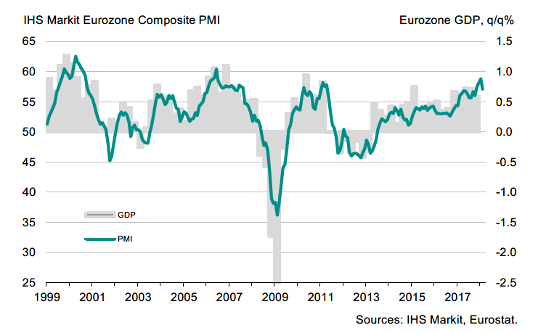
GDP Growth in the Euro Area Has Picked up During the last Months
Purchase Managers’ Index (PMI), 50 = no change from previous month
Latest information February 2018
Source: Markit

Slide 34
Industrial Production Volume
Source: Macrobond

Slide 35
Industrial Production Volume in the EU Countries
Source: Macrobond

Slide 36
Finland’s Industrial Production Has Lagged Behind the Competition Countries
Source: Macrobond, The CPB Netherlands Bureau for Economic Policy Analysis

Slide 37
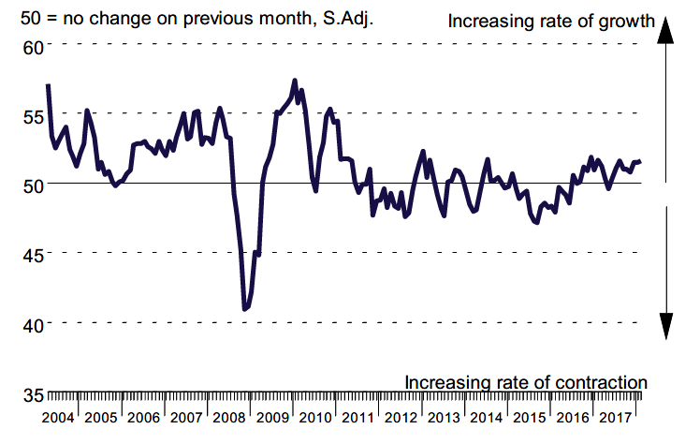
Industrial Production in China is Growing Slightly
Purchase Managers’ Index (PMI) in manufacturing industry in China
Latest information February 2018
Source: Markit

Slide 38
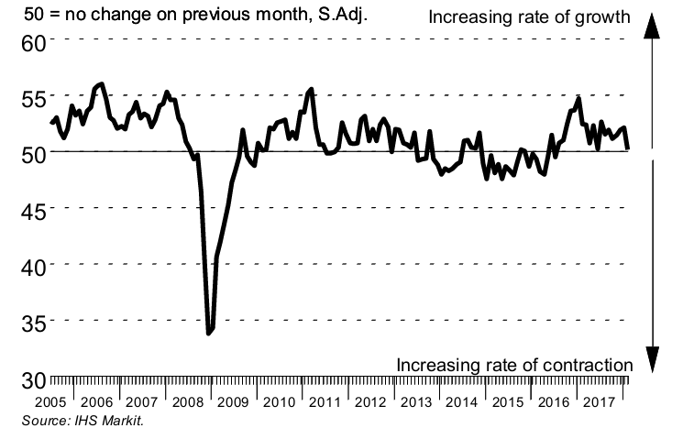
Industrial Production Growth in Russia Has Come to a Standstill
Latest information February 2018
Source: Markit

Slide 39
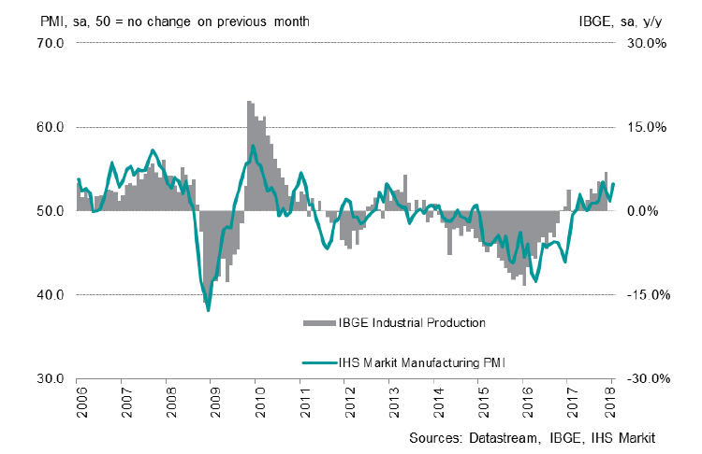
Industrial Production in Brazil Is Growing
Purchase Managers’ Index (PMI) in manufacturing industry in China
Latest information February 2018
Source: Markit

Slide 40
Industrial Production in the USA is Growing
Purchase Managers’ Index (PMI) in manufacturing industry
50 = no change from previous month
Source: Macrobond

Slide 41
Growth of Residence Construction Has Lowered in China
Share of China in Asian GDP is 42% (adjusted for PP)
Source: Macrobond

Slide 42
Fixed Investments Have also Grown in Brazil
Souce: Macrobond

Slide 43
World Trade Has Picked up Again
Source: Macrobond, The CPB Netherlands Bureau for Economic Policy Analysis

Slide 44
Imports to China Have Increased from Several Countries
Source: Macrobond

Slide 45
EU Exports to Russia Have Recovered Slightly
Source: Macrobond

Slide 46
Russia’s Share* of Technology Industry Exports from Finland Has Lowered to Some 5-6 Per Cent
%
*) Soviet Union up to 1991
Source: Finnish Customs

Slide 47
The World Economy Is Projected to Grow by 3.9% in 2018
GDP growth in 2018 / 2017, %
China
India
Average growth:
+3,9 %
Rest of Eastern Europe
Rest of Latin America
Middle East
and Africa
Rest
of Asia
Mexico
North America
Russia
Brazil
Western Europe
Japan
The width of the bar indicates the share of global GDP in 2017 (adjusted for purchasing power parity), %
Source: IMF (January 2018)

Slide 48
Demand in the Finnish Technology Industry Export Market is Expected to Grow by 2.8 % in 2018
GDP growth in 2018 / 2017, %
India
Mexico
China
Rest of Latin America
Average growth:
+2,8 %
Middle East and Africa
Rest of Eastern Europe
Rest
of Asia
North America
Western Europe
Japan
Russia
Brazil
The width of the bar indicates the export share of technology industry from Finland in 2016, %
Source: IMF (January 2018), Finnish Customs

Slide 49
Finland’s Economic Growth Relies on Exports and Investments

Slide 50
Finland's Exports Are still at Low Level
Source: Macrobond, Eurostat

Slide 51
Finnish Exports Have Lagged Behind the Competition Countries
Source: Macrobond, Eurostat

Slide 52
Growth Paradox: the Downsized Industry Has
Limited Opportunities to Increase Finnish Exports
-18 %
2008 | 2009 | 2010 | 2011 | 2012 | 2013 | 2014 | 2015 | 2016 | 2017
Source: Statistics Finland / industrial production volume index

Slide 53
The Decline in Exports and Recession: the Public Debt and Total Tax Rate Increased Significantly
Increased cost burden requires cuts to public sector
Source: Macrobond, Eurostat

Slide 54
Corporate Investments in Finland Are in Real Terms Almost 6 Billion Euros Lower than in 2008
Production and R&D investments in Finland
Billion euros, in the 2016 price level
Source: Statistics Finland, National Accounts

Slide 55
Unlike the Competition Countries, in Finland Business Investment Is Still Below the Level in 2008
Source: OECD, Economic Outlook (December 2017)

Slide 56
Investments in the Manufacturing and Technology Industry in Finland Do Not Promise Long-Term Strong Growth
Production and R&D investments in Finland, million euros, at current prices
Source: Statistics Finland, (National Accounts), The Confederation of Finnish Industries* investment survey (January 2018)

Slide 57
Investments and productivity* are Decisive for Finland’s Success
Productivity of export sector is 10 % lower than in 2007-2008, productivity of entire national economy is 3 % lower
*) Productivity is measured as real value added per hours worked. When productivity grows (the curve rises) value added grows more than hours worked. Value added = turnover – purchasing of materials and services
Value added = labour costs + rents + depreciations + profits
Source: Statistics Finland / National Accounts

Slide 58
Rapid Growth in Labour Costs Has Weakened the Ability of Companies to Invest in Finland
At current prices, index 2008=100
*) Both wages and R & D investments include R&D staff wage costs
Source: Statistics Finland (National Accounts)

Slide 59
Finland’s Price and Cost Competitiveness vis-à-vis the Euro Countries Is still to be Improved
Unit labour costs in the whole economy = labour costs / productivity, including the influence of effective exchange rates
Finland’s price and cost competitiveness declines
Finland’s price and cost
competitiveness improves
00 | 01 | 02 | 03 | 04 | 05 | 06 | 07 | 08 | 09 | 10 | 11 | 12 | 13 | 14 | 15 | 16 | 17
*) In the ECB Harmonised Competitiveness Index, the average effective exchange rate of each country is calculated vis-à-vis 38 main trade partners, as well as the development of unit labour costs for the total economy.
Latest information July-September 2017. Source: European Central Bank

Slide 60
What Should Be Done in Finland?
Support the renewal of the industry.
Taxes should support growth and investment in Finland.
Support decision making in companies related to compensation and working time
No new European nor national burdens on companies, which are deteriorating the competitiveness.

Slide 61
Long-Term Outlook and Challenges
Global Structural Change Set to Continue Apace
  Industrial production and services will relocate to rapidly developing economic areas
  Strong growth, large markets, cheap labour and increasing expertise will increase the attractiveness of these regions.
Competition over Skills and Raw Materials Set to Increase
  Due to an increase in retirement, the sector’s annual recruitment need in Finland will rise considerably in the coming years.
  The availability of reasonably-priced energy also threatens to become an investment bottleneck in Finland
Combating Climate Change
  A challenge as costs are set to grow faster than in competitor countries
  An opportunity for new environmental and energy technologies

Slide 62
Technology Industries of Finland

Slide 63
The Federation’s Member Companies 2016
Number of enterprises / 1 567
Number of personnel / 177 521
1–249 employees
500–999 employees
250–499 employees
1000– employees

Slide 64
The Federation’s SME Member Companies 2016
Number of enterprises / 1 421
Number of personnel / 69 035
1–19 employees
50–99 employees
20–49 employees
100–249 employees

