Slide 1
Technology Industry /
Finnish Economic Outlook
September 2017

Slide 2
The Finnish Technology Industry Is Comprised of Five Sub-Sectors
ELEKTRONICS AND ELECTROTECHNICAL
INDUSTRY
ABB, Ensto, Microsoft Mobile,
Murata Electronics, Nokia, Planmeca,
Polar Electro, Suunto, Vacon, Vaisala…
METALS INDUSTRY
Boliden, Componenta, Kuusakoski, Luvata, Outokumpu, Outotec,
Ovako, Sacotec, SSAB …
MECHANICAL ENGINEERING
Abloy, Cargotec, Finn-Power, Fiskars, Glaston, Kone, Konecranes, Metso,
Meyer Turku, Normet, Oras, Patria, Pemamek, Ponsse, Stala, Valmet,
Valtra, Wärtsilä…
INFORMATION TECHNOLOGY
Affecto, Basware, Bilot, CGI, Comptel, Digia, Efecte, Enfo, F-Secure, Fujitsu Finland, IBM, Innofactor, Knowit,
Microsoft, Nixu, Tieto…
CONSULTING ENGINEERING
A-Insinöörit, Citec, Elomatic, Etteplan, FCG,
Granlund, Neste Jacobs, Pöyry, Ramboll,
Rejlers, SITO, SWECO, WSP…

Slide 3
The Finnish Technology Industry Is Comprised of Five Sub-Sectors
ELEKTRONICS AND ELECTROTECHNICAL
INDUSTRY
Data communications equipment, electrical machinery, medical technology
Turnover (2016): 13.3 billion euros
Personnel (2016): 38,000
METALS INDUSTRY
Steel products, non-ferrous metals, castings, metallic minerals
Turnover (2016): 9.0 billion euros
Personnel (2016): 15,400
MECHANICAL ENGINEERING
Machinery, metal products, vehicles
Turnover (2016): 27.7 billion euros
Personnel (2016): 122,400
INFORMATION TECHNOLOGY
IT services, applications and programming
Turnover (2016): 11.5 billion euros
Personnel (2016): 60,400
CONSULTING ENGINEERING
Expertise for construction industry and infrastructure
Turnover (2016): 5.8 billion euros
Personnel (2016): 49,800

Slide 4

The Technology Industry –
the Largest Export Sector in Finland
50 % of total Finnish exports.
Companies invest about EUR 5.0 billion annually in Finland.
70 % of private-sector R&D investment.
Almost 295,000 employed directly in the sector, 700,000 employed in total, equalling about 30% of the entire Finnish labour force.
Technology Industries of Finland has over 1,600 member companies.

Slide 5
Turnover of the Technology Industry in Finland
Source: Macrobond, Statistics Finland, Technology Industries of Finland

Slide 6

Export of Technology Industry Goods from Finland by Area in 2016
Total goods exports 25.2 billion euros*
Central and Eastern Europe
3.8 billion €
15.0 %
Western Europe
13.7 billion €
53.9 %
North America
2.5 billion €
9.8 %
Asia
3.7 billion €
14.6 %
Middle and Central East
0.5 billion €
1.8 %
South and Middle America
0.8 billion €
3.2 %
Africa
0.4 billion €
1.7 %
*) In addition to goods exports the sector exported services worth some 12.3 billion euros (2015).
Source: National Board of Customs, Statistics Finland

Slide 7
Technology, Forest and Chemical Industries Provide 80 % of Finland's Goods and Services Exports Revenue
Goods and service exports: billion euros and the share of Finnish exports in 2016*
*) Service exports industry-specific data for the year 2015.
Source: Board of Customs, Statistics Finland (National Accounts, Foreign trade in services)

Slide 8
Turnover of the Industry and Technology Industry in Finland
Source: Macrobond, Statistics Finland

Slide 9
Turnover of the Technology Industry in Finland
Source: Macrobond, Statistics Finland

Slide 10
Value of New Orders in the Technology Industry* in Finland
Million euros, at current prices
2008 | 2009 | 2010 | 2011 | 2012 | 2013 | 2014 | 2015 | 2016 | 2017
Change: | II,2017 / II,2016 | II,2017 / I,2017
Export: | +60 % | +31 %
Domestic: | +15 % | +8 %
Combined: | +47 % | +25 %
*) Excl. metals industry and game industry companies
Source: The Federation of Finnish Technology Industries’ order book survey’s respondent companies, latest observation April-June 2017

Slide 11
Value of Order Books in the Technology Industry* in Finland
Million euros, at current prices
Combined
2008 | 2009 | 2010 | 2011 | 2012 | 2013 | 2014 | 2015 | 2016 | 2017
Change: | 30.6.2017 / 30.6.2016 | 30.6.2017 / 31.3.2017
Export: | +25 % | +14 %
Domestic: | -1 % | +2 %
Combined: | +18 % | +10 %
*) Excl. metals industry and game industry companies
Source: The Federation of Finnish Technology Industries’ order book survey’s respondent companies, latest observation 30.6.2017

Slide 12
Tender Requests* Received by Technology Industry Companies in Finland
2008 | 2009 | 2010 | 2011 | 2012 | 2013 | 2014 | 2015 | 2016 | 2017
*) Have you experienced a notable increase or decrease in the number of requests for tenders in recent weeks in comparison to the situation three months ago?”. Balance figure = the number of companies receiving more requests - the number of companies receiving less requests.
Source: The Federation of Finnish Technology Industries’ order book survey’s respondent companies, the last questionnaire is April 2017

Slide 13
Value of New Orders in the Electronics and Electrotechnical Industry in Finland
Million euros, at current prices
2008 | 2009 | 2010 | 2011 | 2012 | 2013 | 2014 | 2015 | 2016 | 2017
Change: | II,2017 / II,2016 | II,2017 / I,2017
Export: | +11 % | +4 %
Domestic: | +45 % | +30 %
Combined: | +18 % | +9 %
Source: The Federation of Finnish Technology Industries’ order book survey’s respondent companies, latest observation April-June 2017

Slide 14
Value of Order Books in the Electronics and Electrotechnical Industry in Finland
Million euros, at current prices
Combined
2008 | 2009 | 2010 | 2011 | 2012 | 2013 | 2014 | 2015 | 2016 | 2017
Change: | 30.6.2017 / 30.6.2016 | 30.6.2017 / 31.3.2017
Export: | +8 % | +4 %
Domestic: | +26 % | +27 %
Combined: | +11 % | +8 %
Source: The Federation of Finnish Technology Industries’ order book survey’s respondent companies, latest observation 30.6.2017

Slide 15
Value of New Orders in the Mechanical Engineering in Finland
Million euros, at current prices
2008 | 2009 | 2010 | 2011 | 2012 | 2013 | 2014 | 2015 | 2016 | 2017
Change: | II,2017 / II,2016 | II,2017 / I,2017
Export: | +113 % | +53 %
Domestic: | +3 % | +7 %
Combined: | +86 % | +45 %
Source: The Federation of Finnish Technology Industries’ order book survey’s respondent companies, latest observation April-June 2017

Slide 16
Value of Order Books in the Mechanical Engineering in Finland
Million euros, at current prices
Combined
2008 | 2009 | 2010 | 2011 | 2012 | 2013 | 2014 | 2015 | 2016 | 2017
Change: | 30.6.2017 / 30.6.2016 | 30.6.2017 / 31.3.2017
Export: | +31 % | +17 %
Domestic: | -10 % | -2 %
Combinedä: | +23 % | +14 %
Source: The Federation of Finnish Technology Industries’ order book survey’s respondent companies, latest observation 30.6.2017

Slide 17
Value of New Orders in the Consulting Engineering in Finland
Million euros, at current prices
2008 | 2009 | 2010 | 2011 | 2012 | 2013 | 2014 | 2015 | 2016 | 2017
Change: | II,2017 / II,2016 | II,2017 / I,2017
Export: | -28 % | -46 %
Domestic: | +11 % | +1 %
Combined: | +5 % | -8 %
Source: The Federation of Finnish Technology Industries’ order book survey’s respondent companies, latest observation April-June 2017

Slide 18
Value of Order Books in the Consulting Engineering in Finland
Million euros, at current prices
Combined
2008 | 2009 | 2010 | 2011 | 2012 | 2013 | 2014 | 2015 | 2016 | 2017
Change: | 30.6.2017 / 30.6.2016 | 30.6.2017 / 31.3.2017
Export: | +78 % | +2 %
Domestic: | +4 % | +2 %
Combined: | +15 % | +2 %
Source: The Federation of Finnish Technology Industries’ order book survey’s respondent companies, latest observation 30.6.2017

Slide 19
Value of New Orders in the Information Technology* in Finland
Million euros, at current prices
2008 | 2009 | 2010 | 2011 | 2012 | 2013 | 2014 | 2015 | 2016 | 2017
Change: | II,2017 / II,2016 | II,2017 / I,2017
Combined: | -1 % | -12 %
*) Excl. game industry companies
Source: The Federation of Finnish Technology Industries’ order book survey’s respondent companies, latest observation April-June 2017

Slide 20
Value of Order Books in the Information Technology* in Finland
Million euros, at current prices
2008 | 2009 | 2010 | 2011 | 2012 | 2013 | 2014 | 2015 | 2016 | 2017
Change: | 30.6.2017 / 30.6.2017 | 30.6.2017 / 31.3.2017
Combined: | -2 % | -5 %
*) Excl. game industry companies
Source: The Federation of Finnish Technology Industries’ order book survey’s respondent companies, latest observation 30.6.2017

Slide 21
Technology Industry Personnel
(30.6)
Source: Statistics Finland, The Federation of Finnish Technology Industries’ labour force survey, Macrobond

Slide 22
Technology Industry Personnel in Finland by Branch
(30.6)
Source: Statistics Finland, The Federation of Finnish Technology Industries’ labour force survey, Macrobond

Slide 23
Technology Industry Personnel in Subsidiaries Abroad by Branch
Source: The Federation of Finnish Technology Industries’ labour force survey, Macrobond

Slide 24
Retirement of Technology Industry Personnel in Finland
Individuals per year
Salaried employees
Blue collar employees
Source: Wage inquiry of the Techonology Industries of Finland, Finnish Centre for Pensions, Statistics Finland

Slide 25
Retirement of Technology Industry Blue Collar Employees in Finland
Individuals per year
Source: Wage inquiry of the Techonology Industries of Finland, Finnish Centre for Pensions, Statistics Finland

Slide 26
Overview of the Situation in the Technology Industry and Outlook for Autumn 2017
- Turnover in Finland totalled some EUR 67.3 billion in 2016. This is about half per cent higher than in 2015. In January-June 2017 turnover was 11 % higher than last year at the same time. In 2008, prior to the financial crises, the corresponding figure was EUR 86 billion.
- The monetary value of new orders reported between April-June 2017 was 25 % higher than in January-March, and 47 % higher than in the corresponding period in 2016.
- At the end of June, the value of order books was 10 % higher than at the end of March, and 18 % higher than in June 2016.
- The turnover of technology industry companies in autumn 2017 is expected to be higher than in the corresponding period last year.
- The number of personnel in Finland increased somewhat in January-June 2017. Personnel increased by two per cent, or by 6,000 employees from the average number in 2016. On average, the industry employed 296,000 people in June. In 2008, the industry employed a total of 326,000 people in Finland.
- The recruitment activities have picked up markedly in 2017. The companies recruited a total of 22,600 new employees between January and June.

Slide 27
World Economic Outlook
- Finland as a Part of Global Economy

Slide 28
Gross Domestic Product Has Grown in the Euro Area for a Long Time, and Now also in Finland
Lähde: Macrobond

Slide 29
Recently, Finland's Economic Growth Has also Been Supported by an Increase in Exports
Source: Macrobond, Statistics Finland

Slide 30
GDP Has Grown for a Long Time in the Euro Area, Now Also in Finland
Lähde: Macrobond

Slide 31
In China and India Growth Continues, also Brazil Is Returning to Growth
Share of global GDP in China, India, Brazil and Russia is 31 % (adjusted for PP)
Lähde: Macrobond

Slide 32
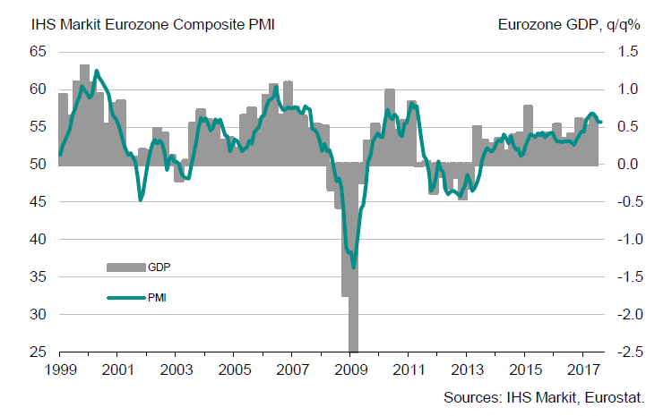
GDP Growth in the Euro Area Has Picked up During the last Months
Purchase Managers’ Index (PMI), 50 = no change from previous month
Latest information August 2017
Source: Markit

Slide 33
Industrial Production Volume
Source: Macrobond

Slide 34
Industrial Production Volume in the EU Countries
Source: Macrobond

Slide 35
Industrial Production is Growing in Particular in Emerging Countries
Source: Macrobond, The CPB Netherlands Bureau for Economic Policy Analysis

Slide 36
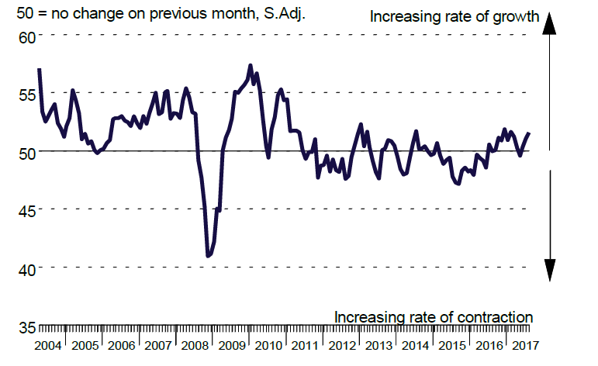
Industrial Production in China is Declining Slightly
Purchase Managers’ Index (PMI) in manufacturing industry in China
Latest information August 2017
Source: Markit

Slide 37
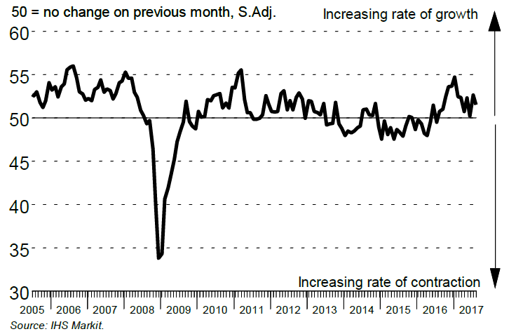
Industrial Production in Russia is Growing
Purchase Managers’ Index (PMI) in manufacturing industry in China
Latest information August 2017
Source: Markit

Slide 38
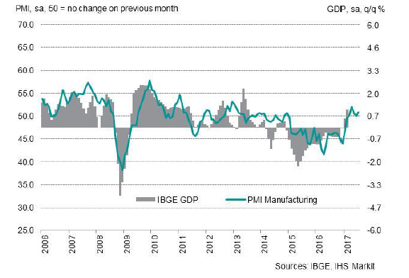
Industrial Production in Brazil Is Increasing
Purchase Managers’ Index (PMI) in manufacturing industry in China
Latest information August 2017
Source: Markit

Slide 39
Industrial Production in USA is Growing
Purchase Managers’ Index (PMI) in manufacturing industry
50 = no change from previous month
Source: Macrobond

Slide 40
Growth of Residence Construction Has Lowered in China
Share of China in Asian GDP is 42% (adjusted for PP)
Source: Macrobond

Slide 41
Fixed Investment in Brazil Continue to Decrease
Share of Russia in European GDP is 13 % (adjusted for PP)
Share of Brazil in Latin American GDP is 35 % (adjusted for PP)
Souce: Macrobond

Slide 42
World Trade Has Picked up Again Import volume development
Source: Macrobond, The CPB Netherlands Bureau for Economic Policy Analysis

Slide 43
Imports to China Have Increased from Several Countries, but Are Slowing Down
Source: Macrobond

Slide 44
Exports from EU Countries to Russia Have Fallen, but Stabilized
Source: Macrobond

Slide 45
Russia’s Share* of Technology Industry Exports from Finland Has Lowered to Some Five Per Cent
%
*) Soviet Union up to 1991
Source: Finnish Customs

Slide 46
Global Economy is Expected to Grow by 3,5 % in 2017
GDP growth in 2017, %
China
India
Rest of
Eastern Europe
Average growth:
+3,5 %
Rest of
Asia
Rest of Latin A,merica
Middle East
and Africa
Mexico
North America
Japan
Russia
Western Europe
Brazil
The width of the bar indicates the share of global GDP in 2015 (adjusted for purchasing power parity), %
Source: IMF (April 2017)

Slide 47
Demand in the Finnish Technology Industry Export Market is Expected to Grow by 2.2 % in 2017
GDP growth 2017 / 2016, %
India
Mexico
Rest of
Eastern Europe
China
Rest of Latin America
Middle East and Africa
Average growth:
+2.2 %
Rest of
Asia
Brazil
North America
Japan
Russia
Western Europe
The width of the bar indicates the export share of technology industry from Finland in 2015, %
Source: IMF (April 2017), Board of Customs

Slide 48
Finland’s Economic Growth Relies on Exports and Investments

Slide 49
Finland's Exports Are still Low and Insufficient to Finance the Public Sector
Source: Macrobond, Eurostat

Slide 50
Finnish Exports Lagging Behind Competitors
Source: Macrobond, Eurostat

Slide 51
Economic Growth is Constrained by the 20% Drop in Production Capacity and a High Rate of Utilization
Investments are vital for the production and export recovery
-21 %
2008 | 2009 | 2010 | 2011 | 2012 | 2013 | 2014 | 2015 | 2016 | 2017
Source: Statistics Finland / National Accounts, Industrial volume index

Slide 52
Growth of Public Expenditures, Debt and Tax Ratio in Finland
Increased cost burden requires cuts to public sector
Source: Macrobond, Eurostat

Slide 53
Corporate Investments in Finland Are in Real Terms Almost 6 Billion Euros Lower than in 2008
Production and R&D investments in Finland
Billion euros, in the 2016 price level
Source: Statistics Finland, National Accounts

Slide 54
Companies in Finland Have Invested Significantly Less than in Competing Countries
Corporate investments, index 2008 = 100
Source: OECD, Economic Outlook (June 2017)

Slide 55
Investments in the Manufacturing and Technology Industry in Finland Do Not Promise Long-Term Strong Growth
Production and R&D investments in Finland, million euros, at current prices
Source: Statistics Finland, (National Accounts), The Confederation of Finnish Industries* investment survey (June 2017)

Slide 56
Investments and productivity* are Decisive for Finland’s Success
Productivity of export sector is 10 % lower than in 2007-2008, productivity of entire national economy is 3 % lower
*) Productivity is measured as real value added per hours worked. When productivity grows (the curve rises) value added grows more than hours worked. Value added = turnover – purchasing of materials and services
Value added = labour costs + rents + depreciations + profits
Source: Statistics Finland / National Accounts

Slide 57
Rapid Growth in Labour Costs Has Weakened the Ability of Companies to Invest in Finland
At current prices, index 2008=100
*) Both wages and R & D investments include R&D staff wage costs
Source: Statistics Finland (National Accounts)

Slide 58
Finland's Price and Cost Competitiveness Vis-à-vis the Euro Area Has Improved Recently
Unit labour costs in the whole economy = labour costs / productivity, including the influence of effective exchange rates
Finland’s price and cost competitiveness declines
Finland’s price and cost
competitiveness improves
 | 01 | 02 | 03 |  | 05 | 06 | 07 | 08 | 09 | 10 | 11 | 12 | 13 | 14 | 15 | 16 | 17
*) In the ECB Harmonised Competitiveness Index, the average effective exchange rate of each country is calculated vis-à-vis 38 main trade partners, as well as the development of unit labour costs for the total economy.
Latest information January-March 2017. Source: European Central Bank

Slide 59
What Should Be Done in Finland?
Support the renewal of the industry.
Taxes should support growth and investment in Finland.
Support decision making in companies related to compensation and working time
No new European nor national burdens on companies, which are deteriorating the competitiveness.

Slide 60
Long-Term Outlook and Challenges
Global Structural Change Set to Continue Apace
  Industrial production and services will relocate to rapidly developing economic areas
  Strong growth, large markets, cheap labour and increasing expertise will increase the attractiveness of these regions.
Competition over Skills and Raw Materials Set to Increase
  Due to an increase in retirement, the sector’s annual recruitment need in Finland will rise considerably in the coming years.
  The availability of reasonably-priced energy also threatens to become an investment bottleneck in Finland
Combating Climate Change
  A challenge as costs are set to grow faster than in competitor countries
  An opportunity for new environmental and energy technologies

Slide 61
Technology Industries of Finland

Slide 62
The Federation’s Member Companies 2016
Number of enterprises / 1 567
Number of personnel / 177 521
1–249 employees
500–999 employees
250–499 employees
1000– employees

Slide 63
The Federation’s SME Member Companies 2016
Number of enterprises / 1 421
Number of personnel / 69 035
1–19 employees
50–99 employees
20–49 employees
100–249 employees

