Slide 1
Technology Industry /
Finnish Economic Outlook
February 2016

Slide 2

The Technology Industry – the Largest Export Sector in Finland
50% of total Finnish exports.
75% of private-sector
R&D investment.
Some 280,000 employed directly in the sector, 700,000 employed in total, equalling about 30% of the entire Finnish labour force.
The Federation of Finnish Technology Industries has over 1,600 member companies.

Slide 3
The Finnish Technology Industry Is Comprised of Five Sub-Sectors
Electronics and
Electrotechnical Industry
ABB, Ensto, Microsoft Mobile, Murata Electronics, Nokia, Planmeca, Polar Electro, Suunto, Vacon, Vaisala…
Metals Industry
Boliden, Componenta, Kuusakoski, Luvata, Outokumpu, Outotec, Ovako, Sacotec,
SSAB …
Mechanical Engineering
Abloy, Cargotec, Finn-Power, Fiskars, Glaston, Kone, Konecranes, Metso, Meyer Turku, Normet, Oras, Patria, Pemamek, Ponsse, Stala, Valmet, Valtra, Wärtsilä…
Information Technology
Affecto, Basware, Bilot, CGI, Comptel, Digia, Efecte, Enfo,
F-Secure, Fujitsu Finland, IBM, Innofactor, Knowit, Microsoft, Nixu, Tieto…
Consulting Engineering
A-Insinöörit, Citec, Elomatic, Etteplan, FCG, Granlund, Neste Jacobs, Pöyry, Ramboll,
Rejlers, SITO, SWECO, WSP...

Slide 4
The Finnish Technology Industry is Comprised of Five Sub-Sectors
Electronics and
Electrotechnical Industry
Data communications equipment,
electrical machinery, medical technology products
Turnover (2015): 13.6 billion euros
Personnel (2015): 40,500
Metals Industry
Steel products, non-ferrous
metals, castings
Turnover (2015): 10.1 billion euros
Personnel (2015): 15,100
Information Technology
IT services, applications
and programming
Turnover (2015): 10.8 billion euros
Personnel (2015): 57,900
Mechanical Engineering
Machinery, metal products,
vehicles
Turnover (2015): 27.6 billion euros
Personnel (2015): 121,000
Consulting Engineering
Expertise for construction industry and infrastructure
Turnover (2015): 5.6 billion euros
Personnel (2015): 47,300

Slide 5
Turnover of the Technology Industry in Finland
Source: Macrobond, Statistics Finland

Slide 6
Export of Technology Industry Goods from
Finland by Area in 2014
Total goods exports 26.2 billion euros*
North America
2.6 billion €
9.8%
Western Europe
13.1 billion €
50.1%
Central and Eastern Europe
4.5 billion €
17.1%
Middle and Central East
0.5 billion €
2.1%
Africa
0.5 billion €
1.8%
Asia
4.1 billion €
15.8%
South and Middle America
0.9 billion €
3.3%
*) In addition to goods exports the sector exported services worth 10.9 billion euros.
Source: National Board of Customs, Statistics Finland

Slide 7
Turnover of the Industry and Technology
Industry in Finland
Source: Macrobond, Statistics Finland

Slide 8
Turnover of the Technology Industry in Finland
Source: Macrobond, Statistics Finland

Slide 9
Value of New Orders in the Technology Industry* in Finland
Million euros, at current prices
2005 | 2006 | 2007 | 2008 | 2009 | 2010 | 2011 | 2012 | 2013 | 2014 | 2015
Change: | IV,2015 / IV,2014 | IV,2015 / III,2015
Export: | -13 % | -5 %
Domestic: | +8 % | +24 %
Combined: | -8 % | +2 %
*) Excluding metals industry and game industry companies.
Source: The Federation of Finnish Technology Industries’ order book survey’s respondent companies,
latest information October-December 2015

Slide 10
Value of Order Books in the Technology Industry* in Finland
Million euros, at current prices
Combined
2005 | 2006 | 2007 | 2008 | 2009 | 2010 | 2011 | 2012 | 2013 | 2014 | 2015
Change: | 31.12.2015 / 31.12.2014 | 31.12.2015 / 31.9.2015
Export: | +18 % | +3 %
Domestic: | +7 % | +4 %
Combined: | +15 % | +3 %
*) Excluding metals industry
and game industry companies.
Source: The Federation of Finnish Technology Industries’ order book survey’s respondent companies,
latest information 31.12.2015

Slide 11
Tender Requests* Received by Technology Industry Companies in Finland
2005 | 2006 | 2007 | 2008 | 2009 | 2010 | 2011 | 2012 | 2013 | 2014 | 2015 | 2016
“Have you experienced a notable increase or decrease in the number of requests for tenders in recent weeks in comparison to the situation three months ago?”. Balance figure = the number of companies receiving more requests - the number of companies receiving less requests.
Source: The Federation of Finnish Technology Industries’ order book survey,
latest information January 2016.

Slide 12
Value of New Orders in the Electronics and Electrotechnical Industry in Finland
Million euros, at current prices
2005 | 2006 | 2007 | 2008 | 2009 | 2010 | 2011 | 2012 | 2013 | 2014 | 2015
Change: | IV,2015 / IV,2014 | IV,2015 / III,2015
Export: | -21 % | +15 %
Domestic: | +9 % | +15 %
Combined: | -18 % | +15 %
Source: The Federation of Finnish Technology Industries’ order book survey’s respondent companies,
latest information October-December 2015

Slide 13
Value of Order Books in the Electronics and Electrotechnical Industry in Finland
Million euros, at current prices
Combined
2005 | 2006 | 2007 | 2008 | 2009 | 2010 | 2011 | 2012 | 2013 | 2014 | 2015
Change: | 31.12.2015 / 31.12.2014 | 31.12.2015 / 30.9.2015
Export: | -13 % | +7 %
Domestic: | +6 % | +4 %
Combined: | -11 % | +7 %
Source: The Federation of Finnish Technology Industries’ order book survey’s respondent companies,
latest information 31.12.2015

Slide 14
Value on New Orders in the Mechanical Engineering in Finland
Million euros, at current prices
2005 | 2006 | 2007 | 2008 | 2009 | 2010 | 2011 | 2012 | 2013 | 2014 | 2015
Change: | IV,2015 / IV,2014 | IV,2015 / III,2015
Export: | -1 % | -20 %
Domestic: | +11 % | +45 %
Combined: | +2 % | -11 %
Source: The Federation of Finnish Technology Industries’ order book survey’s respondent companies,
latest information October-December 2015

Slide 15
Value of Order Books in the Mechanical Engineering in Finland
Million euros, at current prices
Combined
2005 | 2006 | 2007 | 2008 | 2009 | 2010 | 2011 | 2012 | 2013 | 2014 | 2015
Change: | 31.12.2015 / 31.12.2014 | 31.12.2015 / 30.9.2015
Export: | +36 % | +2 %
Domestic: | +3 % | +2 %
Combined: | +28 % | +2 %
Source: The Federation of Finnish Technology Industries’ order book survey’s respondent companies,
latest information 31.12.2015

Slide 16
Value of New Orders in the Consulting Engineering in Finland
Million euros, at current prices
2005 | 2006 | 2007 | 2008 | 2009 | 2010 | 2011 | 2012 | 2013 | 2014 | 2015
Change: | IV,2015 / IV,2014 | IV,2015 / III,2015
Export: | -26 % | +42 %
Domestic: | -14 % | +20 %
Combined: | -15 % | +23 %
Source: The Federation of Finnish Technology Industries’ order book survey’s respondent companies,
latest information October-August 2015

Slide 17
Value of Order Books in the Consulting Engineering in Finland
Million euros, at current prices
Combined
2005 | 2006 | 2007 | 2008 | 2009 | 2010 | 2011 | 2012 | 2013 | 2014 | 2015
Change: | 31.12.2015 / 31.12.2014 | 31.12.2015 / 31.9.2015
Export: | -20 % | -10 %
Domestic: | +16 % | -1 %
Combined: | +9 % | -2 %
Source: The Federation of Finnish Technology Industries’ order book survey’s respondent companies,
latest information 31.12.2015

Slide 18
Value of New Orders in the Information Technology in Finland
Million euros, at current prices
2005 | 2006 | 2007 | 2008 | 2009 | 2010 | 2011 | 2012 | 2013 | 2014 | 2015
Change: | IV,2015 / IV,2014 | IV,2015 / III,2015
Combined: | +3 % | +14 %
*) Excl. game
industry companies
Source: The Federation of Finnish Technology Industries’ order book survey’s respondent companies,
latest information October-December 2015

Slide 19
Value of Order Books in the Information Technology in Finland
Million euros, at current prices
2007 | 2008 | 2009 | 2010 | 2011 | 2012 | 2013 | 2014 | 2015
Change: | 31.12.2015 / 31.12.2014 | 31.12.2015 / 31.9.2015
Combined: | +11 % | +7 %
*) Excl. game
industry companies
Source: The Federation of Finnish Technology Industries’ order book survey’s respondent companies,
latest information 31.12.2015

Slide 20
Personnel in the Technology Industry
Some 17,000 of personnel
affected by temporary or part-time lay-offs 31.12.2015
Source: Statistics Finland, The Federation of Finnish Technology Industries’ labour force survey

Slide 21
Technology Industry Personnel in Finland by Branch
Source: Statistics Finland, The Federation of Finnish Technology Industries’ labour force survey

Slide 22
Technology Industry Personnel in Subsidiaries Abroad by Branch
Source: The Federation of Finnish Technology Industries’ labour force survey

Slide 23
Retirement of Technology Industry Personnel
Individuals per year
Salaried employees
Blue collar employees
Source: Wage inquiry of the Federation of Finnish Technology Industries, Finnish Centre for Pensions, Statistics Finland

Slide 24
Retirement of Technology Industry Blue Collar Employees
Individuals per year
Source: Wage inquiry of the Federation of Finnish Technology Industries, Finnish Centre for Pensions, Statistics Finland

Slide 25
Economic Outlook in the Technology Industry
- Finland is in the grip of structural change. Development remains uneven between companies.
- Turnover in Finland increased slightly in 2015. Turnover totalled EUR 67.7 billion. In the pre-crisis year 2008 it was EUR 86 billion.
- The monetary value of new orders reported between October-December 2015 was 8 % lower than in the corresponding period in 2014, but 2 % higher than in the preceding quarter.
- At the end of December, the value of order books was 15 % higher year-on-year, and 3 % higher the value reported at the end of September.
- The turnover of technology industry companies in early 2016 is expected to remain at the same level or a slightly lower level as in the corresponding period last year.
- Since 2008, personnel numbers in Finland have shrunk by 44,000 employees, totalling on average 282,000 in 2015.

Slide 26
Global Economy Grows, but Outlook Is Uncertain

Slide 27
GDP is Growing in Western Europe and USA , Except in Finland
Source: Macrobond

Slide 28
Growth is Lowering in China
Recession Continues in Russia and Brazil
Share of global GDP in these countries is 23%, in China 16% (adjusted for PP)
Source: Macrobond

Slide 29
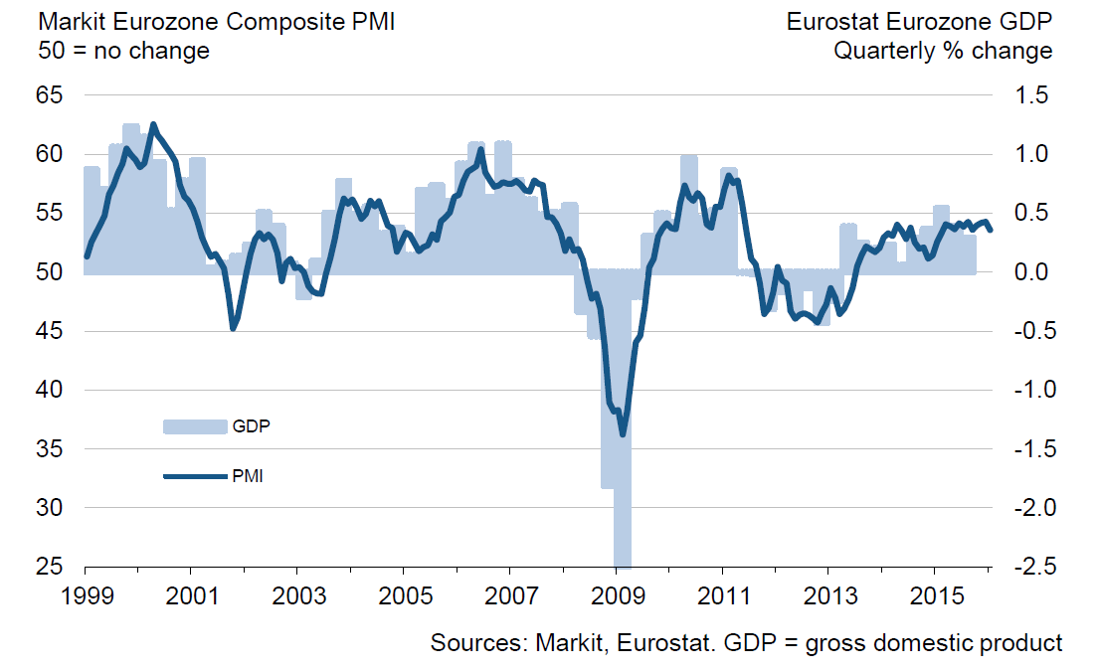
GDP Growth Has Continued in Eurozone in January 2016
Purchase Managers’ Index (PMI), 50 = no change from previous month
Latest information January 2016.
Source: Markit

Slide 30
Industrial Production Volume
Source: Macrobond

Slide 31
Industrial Production Volume in EU Countries
Source: Macrobond

Slide 32
Global Industrial Production Growth has Slowed Down
Source: Macrobond, The CPB Netherlands Bureau for Economic Policy Analysis

Slide 33
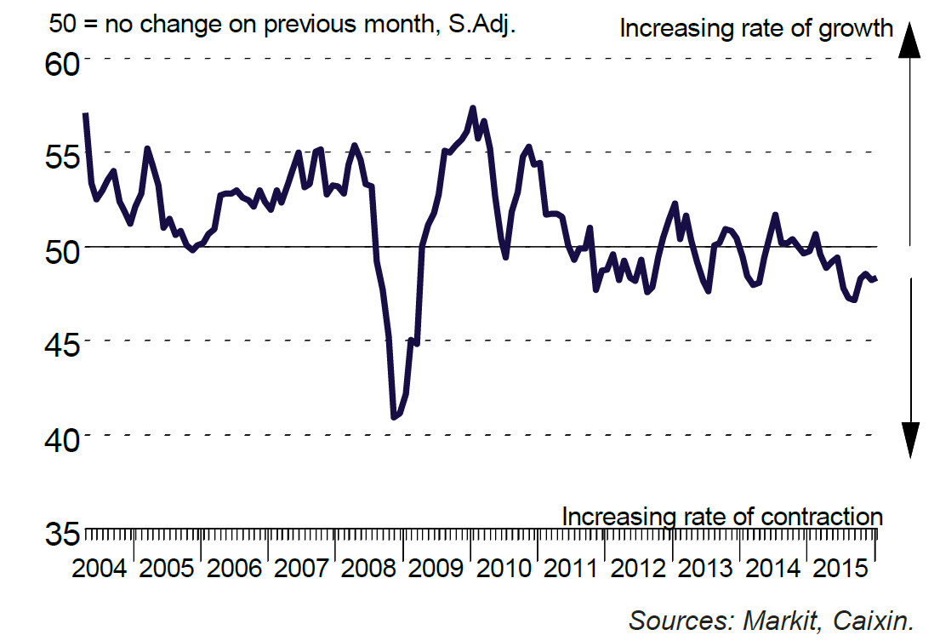
Industrial Production in China is Dropping
Purchase Managers’ Index (PMI) in manufacturing industry in China
50 = no change from previous month
Latest information January 2016.
Source: Markit

Slide 34
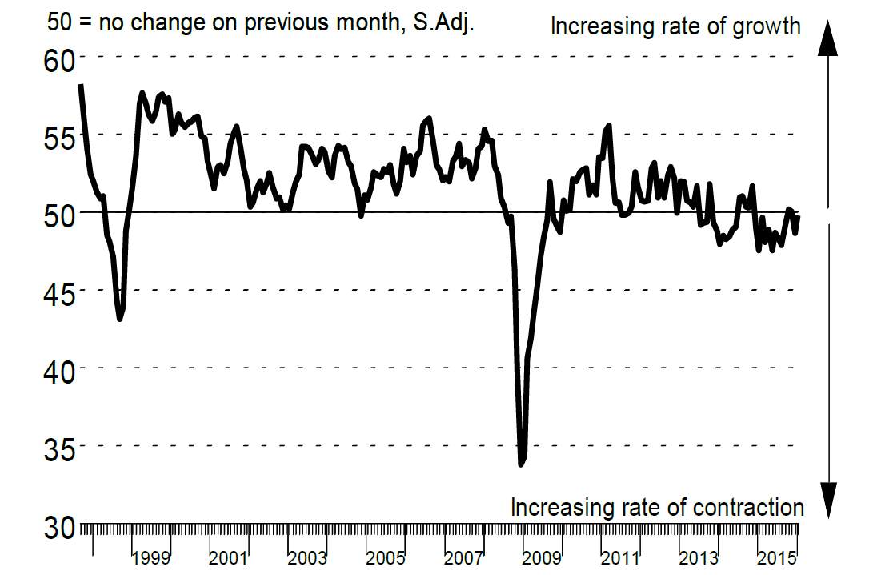
Industrial Production in Russia is Dropping
Purchase Managers’ Index (PMI) in manufacturing industry in Russia
50 = no change from previous month
Latest information January 2016.
Source: Markit

Slide 35
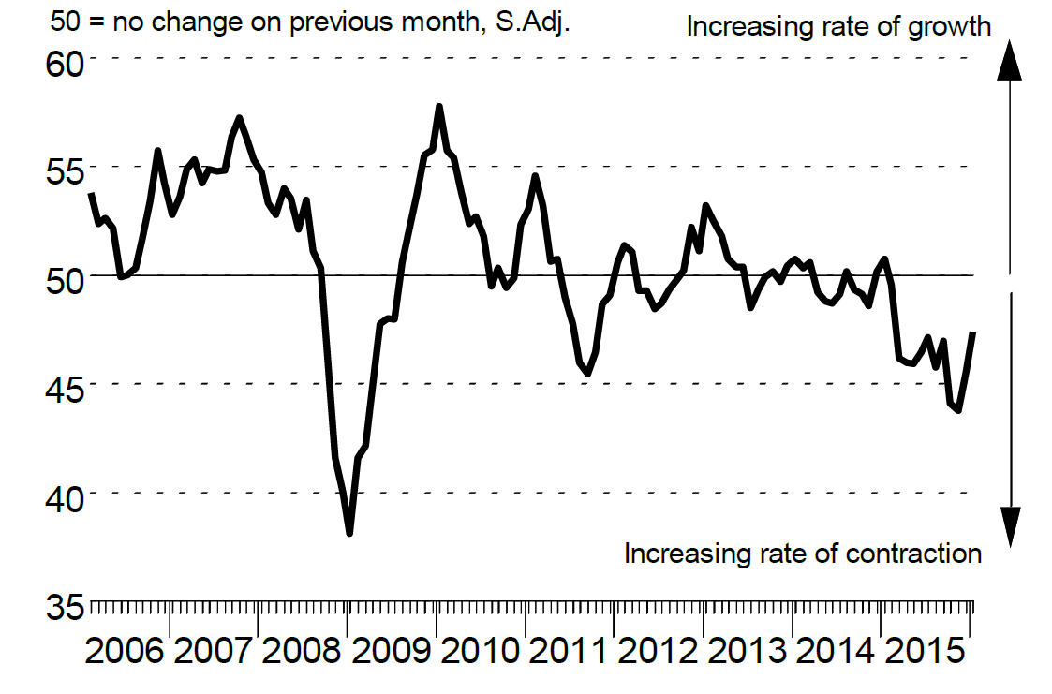
Industrial Production in Brazil is Dropping
Purchase Managers’ Index (PMI) in manufacturing industry in Russia
50 = no change from previous month
Latest information January 2016.
Source: Markit

Slide 36
Industrial Production in USA is Dropping
Purchase Managers’ Index (PMI) in manufacturing industry in Russia
50 = no change from previous month
Lähde: Macrobond

Slide 37
Growth of Residence Construction Has Finished in China
Share of China in Asian GDP is 42% (adjusted for PP)
Source: Macrobond

Slide 38
Fixed Investments in Russia and Brazil are Falling
Share of Russia in European GDP is 13% (adjusted for PP)
Share of Brazil in Latin American GDP is 35% (adjusted for PP)
Source: Macrobond

Slide 39
Import to Emerging Countries Has Lowered
Import volume development
Source: Macrobond, The CPB Netherlands Bureau for Economic Policy Analysis

Slide 40
Import to China Has Reduced from Other Countries
Source: Macrobond

Slide 41
Exports from EU Countries to Russia is Falling
Source: Macrobond

Slide 42
Russia’s Share of Technology Industry Exports Will Decline Again to the Level of Approximately Five Per Cent
%
*) Soviet Union up to 1991.
Source: Finnish Customs

Slide 43
Raw Material Prices are Falling
Spot prices of hot-rolled coils
US dollars / ton
Latest information December 2015
Source: CRU

Slide 44
Exchange Rates in Emerging Countries are Varying
Euro exchange rate compared to other currencies
Source: Macrobond

Slide 45
Global Economy is Expected to Grow by 3.4 % in 2016
GDP growth in 2016, %
India
China
Rest of Eastern Europe
Middle East and Africa
Average growth:
+3,4 %
Rest of
Asia
Mexico
Rest of Latin America
North America
Western Europe
Russia
Japan
Brazil
The width of the bar indicates the share of global GDP in 2014 (adjusted for purchasing power parity), %
Source: IMF (January 2016)

Slide 46
Export Demand for Technology Industry in Finland Will Grow by 2.3% in 2016
GDP growth in 2016, %
India
China
Rest of Latin America
Middle East and Africa
Rest of Eastern Europe
Average growth:
+2,3 %
Rest of
Asia
Mexico
North America
Western Europe
Japan
Russia
Brazil
The width of the bar indicates the export share of technology industry from Finland in 2014, %
Source IMF (January 2016), Board of Customs

Slide 47
Breakdown of World Industrial Production
%
Purchasing power parity adjusted shares.
Source: Maddison (Historical Statistics), IMF and ETLA

Slide 48
Industrial Production Development by Year
Source: Macrobond

Slide 49
The Big Challenge for Finland after 2008

Slide 50
Finnish Exports up to EUR 30 Billion Short of Annual Target Level
Source: Macronond, Statistics Finland / National Accounts

Slide 51
Finnish Exports Lagging Behind Competitors
Source: Macrobond, Eurostat

Slide 52
The Share of Industry in GDP in Finland 1900-2014
*) During 1900-1974 industry covers also mines, energy, water and refuse collection sectors.
Source: Statistics Finland / National Accounts

Slide 53
Finland’s Industrial Production Will not Regain the Level of 2008 with the Present Production Capacity
Finland’s production capasity has decreased by 20%
-21%
2008 | 2009 | 2010 | 2011 | 2012 | 2013 | 2014 | 2015
Source: Statistics Finland / National Accounts, Industrial volume index

Slide 54
Growth of Public Debt and Tax Rate Out of Control
Increased cost burden requires cuts to public sector
Source: Macrobond, Statistics Finland

Slide 55
Upswing of Investments Required in Finland
Source: OECD, Economic Outlook 2015

Slide 56
Industrial Companies’ Investment Plans Indicate an Increase in Investments Both in 2015 and 2016
Industrial fixed and R&D investments in Finland
Million euros, at current prices
Source: Statistics Finland, Confederation of Finnish Industries’
Investment Survey (January 2016)

Slide 57
Turning Point of Productivity* Development in Finland
After 2008 Finland has lost considerable volume production in electronics, forest and machinery industries**
Index, 2000=100
**) The structure of current industry does not enable the similar productivity development as during the years 2000-2008
*) Productivity is measured as real value added per hours worked. When productivity grows (the curve rises) value added grows more than hours worked.
Value added = turnover – purchasing of materials and services
Value added = labour costs + rents + depreciations + profits
Source: Statistics Finland / National Accounts

Slide 58
Unit Labour Costs at the National Economy Level
Unit labour costs = labour costs / productivity, including the influence of effective exchange rates
2005,I =100
Finland’s price and cost
competitiveness
declines
Finland’s price and cost
competitiveness
improves
2005 | 2006 | 2007 | 2008 | 2009 | 2010 | 2011 | 2012 | 2013 | 2014 | 2015
*) In the ECB Harmonised Competitiveness Index, the average effective exchange rate of each country is calculated vis-à-vis 20 to 30 main trade partners, as well as the development of unit labour costs for the total economy.
Latest information III/2015. Source: European Central Bank

Slide 59
What should be done?
Support the renewal of the industry
Taxes should support growth and investment in Finland
Support decision making in companies related to compensation and working time
No new European nor national burdens on companies, which are deteriorating the competitiveness

Slide 60
Long-Term Outlook and Challenges
Global Structural Change Set to Continue Apace
  Industrial production and services will relocate to rapidly developing economic areas
  Strong growth, large markets, cheap labour and increasing expertise will increase the attractiveness of these regions.
Competition over Skills and Raw Materials Set to Increase
  Due to an increase in retirement, the sector’s annual recruitment need in Finland will rise considerably in the coming years.
  The availability of reasonably-priced energy also threatens to become an investment bottleneck in Finland
Combating Climate Change
  A challenge as costs are set to grow faster than in competitor countries
  An opportunity for new environmental and energy technologies

Slide 61
The Federation of Finnish Technology Industries

Slide 62
The Federation’s Member Companies 2014
Number of enteprises / 1 583
Number of personnel / 183 772
1–249 employees
500–999 employees
250–499 employees
1000– employees
Source: The Federation of Finnish Technology industries

Slide 63
The Federation’s SME Member Companies 2014
Number of enterprises / 1 439
Number of personnel / 71 069
1–19 employees
50–99 employees
20–49 employees
100–249 employees
Source: The Federation of Finnish Technology industries

