Slide 1
GDP Growth Forecasts for 2019 Have Been Weakened in Recent Months
Source: Consensus Economics

Slide 2
Industrial Output Growth in the EU Countries Stopped already in 2018
Source: Macrobond

Slide 3
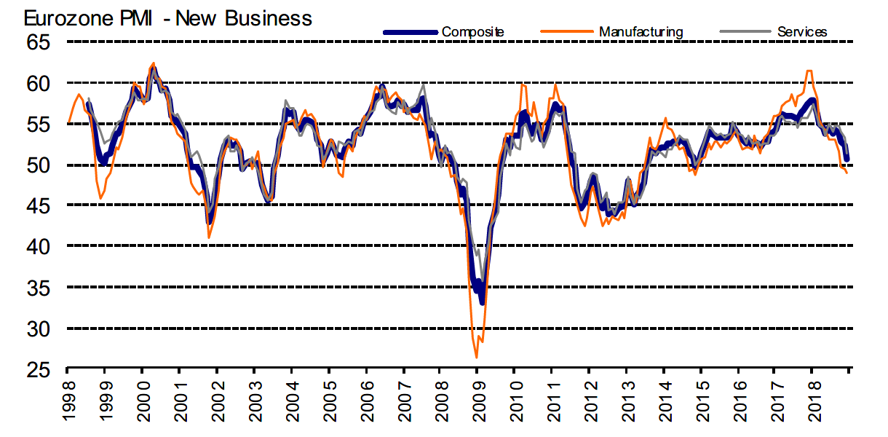
New Orders in the Manufacturing Industry in the Euro Area Declined Towards the End of 2018, Services Come after
Teollisuuden ja palvelujen ostopäällikköindeksi, 50 = ei muutosta edelliskuukaudesta
Latest information December 2018
Source: Markit

Slide 4
Finland’s Export Growth Ended in 2018, with a 40% Growth Gap Compared to Euro Area
Source: Macrobond, Eurostat

Slide 5
Industrial Fixed (Tangible) Investment Growth in Finland Has Lagged behind that of Competitors
Billion euros, at fixed 2010 prices, index 2005=100
Source: Eurostat (National Accounts), Confederation of Finnish Industries’ investment survey, January 2019

Slide 6
Investment Rate in Industrial Fixed Investments Is at a Low Level in Finland
Tangible investments / value added, %
Source: Eurostat (National Accounts), Confederation of Finnish Industries’ investment survey, January 2019

Slide 7
Industrial Intangible Investments * in Finland Have almost Halved since 2005
Billion euros, at fixed 2010 prices,
index 2005=100
*) Intangible investments include research and development and software investments etc.
Source: Eurostat (National Accounts), Confederation of Finnish Industries’ investment survey, January 2019

Slide 8
Investment Rate of Industrial Intangible Investments* Has Dropped Significantly in Finland
Intangible investments / value added, %
*) Intangible investments include research and development and software investments.
Source: Eurostat (National Accounts), Confederation of Finnish Industries’ investment survey, January 2019

Slide 9
Turnover of Technology Industry in Finland Increased by 6% in 2018, to EUR 77 Billion
Growth of turnover 2018, %:
Mechanical engineering +6 %
Electronics and electrotechnical +6 %
Metals industry +7 %
Consulting engineering +5 %
Information technology +6 %
Source: Macrobond, Statistics Finland / National Accounts, Federation of Finnish Technology Industries

Slide 10
Value of New Orders in the Technology Industry* in Finland
Million euros, at current prices
2008 | 2009 | 2010 | 2011 | 2012 | 2013 | 2014 | 2015 | 2016 | 2017 | 2018
Change: | IV,2018 / IV,2017 | IV,2018 / III,2018
Export: | -13 % | +8 %
Domestic: | -15 % | +11 %
Combined: | -13 % | +9 %
*) Excl. metals industry, game industry and data center companies
Source: The Federation of Finnish Technology Industries’ order book survey’s respondent companies, latest observation October-December 2018

Slide 11
Value of Order Books in the Technology Industry* in Finland
Million euros, at current prices
Combined
2008 | 2009 | 2010 | 2011 | 2012 | 2013 | 2014 | 2015 | 2016 | 2017 | 2018
Change: | 31.12.2018 / 31.12.2017 | 31.12.2018 / 30.9.2018
Export: | +11 % | +4 %
Domestic: | +7 % | +1 %
Domestic: | +10 % | +3 %
*) Excl. metals industry, game industry and data center companies
Source: The Federation of Finnish Technology Industries’ order book survey’s respondent companies, latest observation 31th December 2018.

Slide 12
Technology Industry Personnel in Finland and Abroad
Source: Statistics Finland, Federation of Finnish Technology Industries’ labour force survey

Slide 13
Value of New Orders in the Electronics and Electrotechnical Industry in Finland
Million euros, at current prices
2008 | 2009 | 2010 | 2011 | 2012 | 2013 | 2014 | 2015 | 2016 | 2017 | 2018
Change: | IV,2018 / IV,2017 | IV,2018 / III,2018
Export: | +16 % | +12 %
Domestic: | -13 % | 0 %
Combined: | +9 % | +10 %
Source: The Federation of Finnish Technology Industries’ order book survey’s respondent companies, latest observation October-December 2018

Slide 14
Value of Order Books in the Electronics and Electrotechnical Industry in Finland
Million euros, at current prices
Combined
2008 | 2009 | 2010 | 2011 | 2012 | 2013 | 2014 | 2015 | 2016 | 2017 | 2018
Change: | 31.12.2018 / 31.12.2017 | 31.12.2018 / 30.9.2018
Export: | +9 % | +6 %
Domestic: | -12 % | 0 %
Combined: | +5 % | +5 %
Source: The Federation of Finnish Technology Industries’ order book survey’s respondent companies, latest observation 31th December 2018.

Slide 15
Value of New Orders in the Mechanical Engineering in Finland
Million euros, at current prices
2008 | 2009 | 2010 | 2011 | 2012 | 2013 | 2014 | 2015 | 2016 | 2017 | 2018
Change: | IV,2018 / IV,2017 | IV,2018 / III,2018
Export: | -27 % | +5 %
Domestic: | -32 % | +14 %
Combined: | -28 % | +6 %
Source: The Federation of Finnish Technology Industries’ order book survey’s respondent companies, latest observation October-December 2018

Slide 16
Value of Order Books in the Mechanical Engineering in Finland
Million euros, at current prices
Combined
2008 | 2009 | 2010 | 2011 | 2012 | 2013 | 2014 | 2015 | 2016 | 2017 | 2018
Change: | 31.12.2018 / 31.12.2017 | 31.12.2018 / 30.9.2018
Export: | +12 % | +3 %
Domestic: | +12 % | +2 %
Combined: | +12 % | +3 %
Source: The Federation of Finnish Technology Industries’ order book survey’s respondent companies, latest observation 31th December 2018.

Slide 17
Turnover of the Metals Industry in Finland
Seasonal adjusted turnover index
Source: Macrobond, Statistics Finland

Slide 18
Production Volume of the Metals Industry in Finland
Seasonal adjusted volume index
Source: Macrobond, Statistics Finland

Slide 19
Value of New Orders in the Consulting Engineering in Finland
Million euros, at current prices
2008 | 2009 | 2010 | 2011 | 2012 | 2013 | 2014 | 2015 | 2016 | 2017 | 2018
Change: | IV,2018 / IV,2017 | IV,2018 / III,2018
Export: | +90 % | +7 %
Domestic: | +31 % | +32 %
Combined: | +37 % | +28 %
Source: The Federation of Finnish Technology Industries’ order book survey’s respondent companies, latest observation October-December 2018

Slide 20
Value of Order Books in the Consulting Engineering in Finland
Million euros, at current prices
Combined
2008 | 2009 | 2010 | 2011 | 2012 | 2013 | 2014 | 2015 | 2016 | 2017 | 2018
Change: | 31.12.2018 / 31.12.2017 | 31.12.2018 / 30.9.2018
Export: | -15 % | -13 %
Domestic: | +30 % | -3 %
Combined: | +21 % | -5 %
Source: The Federation of Finnish Technology Industries’ order book survey’s respondent companies, latest observation 31th December 2018.

Slide 21
Value of New Orders in the Information Technology* in Finland
Million euros, at current prices
2008 | 2009 | 2010 | 2011 | 2012 | 2013 | 2014 | 2015 | 2016 | 2017 | 2018
Change: | IV,2018 / IV,2017 | IV,2018 / III,2018
Combined: | +20 % | +25 %
*) Excl. game industry and data center companies
Source: The Federation of Finnish Technology Industries’ order book survey’s respondent companies, latest observation October-December 2018

Slide 22
Value of Order Books in the Information Technology* in Finland
Million euros, at current prices
2008 | 2009 | 2010 | 2011 | 2012 | 2013 | 2014 | 2015 | 2016 | 2017 | 2018
Change: | 31.12.2018 / 31.12.2017 | 31.12.2018 / 30.9.2018
Combined: | +6 % | +3 %
*) Excl. game industry and data center companies
Source: The Federation of Finnish Technology Industries’ order book survey’s respondent companies, latest observation 31th December 2018.

