Slide 1
Technology Industry /
Finnish Economic Outlook
February 2020

Slide 2
The Finnish Technology Industry Is Comprised of Five Sub-Sectors
ELEKTRONICS AND ELECTROTECHNICAL
INDUSTRY
ABB, Ensto, Microsoft Mobile,
Murata Electronics, Nokia, Planmeca,
Polar Electro, Suunto, Vacon, Vaisala…
METALS INDUSTRY
Boliden, Componenta, Kuusakoski, Luvata, Outokumpu, Outotec,
Ovako, Sacotec, SSAB …
MECHANICAL ENGINEERING
Abloy, Cargotec, Finn-Power, Fiskars, Glaston, Kone, Konecranes, Metso,
Meyer Turku, Normet, Oras, Patria, Pemamek, Ponsse, Stala, Valmet,
Valtra, Wärtsilä…
INFORMATION TECHNOLOGY
Affecto, Basware, Bilot, CGI, Comptel, Digia, Efecte, Enfo, F-Secure, Fujitsu Finland, IBM, Innofactor, Knowit,
Microsoft, Nixu, Tieto…
CONSULTING ENGINEERING
A-Insinöörit, Citec, Elomatic, Etteplan, FCG,
Granlund, Neste Jacobs, Pöyry, Ramboll,
Rejlers, SITO, SWECO, WSP…

Slide 3
The Finnish Technology Industry Is Comprised of Five Sub-Sectors
ELEKTRONICS AND ELECTROTECHNICAL
INDUSTRY
Data communications equipment, electrical machinery, medical technology
Turnover (2019): 18.0 billion euros
Personnel (2019): 38,700
METALS INDUSTRY
Steel products, non-ferrous metals, castings, metallic minerals
Turnover (2019): 10.7 billion euros
Personnel (2019): 15,800
MECHANICAL ENGINEERING
Machinery, metal products, vehicles
Turnover (2019): 32.8 billion euros
Personnel (2019): 134,200
INFORMATION TECHNOLOGY
IT services, applications and programming
Turnover (2019): 14.8 billion euros
Personnel (2019): 74,100
CONSULTING ENGINEERING
Expertise for construction industry and infrastructure
Turnover (2019): 6.6 billion euros
Personnel (2019): 56,200

Slide 4

The Technology Industry –
the Largest Export Sector in Finland
Over 50 % of total exports.
Some 320,000 employed directly in the sector, including indirect effects 675,000 people.
Effect on value added totaling € 57 billion, or 28% of GDP value added.
Bring to Finland € 18 billion tax revenue annually.
Investments about EUR 5.0 billion annually in Finland.
70 % of private-sector R&D investment.

Slide 5
Value Added to the Economy Generated by the Technology Industry Is EUR 55 Billion, or over 28% of GDP * (2017)
*) GDP value added was EUR 193.3 billion in 2017.
Source: Economic Impact of the Technology Industry in Finland 11/2018

Slide 6
Technology Industry Generates nearly 650,000 Jobs in Finland (over 25% of All Employees) (2017)
10 jobs in the technology industry bring
11 jobs to the rest of the economy
Source: Economic Impact of the Technology Industry in Finland 11/2018

Slide 7
Every Job in the Technology Industry Generates almost another Job in the Services (2017)
*) Excl. the services industries in the technology industry.
Source: Economic Impact of the Technology Industry in Finland 11/2018

Slide 8
Technology Industry Generates over 18 Billion Euros in Tax Revenue Annually in Finland (2017)
Source: Economic Impact of the Technology Industry in Finland 11/2018

Slide 9
Turnover of the Technology Industry in Finland
Source: Macrobond, Statistics Finland, Technology Industries of Finland

Slide 10

Export of Technology Industry Goods from Finland by Area in 2018
Total goods exports 32.5 billion euros*
Central and Eastern Europe
5.06 billion €
15.5 %
Western Europe
17.51 billion €
53.9 %
North America
3.04 billion €
9.4 %
Asia
5.04 billion €
15.5 %
Middle and Central East
0.48 billion €
1.5 %
South and Middle America
0.89 billion €
2.7 %
Africa
0.48 billion €
1.5 %
*) In addition to goods exports the sector exported services worth some 13 billion euros.
Source: National Board of Customs, Statistics Finland

Slide 11
Technology, Forest and Chemical Industries Provide 81 % of Finland's Goods and Services Exports Revenue
Goods and service exports: billion euros and the share of Finnish exports in 2017
*) Service exports industry-specific data for the year 2017 are preliminary information.
Source: Board of Customs, Statistics Finland (National Accounts, Foreign trade in services), Federation of Finnish Technology Industries

Slide 12
Turnover of the Industry and Technology Industry in Finland
Source: Macrobond, Statistics Finland

Slide 13
Turnover of the Technology Industry in Finland
Source: Macrobond, Statistics Finland

Slide 14
Value of New Orders in the Technology Industry* in Finland
Million euros, at current prices
2008 | 2009 | 2010 | 2011 | 2012 | 2013 | 2014 | 2015 | 2016 | 2017 | 2018 | 2019
Change: | IV/2019 / IV,2018 | IV,2019 / III,2019
Export: | +26 % | +25 %
Domestic: | -8 % | -14 %
Combined: | +17 % | +15 %
*) Excl. metals industry, game industry and data center companies
Source: The Federation of Finnish Technology Industries’ order book survey’s respondent companies, latest observation October-December 2020

Slide 15
Value of Order Books in the Technology Industry* in Finland
Million euros, at current prices
Combined
2008 | 2009 | 2010 | 2011 | 2012 | 2013 | 2014 | 2015 | 2016 | 2017 | 2018 | 2019
Change: | 31.12.2019 / 31.12.2018 | 31.12.2019 / 30.9.2019
Export: | +8 % | +3 %
Domestic: | +13 % | 0 %
Combined: | +9 % | +2 %
*) *) Excl. metals industry, game industry and data center companies
Source: The Federation of Finnish Technology Industries’ order book survey’s respondent companies, latest observation 31th December 2019.

Slide 16
Tender Requests* Received by the Technology Industry Companies in Finland
2008 | 2009 | 2010 | 2011 | 2012 | 2013 | 2014 | 2015 | 2016 | 2017 | 2018 | 2019 | 2020
*) ”Have you experienced a notable increase or decrease in the number of requests for tenders in recent weeks in comparison to the situation three months ago?”. Balance figure = the number of companies receiving more requests - the number of companies receiving less requests.”
Source: The Federation of Finnish Technology Industries’ order book survey’s respondent companies, the last questionnaire in January 2020.

Slide 17
Value of New Orders in the Electronics and Electrotechnical Industry in Finland
Million euros, at current prices
2008 | 2009 | 2010 | 2011 | 2012 | 2013 | 2014 | 2015 | 2016 | 2017 | 2018 | 2019
Change: | IV,2019 / IV,2018 | IV,2019 / III,2019
Export: | +42 % | +9 %
Domestic: | +1 % | +10 %
Combined: | +34 % | +9 %
Source: The Federation of Finnish Technology Industries’ order book survey’s respondent companies, latest observation October-December 2019

Slide 18
Value of Order Books in the Electronics and Electrotechnical Industry in Finland
Million euros, at current prices
Combined
2008 | 2009 | 2010 | 2011 | 2012 | 2013 | 2014 | 2015 | 2016 | 2017 | 2018 | 2019
Change: | 31.12.2019 / 31.12.2018 | 31.12.2019 / 30.9.2019
Export: | +35 % | +6 %
Domestic: | -2 % | +5 %
Combined: | +28 % | +6 %
Source: The Federation of Finnish Technology Industries’ order book survey’s respondent companies, latest observation 31th December 2019.

Slide 19
Value of New Orders in the Mechanical Engineering in Finland
Million euros, at current prices
2008 | 2009 | 2010 | 2011 | 2012 | 2013 | 2014 | 2015 | 2016 | 2017 | 2018 | 2019
Change: | IV,2019 / IV,2018 | IV,2019 / III,2019
Export: | +13 % | +47 %
Domestic: | -19 % | -42 %
Combined: | +7 % | +21 %
Source: The Federation of Finnish Technology Industries’ order book survey’s respondent companies, latest observation October-December 2019

Slide 20
Value of Order Books in the Mechanical Engineering in Finland
Million euros, at current prices
Combined
2008 | 2009 | 2010 | 2011 | 2012 | 2013 | 2014 | 2015 | 2016 | 2017 | 2018 | 2019
Change: | 31.12.2019 / 31.12.2018 | 31.12.2019 / 30.9.2019
Export: | +1 % | +2 %
Domestic: | +36 % | -3 %
Combined: | +5 % | +1 %
Source: The Federation of Finnish Technology Industries’ order book survey’s respondent companies, latest observation 31th December 2019.

Slide 21
Value of New Orders in the Consulting Engineering in Finland
Million euros, at current prices
2008 | 2009 | 2010 | 2011 | 2012 | 2013 | 2014 | 2015 | 2016 | 2017 | 2018 | 2019
Change: | IV,2019 / IV,2018 | IV,2019 / III,2019
Export: | +5 % | -13 %
Domestic: | +1 % | +25 %
Combined: | 0 % | +21 %
Source: The Federation of Finnish Technology Industries’ order book survey’s respondent companies, latest observation October-December 2019.

Slide 22
Value of Order Books in the Consulting Engineering in Finland
Million euros, at current prices
Combined
2008 | 2009 | 2010 | 2011 | 2012 | 2013 | 2014 | 2015 | 2016 | 2017 | 2018 | 2019
Change: | 31.12.2019 / 31.12.2018 | 31.12.2019 / 30.9.2019
Export: | -18 % | -8 %
Domestic: | -2 % | +2 %
Combined: | -4 % | +1 %
Source: The Federation of Finnish Technology Industries’ order book survey’s respondent companies, latest observation 31th December 2019.

Slide 23
Value of New Orders in the Information Technology* in Finland
Million euros, at current prices
2008 | 2009 | 2010 | 2011 | 2012 | 2013 | 2014 | 2015 | 2016 | 2017 | 2018 | 2019
Change: | IV,2019 / IV,2018 | IV,2019 / III,2019
Combined: | -1 % | +30 %
*) Excl. game industry and data center companies
Source: The Federation of Finnish Technology Industries’ order book survey’s respondent companies, latest observation October-December 2019.

Slide 24
Value of Order Books in the Information Technology* in Finland
Million euros, at current prices
2008 | 2009 | 2010 | 2011 | 2012 | 2013 | 2014 | 2015 | 2016 | 2017 | 2018 | 2019
Change: | 31.12.2019 / 31.12.2018 | 31.12.2019 / 30.9.2019
Combined: | +1 % | +1 %
*) Excl. game industry and data center companies
Source: The Federation of Finnish Technology Industries’ order book survey’s respondent companies, latest observation 31th December 2019.

Slide 25
Technology Industry Personnel
Some 11,000 of employees
affected by temporary or part-time lay-offs 31st December 2019
Source: Statistics Finland, The Federation of Finnish Technology Industries’ labour force survey, Macrobond

Slide 26
Technology Industry Personnel Recruitment in Finland by Quarters
Source: The Federation of Finnish Technology Industries’ labour force survey

Slide 27
Technology Industry Personnel in Finland by Branch
Source: Statistics Finland, The Federation of Finnish Technology Industries’ labour force survey, Macrobond

Slide 28
Technology Industry Personnel in Subsidiaries Abroad by Branch
Source: The Federation of Finnish Technology Industries’ labour force survey, Macrobond

Slide 29
Technology Industry Personnel in Subsidiaries Abroad by Country
Information from year 2018
Source: The Federation of Finnish Technology Industries’ labour force survey

Slide 30
Retirement of Technology Industry Personnel in Finland
Individuals per year
Salaried employees
Blue collar employees
Source: Wage inquiry of the Techonology Industries of Finland, Finnish Centre for Pensions, Statistics Finland

Slide 31
Retirement of Technology Industry Blue Collar Employees in Finland
Individuals per year
Source: Wage inquiry of the Techonology Industries of Finland, Finnish Centre for Pensions, Statistics Finland

Slide 32
Overview of the Situation in the Technology Industry and Outlook for the Winter 2020
- Turnover in Finland totalled some EUR 83 billion in 2019. The turnover was up 6% year-on-year.
- The monetary value of new orders reported between October-December 2019 was 15% higher than in the preceding quarter, and 17% higher than in the corresponding period in 2018.
- At the end of December, the value of order books was 2% higher than at the end of September, and 9% higher than in December 2019.
- The turnover of technology industry companies in the winter of 2020 is expected to be higher than in the corresponding period last year.
- The number of personnel employed by technology industry companies in Finland grew by 3 per cent in 2019 from the 2018 average. The industry employed some 319,000 people, up 10,000 from 2018.
- The recruitment activities in the sector was downward towards the end of 2019. During the year 2019 the number of recruitments was over 40,000, when in the previous year the number was some 50,000.

Slide 33
World Economic Outlook
- Finland as a Part of Global Economy

Slide 34
GDP Growth Projections for 2020 Do Not Anticipate a Downturn, at least at the Level of the Whole Year
Forecast period
Source: Consensus Economics

Slide 35
Finland’s GDP Backlog for the Other Euro Area Countries Is Close to 4%
Lähde: Macrobond

Slide 36
Finland’s Export Backlog for the Other Euro Area Countries Is Some 35%
Source: Macrobond, Eurostat

Slide 37
Finland’s GDP Growth Has Recently been Supported by Exports, Construction and Private Consumption
Source: Macrobond, Statistics Finland

Slide 38
Gross Domestic Product Has Grown Long in Europe and the USA, Finland is Lagging Behind
Souce: Macrobond

Slide 39
In China and India, Growth Is Slowing Down, Brazil and Russia Are Experiencing Weak Growth
Share of global GDP in China, India, Brazil and Russia is 31 % (adjusted for PP)
Lähde: Macrobond

Slide 40
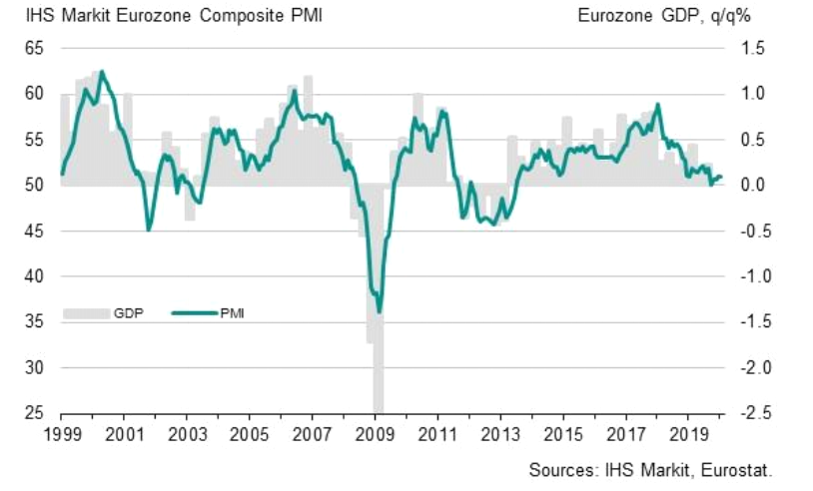
Economic Growth in the Euro Area Is Weak
Purchase Managers’ Index (PMI), 50 = no change from previous month
Latest information January 2020
Source: Markit

Slide 41
The Backlog of Industrial Production in Finland Compared to EU Countries Is Closing
Source: Macrobond

Slide 42
Industrial Output Has Fallen the Longest in Germany
Source: Macrobond

Slide 43
Industrial Production Is Now Stagnating Worldwide
Source: Macrobond, The CPB Netherlands Bureau for Economic Policy Analysis

Slide 44
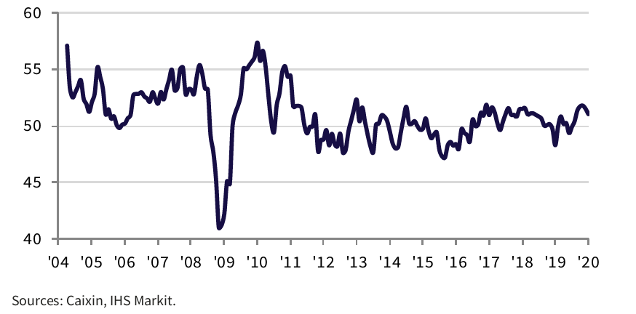
Industrial Production in China Is Increasing
Purchase Managers’ Index (PMI) in manufacturing industry in China
Latest information January 2020
Source: Markit

Slide 45
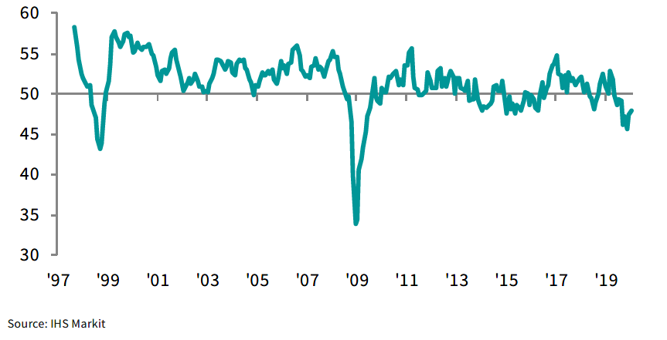
Industrial Production in Russia Is Decreasing Purchase Managers’ Index (PMI) in manufacturing industry in Russia
Latest information January 2020
Source: Markit

Slide 46
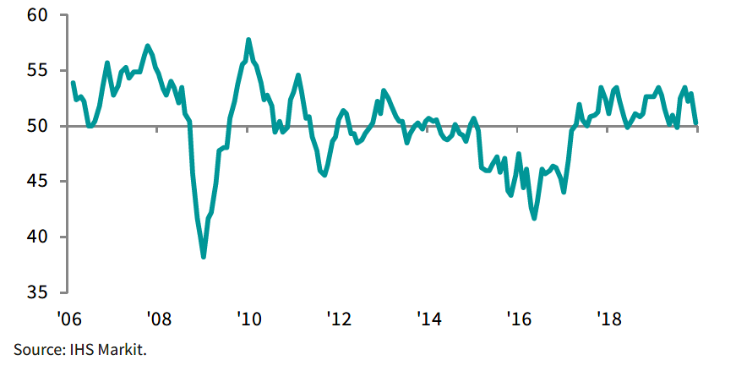
Industrial Production in Brazil Is Stagnating
Purchase Managers’ Index (PMI) in manufacturing industry in Brazil
Latest information January 2020
Source: Markit

Slide 47
Industrial Production in the USA Is Again Increasing
Purchase Managers’ Index (PMI) in manufacturing industry
50 = no change from previous month
Source: Macrobond

Slide 48
Political Uncertainty Destabilises Global Economic Stability - Exchange Rates Are Changing a Lot
Source: Macrobond

Slide 49
Fixed Investment in Russia and Brazil Is Growing Slightly
Souce: Macrobond

Slide 50
World Trade Is Declining Slightly Goods export volume
Source: Macrobond, The CPB Netherlands Bureau for Economic Policy Analysis

Slide 51
Chinese Imports Showed a Slight Pick-up Towards the End of 2019
Source: Macrobond

Slide 52
EU Exports to Russia Have Recovered only Slightly
Source: Macrobond

Slide 53
Russia’s Share* of Technology Industry Exports from Finland Has Lowered to 5-6%
%
*) Soviet Union up to 1991
Source: Finnish Customs

Slide 54
The World Economy Is Projected to Grow by 3.3% in 2020 GDP growth 2020 / 2019, %
India
China
Average growth:
+3,3 %
Rest of Eastern Europe
Rest of Latin America
Middle East and Africa
Rest of Asia
Russia
Brazil
North America
Mexico
Western Europwe
Japan
The width of the bar indicates the share of global GDP in 2019 (adjusted for purchasing power parity), %
Source: IMF (January 2020)

Slide 55
Demand in the Finnish Technology Industry Export Market is Expected to Grow by 2.1 % in 2020
GDP growth 2020/2019, %
India
China
Rest of Latin America
Middle East and Africa
Mexico
Average growth:
+2,1 %
Rest of Eastern Europe
Rest of Asia
Brazil
Japan
Russia
North America
Western Europe
The width of the bar indicates the export share of technology industry from Finland in 2018, %
Source: IMF (January 2020), Board of Customs

Slide 56
Finland’s Economic Growth Relies on Exports and Investments

Slide 57
Finnish Exports Have Lagged Behind the Competitor Countries
Source: Macrobond, Eurostat

Slide 58
Government and Municipal Debt Is at a High Level
Source: Macrobond, Eurostat

Slide 59
Unlike the Competitor Countries, in Finland Business Investment Is Still Below the Level in 2008
Source: OECD, Economic Outlook (November 2019)

Slide 60
Industrial and Technology Industry Investments in Finland Are Still at a Low Level
Production and R&D investments in Finland, million euros, at fixed 2017 prices
Source: Statistics Finland, (National Accounts), The Confederation of Finnish Industries* investment survey

Slide 61
Industrial Tangible and Intangible Investment* in Finland Have Not Yet Reached the 2007-2008 Levels
Billion euros, at fixed 2015 prices
*) Including software investments.
Source: Statistics Finland (National Accounts), Confederation of Finnish Industries’ Investment Survey January 2020

Slide 62
Total Industrial Investment in Finland Is Now at Around the Level of Capital Consumption
Billion euros, at fixed 2015 prices
*) Including software investments.
Source: Statistics Finland (National Accounts), Confederation of Finnish Industries’ Investment Survey January 2020

Slide 63
Tangible Investments by Industry in Finland Are Now Higher than the Consumption of Capital
Billion euros, at fixed 2015 prices
Source: Statistics Finland (National Accounts), Confederation of Finnish Industries’ Investment Survey January 2020

Slide 64
Industrial Production Capital in Finland Has Disappeared Significantly, Especially after 2008
Billion euros, at fixed 2015 prices
Information on consumption of tangible capital is at 2010 prices.
Source: Statistics Finland (National Accounts)

Slide 65
Industrial Tangible Investment Growth in Finland Has Lagged behind that of Competitors
Billion euros, at fixed 2015 prices, index 2005=100
Source: Eurostat (National Accounts), Confederation of Finnish Industries’ investment survey, January 2020

Slide 66
Investment Rate in Industrial Tangible Investments Is at a Low Level in Finland
Tangible investments / value added, %
Source: Eurostat (National Accounts)

Slide 67
Industrial Intangible Investments * in Finland Have almost Halved since 2005
Billion euros, at fixed 2015 prices,
index 2005=100
*) Intangible investments include research and development and software investments etc.
Source: Eurostat (National Accounts), Confederation of Finnish Industries’ investment survey, January 2020

Slide 68
Investment Rate of Industrial Intangible Investments* Has Dropped Significantly in Finland
Intangible investments / value added, %
*) Intangible investments include research and development and software investments.
Source: Eurostat (National Accounts)

Slide 69
Investments and productivity* are Decisive for Finland’s Success
*) Productivity is measured as real value added per hours worked. When productivity grows (the curve rises) value added grows more than hours worked.
Source: Statistics Finland

Slide 70
Finland’s GDP Productivity Has Lagged Behind Other EU and Euro Countries GDP at fixed prices / hours worked
Index 2008=100 (the year before the collapse of Finnish industrial production capacity)
Latest information July-September 2019.
Source: Eurostat: Quarterly National Accounts

Slide 71
In Industrial Productivity, Finland Is Still Behind the EU and Eurozone Average Industrial value added at fixed prices / hours worked
2008=100 (the year before the collapse of Finnish industrial production capacity)
Latest information July-September 2019.
Source: Eurostat: Quarterly National Accounts

Slide 72
The Investment Rate of Companies in Finland Is Clearly Lower than the EU Average
Corporate fixed investment compared to value added, % (excl. financial sector)
Lates information July-September 2019.
Source: Eurostat

Slide 73
Finland’s Cost Competitiveness Has Improved, but Is Still Behind Other Euro Countries
Unit labour costs in the whole economy = labour costs / productivity, including the influence of effective exchange rates
Finland’s price and cost competitiveness declines
Finland’s price and cost
competitiveness improves
00 | 01 | 02 | 03 | 04 | 05 | 06 | 07 | 08 | 09 | 10 | 11 | 12 | 13 | 14 | 15 | 16 | 17 | 18 | 19
*) In the ECB Harmonised Competitiveness Index, the average effective exchange rate of each country is calculated vis-à-vis 38 main trade partners, as well as the development of unit labour costs for the total economy.
Latest information July-September 2019. Source: European Central Bank

Slide 74
Member Companies of the Federation of Finnish Technology Industries

Slide 75
The Federation’s Member Companies 2018
Number of enterprises / 1,588
Number of personnel / 179,700
1–249 employees
500–999 employees
250–499 employees
1000– employees

Slide 76
The Federation’s SME Member Companies 2018
Number of enterprises / 1,440
Number of personnel / 70,029
1–19 employees
50–99 employees
20–49 employees
100–249 employees

Slide 77
Operating Profit in the Member Companies of Technology Industries of Finland in 2018
Operating profit-% = operating result / turnover * 100 (before taxes and financial income and expenses)
Companies in random order
Source: Statistics Finland

Slide 78
Net Profit in the Member Companies of Technology Industries of Finland in 2018
Net profit -% = net profit / turnover * 100 (after tax and financial income and expenses)
Good (21 %)
Satisfactory (23 %)
Weak (33 %)
Unprofitable (23 %)
Companies in random order
Source: Statistics Finland

Slide 79
Return on Assets in the Member Companies of Technology Industries of Finland in 2018
Return on assets -% = (net income + financial expenses + taxes) / (capital invested in the financial year) * 100
Companies in random order
Source: Statistics Finland

Slide 80
Equity Ratio in the Member Companies of Technology Industries of Finland in 2018
Equity ratio -% = (total equity + total appropriations accrued) / adjusted balance sheet * 100
Companies in random order
Source: Statistics Finland

