Slide 1
EU Policy Priorities (Q1-Q2 2023)
Jussi Mäkinen & Henrique Laitenberger
16 December 2022

Slide 2
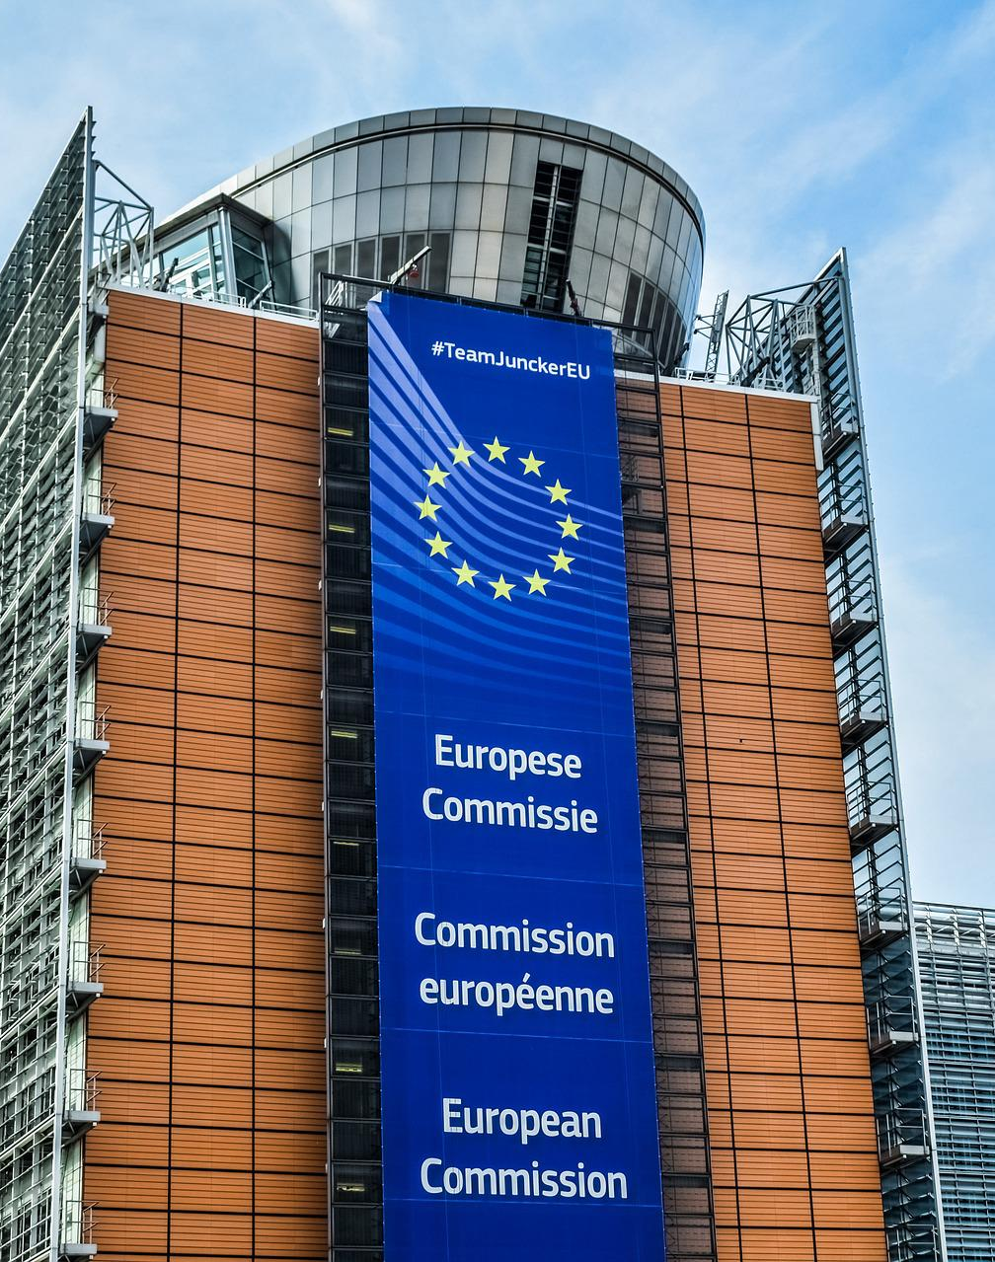
Contents
Overview
High Priority
Medium Priority
Observation
Picture Credit: Dimitris Vetsikas from Pixabay

Slide 3
Overview
High Priority
Active advocacy efforts before EU institutions
Prepare written advocacy materials (e.g., position papers)
Work closely with TIF experts and members
Medium Priority
Observe closely and react to key developments
Prepare written advocacy materials if needed according to substance units and/or members
Report regularly to substance units and members
Observation
Monitoring
No written advocacy materials
Report essential developments to substance units and members

Slide 4
High Priority

Slide 5
Ongoing Initiatives
File | Category | Status | EU/National Focus
Ecodesign for Sustainable Products Regulation | Sustainable Growth | Council/EP Review | EU
Corporate Sustainability Due Diligence Directive | Sustainable Growth | Council/EP Review | EU
Cybersecurity Act | Forerunner in Technology | Implementation | EU + National
Data Act | Forerunner in Technology | Council/EP Review | EU
AI Act | Forerunner in Technology | Council/EP Review | EU
OECD Minimal Taxation Agreement | Future Skills and Work | Council Approval | EU + National
VAT in Digital Age | Forerunner in Technology | Council Review | EU
Platform Work Directive | Future Skills and Work | Council/EP Review | EU
Industrial Strategy – Industrial Forum Report | Forerunner in Technology | Commission | EU
Tech Industries of Finland EU24 Agenda | All units |  | EU + National

Slide 6
Upcoming Initiatives
File | Category | Planned Adoption Date
Revision of EU’s internal electricity market rules | Forerunner in Technology, Sustainable Growth | Q1/2023
European Critical Raw Materials Act | Forerunner in Technology, Sustainable Growth | Q1/2023
Review of the functioning of the Multiannual Financial Framework | Forerunner in Technology, Sustainable Growth, Future Skills and Work | Q2/2023
Halfway evaluation of innovation/RDI programmes | Forerunner in Technology | Q2/2023
EU Hydrogen Bank | Forerunner in Technology, Sustainable Growth | Q3/2023

Slide 7
Medium Priority

Slide 8
Ongoing Initiatives
File | Category | Status | EU/National Focus
Revision of Industrial Emissions Directive | Sustainable Growth | Council/EP Review | EU
European Data Spaces | Forerunner in Technology | Council/EP Review | EU
Artificial Intelligence Liability Directive | Forerunner in Technology | Council / EP Review | EU
Shipment of Waste Regulation | Sustainable Growth | Council / EP Review | EU
Carbon removal certification | Sustainable Growth | Council / EP Review | EU
European Chips Act | Forerunner in Technology | Council/EP Review | EU

Slide 9
Ongoing Initiatives cont’d
File | Category | Status | EU/National Focus
Revision of Product Liability Directive | Forerunner in Technology | EP/ Council Review | EU
Labour Skills and Mobility Communication | Future Skills and Work | EP/ Council Review | EU
Taxonomy, enabling technologies and environmental criteria | Sustainable development, Forerunner in Technology | Implementation | EU + National

Slide 10
Upcoming Initiatives
File | Category | Planned Adoption
Initiative on virtual worlds, such as metaverse | Forerunner in Technology | Q2/2023
TIF and Finnish initiatives for year of Skills 2023, incl. Cybersecurity Academy, learning mobility | Future Skills and Work, Forerunner in Industry | Q3/2023

Slide 11
Observation

Slide 12
Ongoing Initiatives
File | Category | Status | EU/National Focus
Corporate Sustainability Reporting Directive | Sustainable Growth | Implementation | National
European Digital Identity | Forerunner in Technology | Council/EP Review | EU
Standardisation strategy | Forerunner in Technology | EP Review | EU
Directive on adequate minimum wages | Future Skills and Work | Implementation | National
Packaging and packaging waste Directive | Sustainable Growth | Council / EP Review | EU

Slide 13
Upcoming Initiatives
File | Category | Planned Adoption
REACH revision | Sustainable Development | Q4/2023

