Slide 1
BUSINESS MODEL CANVAS
Introduction

Slide 2
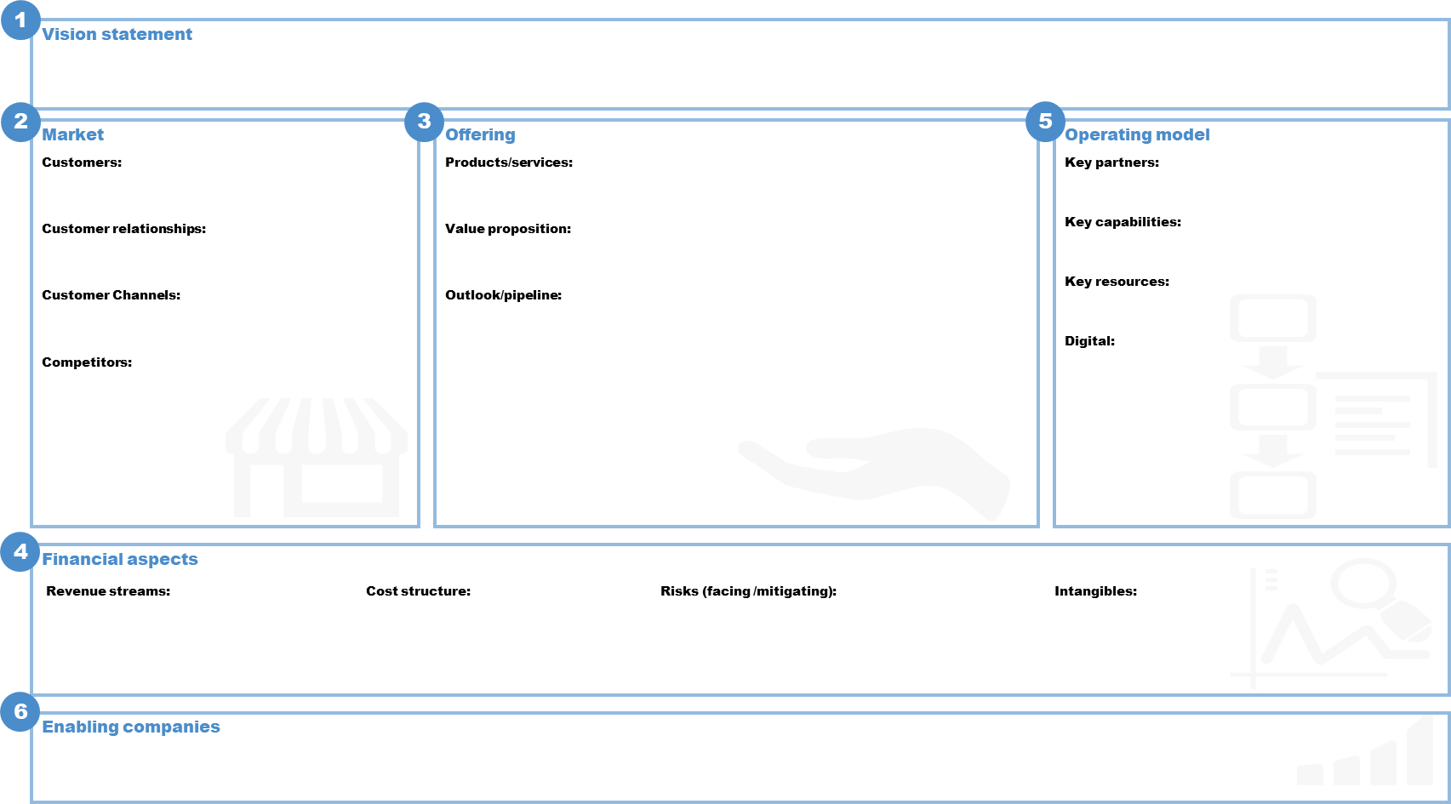
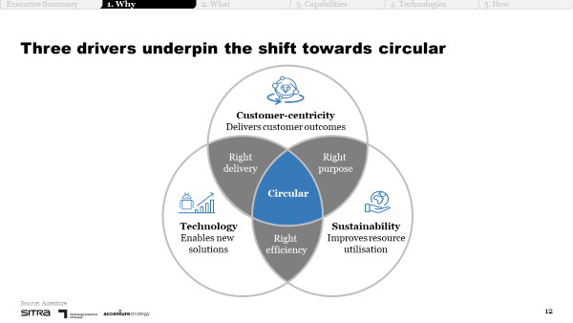
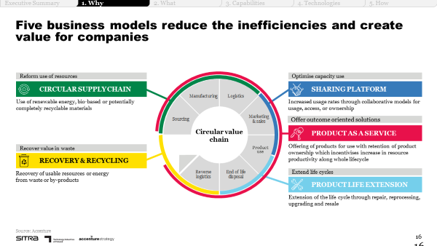
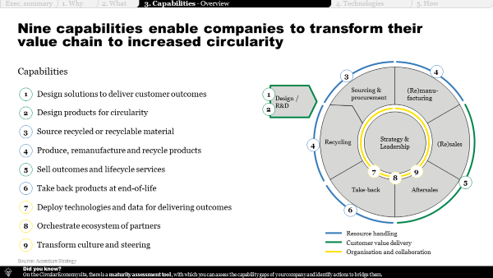
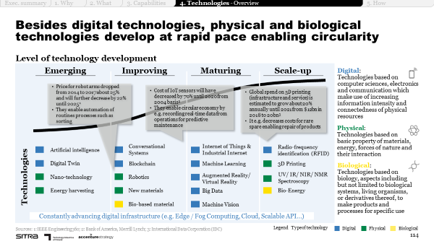
Business model canvas
INTRODUCTION
Purpose
The purpose of the business model canvas tool is to help you crystallise your circular business idea by reflecting on its key building blocks, including your value proposition, infrastructure, customers and financing.
Illustration of the tool
Instructions
Vision – describe your long-term vision and wanted position
Market - reflect on customers, the required customer relationships, the channels you could use to reach them and what competition you will see on the market.
Offering - detail what the solution you want to offer could look like, what the concrete value proposition to your customers is and draft an outlook on how it could be developed further or what other solutions could be connected with it.
Financial aspects – use the value case tool to assess value levers per circular sub-model. Provide a high-level estimate on revenues, costs, and investments.
Operating model – reflect on key partners, capabilities, resources and digital technologies needed to operate your circular business idea.
Enabling companies – list companies that can support the development of your circular business model, such as financiers and technology providers.
Supporting materials
All playbook chapters + supporting tools
1. Why circular economy?
2. What opportunities exist?
3. Which capabilities are required?
4. Which technologies can support?
5. How to design the transformation journey?
Illustrative playbook pages – please refer to the entire chapters for support.

Slide 3
Business model canvas
EXAMPLE
Example
Vision statement
Optimised use of equipment capacity – in an easy and cost-efficient way
Market
Customers:
Customer relationships:
Customer Channels:
Competitors:
Offering
Products/services:
Value proposition:
Outlook/pipeline:
Operating model
Key partners:
Key capabilities:
Key resources:
Digital:
Manufacturing companies
Individual consumers
Facilitating matches between companies owning a piece of machinery / equipment that is not needed all the time and those needing the equipment every now and then
Maintenance services for shared products
Companies willing to share their products
IT partners to develop and maintain platform
Payment solution providers
Establishing and cultivating equipment sharing community
Avoided unnecessary costs from underutilised equipment
Optimised use of capacity
Easy and cost-efficient way to get equipment for use
Leveraging data to support product sharing
Attracting customers to join the platform and cultivating the platform community
Illustrative example for equipment sharing platform
Website
App
Providing additional services for shared products, e.g. insurance, maintenance etc
Expanding operations to other areas in Finland
Using devices to facilitate tracking of products
IT platform
Products to be shared
OEMs
Other equipment sharing/rental platforms
Big data to improve understanding of customer needs and preferences
Potential use of IoT solutions to track product location, availability, energy consumption etc
Financial aspects
Revenue streams:
Cost structure:
Risks (facing /mitigating):
Intangibles:
Transaction fees
Add-on sales
Platform development & maintenance
Service costs (logistics, maintenance, etc)
Mitigating risk of owning costly machinery & equipment
Facing risk of attracting enough customers to the platform
Strengthened customer relationships through more frequent interaction
Improved understanding of customer base
Improved company image
Enabling companies
Financiers
Insurance companies
Technology providers

Slide 4
BUSINESS MODEL CANVAS
Tool

Slide 5
Vision statement
Market
Customers:
Customer relationships:
Customer Channels:
Competitors:
Offering
Products/services:
Value proposition:
Outlook/pipeline:
Operating model
Key partners:
Key capabilities:
Key resources:
Digital:
Financial aspects
Revenue streams:
Cost structure:
Risks (facing /mitigating):
Intangibles:
Enabling companies

