Slide 1
BUSINESS MODEL DEVELOPMENT TOOLKIT
Introduction

Slide 2
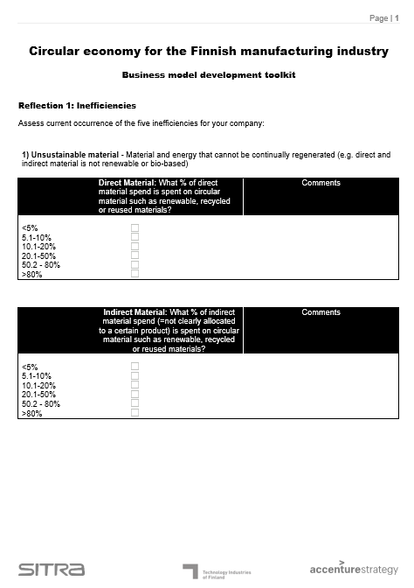
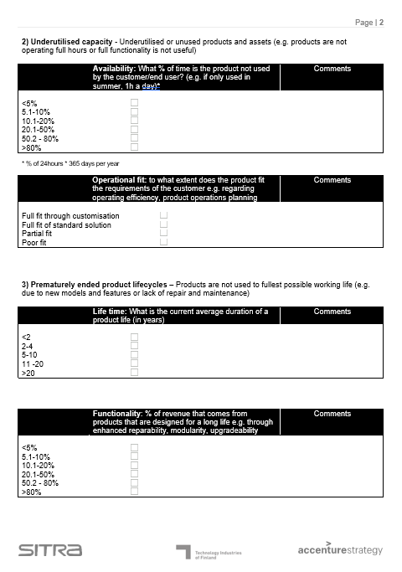
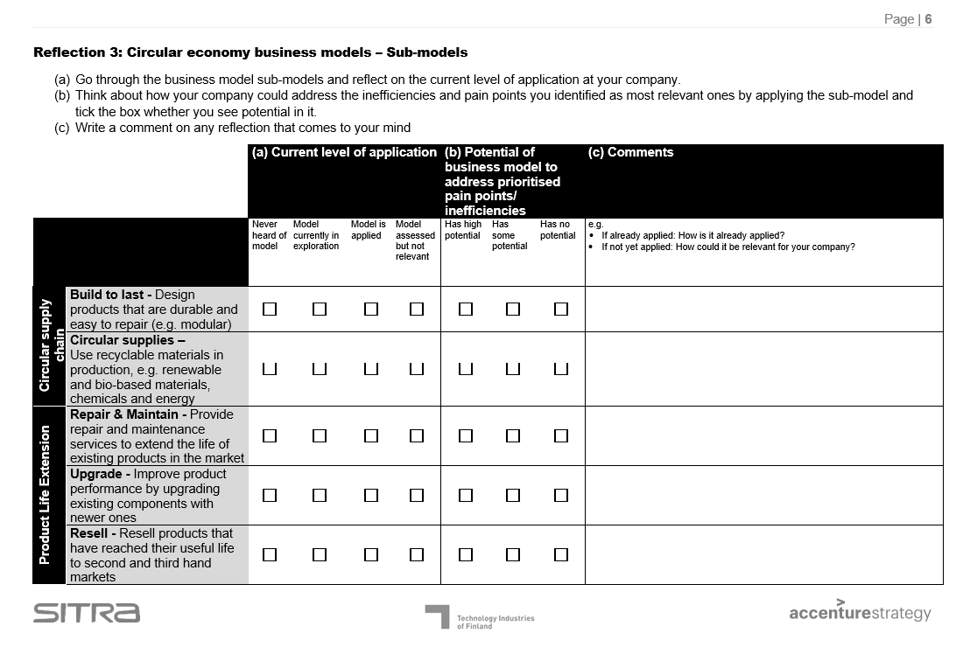
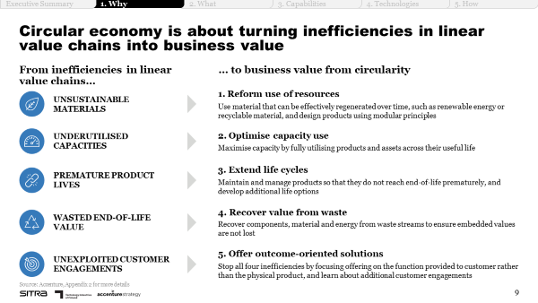
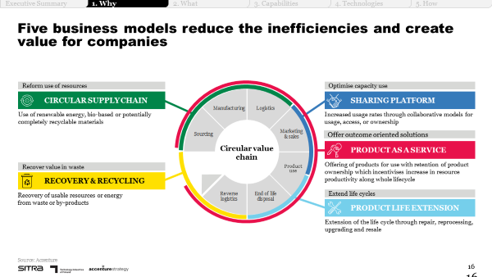
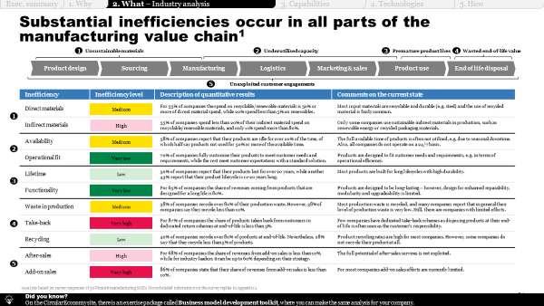
Business model development toolkit
INTRODUCTION
Purpose
The business model development toolkit consists of a set of exercises that support you in identifying inefficiencies and customer pain points, assessing relevance of circular business models, and prioritising them for development.
By completing the exercises, you should have a high-level idea of the most promising circular business model(s) for your company.
Illustration of the tool
Instructions
Assess the current occurrence of the five inefficiencies of the linear model for your company (Reflection 1)
Reflect on your customers and think about their key pain points (Reflection 2)
Go through the circular business model sub-models, reflect on their current level of application in your company, and their potential (Reflection 3).
List potential circular business opportunities based on the reflections you have made on the inefficiencies, customer pain points and circular business model potential, and concretise the value proposition and key value levers for top 3 opportunities (Exercise 1).
Finally, select 1-2 opportunities to explore further and continue their evaluation with the value case tool and the business model canvas.
Supporting materials
Chapter 1:
Why circular economy?
Chapter 2:
What opportunities exist?
Five inefficiencies in the linear model
Circular business models & sub-models
Inefficiency analysis
Illustrative playbook pages – please refer to the entire chapter for support.

Slide 3
BUSINESS MODEL DEVELOPMENT TOOLKIT
Tool

Slide 4
Business model development toolkit
TOOL
Tool
Access the business model development toolkit by double-clicking on the icon below.

