Slide 1
CULTURE GAP ANALYSIS
Introduction

Slide 2
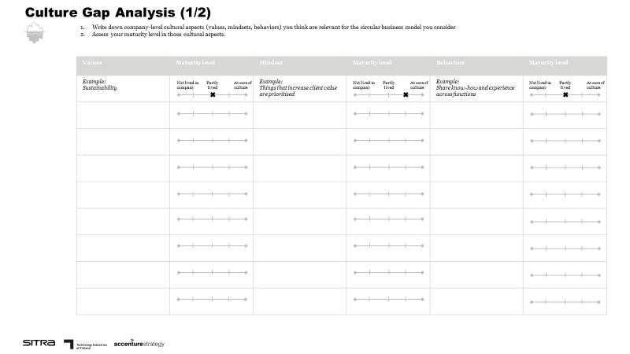
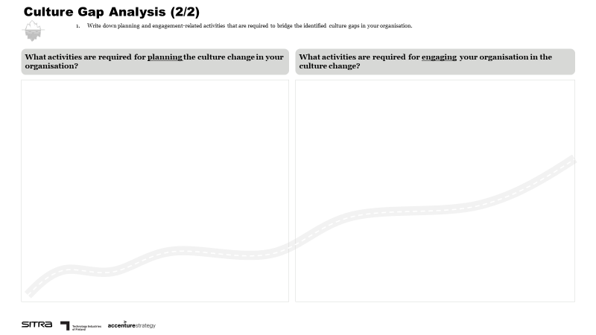
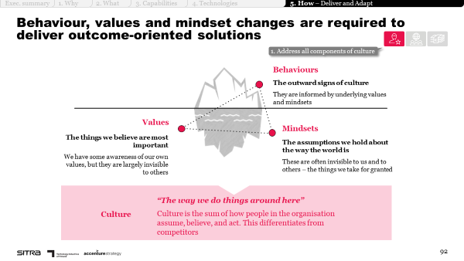
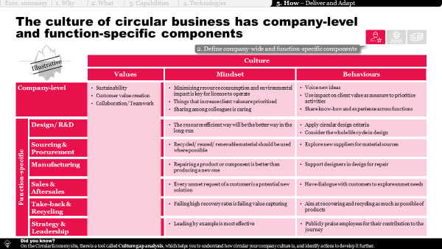
Culture gap analysis
INTRODUCTION
Purpose
The culture gap analysis tool supports you in analysing how your current company culture supports the adoption of circular business models, and in identifying activities to bridge identified culture gaps.
Illustration of the tool
Instructions
Write down company-level cultural aspects (values, mindsets, behaviours) you think are relevant for the circular business model you consider
Assess your maturity level in those cultural aspects
Summarise key planning and engagement-related activities that are required to bridge the identified culture gaps in your organisation
Supporting materials
Chapter 5: How to design the transformation journey?
Key building blocks of culture
Examples of cultural aspects supporting circularity
Illustrative playbook pages – please refer to the entire chapter for support.

Slide 3
Culture gap analysis
EXAMPLE
Example
Example value:
Customer-centricity
Example behaviour:
Apply circular design criteria
Example mindset:
Repairing a product or component is better than producing a new one
Example planning-related activities:
Identify change management lead/champion
Develop future-state vision of company culture
Plan culture change programme, including key activities and milestones
Example engagement-related activities:
Start internal communications around change programme
Organise kick-off event
Conduct regular status update sessions
Develop supporting incentives

Slide 4
CULTURE GAP ANALYSIS
Tool

Slide 5
Culture Gap Analysis (1/2)
Write down company-level cultural aspects (values, mindsets, behaviours) you think are relevant for the circular business model you consider
Assess your maturity level in those cultural aspects.
Values | Maturity level | Mindset | Maturity level | Behaviours | Maturity level
Example: Sustainability |  | Example: Things that increase client value are prioritised |  | Example: Share know-how and experience across functions
Not lived in company
Partly lived
At core of culture
Not lived in company
Partly lived
At core of culture
Not lived in company
Partly lived
At core of culture

Slide 6
Culture Gap Analysis (2/2)
Write down planning and engagement-related activities that are required to bridge the identified culture gaps in your organisation.
What activities are required for planning the culture change in your organisation?
What activities are required for engaging your organisation in the culture change?

