Slide 1
FUNDING REQUIREMENT ANALYSIS
Introduction

Slide 2
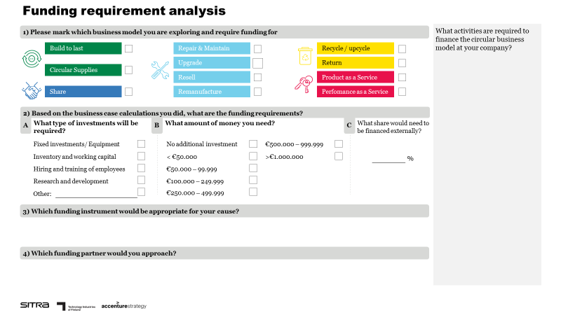
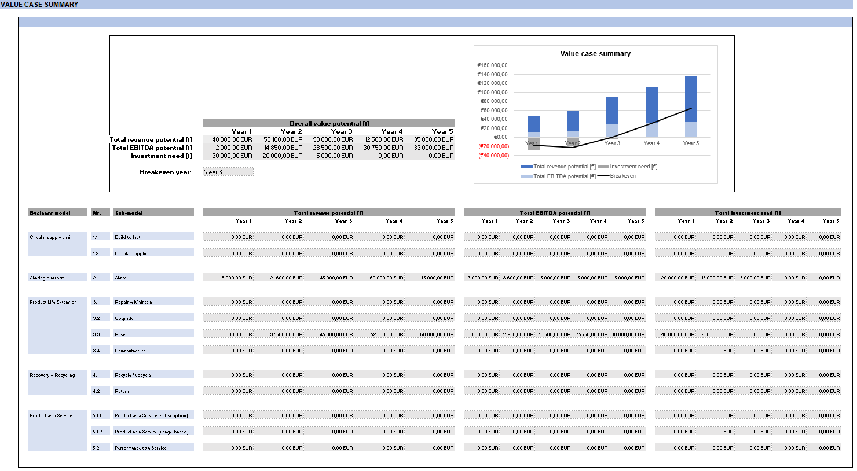
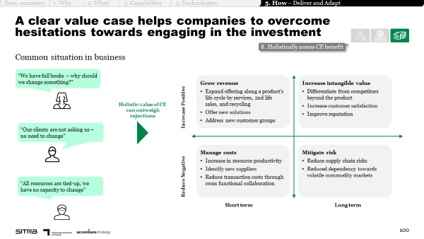
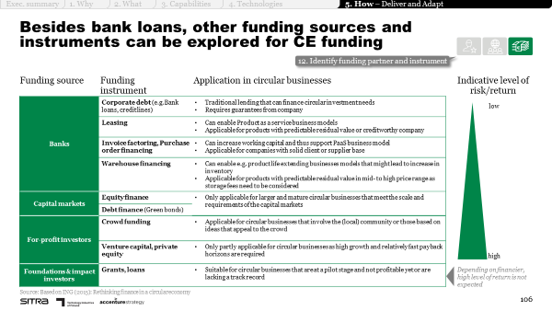
Funding requirement analysis
INTRODUCTION
Purpose
The funding requirement analysis tool helps you to reflect on the funding requirements of your circular business idea, and the activities related to them.
Illustration of the tool
Instructions
Mark the business model you are considering to implement
Reflect on
a) The type of investments required
b) The amount of investments needed
c) The share of external financing required
Describe the appropriate funding instrument for your cause
Identify the funding partner(s) you could approach for funding
List activities required to finance the circular business model at your company
Supporting materials
Chapter 5: How to design the transformation journey?
Value case tool
Calculate high-level business case to underdtand funding requirements
Key barriers related to financing circular models and ways to overcome them
Illustrative playbook pages – please refer to the entire chapter for support.

Slide 3
Funding requirement analysis
EXAMPLE
Example
Finalise business case calculations to understand funding need
Apply for funding from Business Finland
50
Research grant
Business Finland

Slide 4
FUNDING REQUIREMENT ANALYSIS
Tool

Slide 5
Funding requirement analysis
1) Please mark which business model you are exploring and require funding for
What activities are required to finance the circular business model at your company?
Build to last
Repair & Maintain
Recycle / upcycle
Upgrade
Return
Circular Supplies
Resell
Product as a Service
Share
Remanufacture
Perfomance as a Service
2) Based on the business case calculations you did, what are the funding requirements?
A
What type of investments will be required?
B
What amount of money you need?
C
What share would need to be financed externally?
Fixed investments/ Equipment
No additional investment
€500.000 – 999.999
Inventory and working capital
< €50.000
>€1.000.000
%
Hiring and training of employees
€50.000 – 99.999
Research and development
€100.000 – 249.999
Other:
€250.000 – 499.999
3) Which funding instrument would be appropriate for your cause?
4) Which funding partner would you approach?

