Slide 1
ROADMAP DEVELOPMENT
Introduction

Slide 2
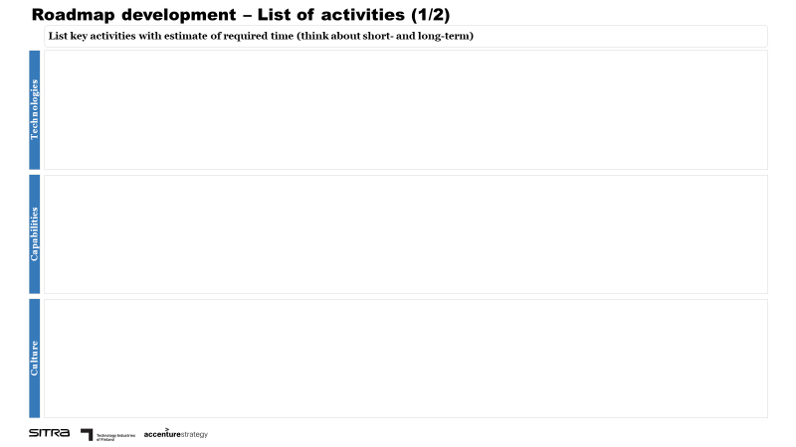
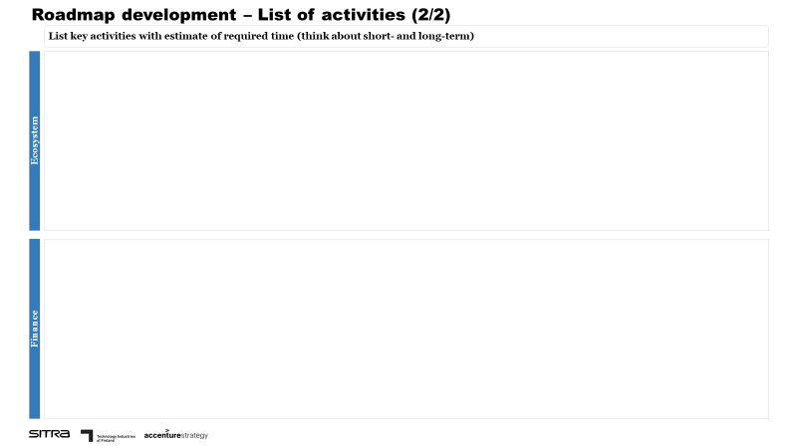
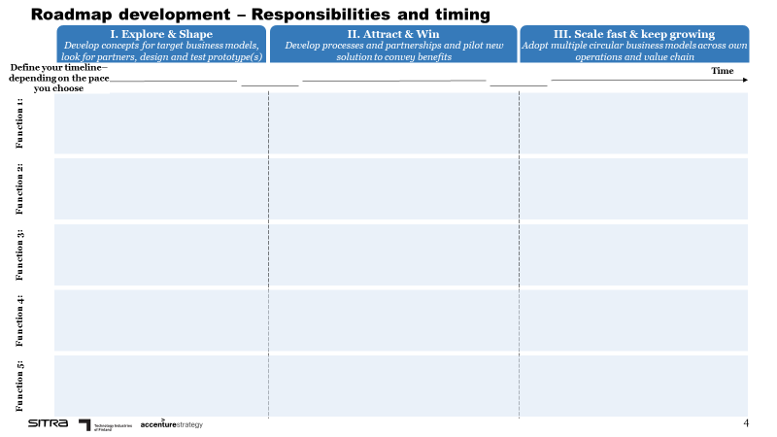
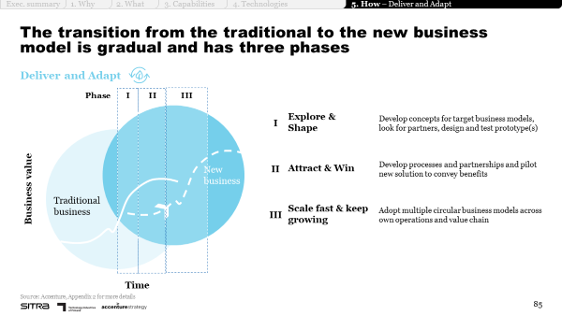
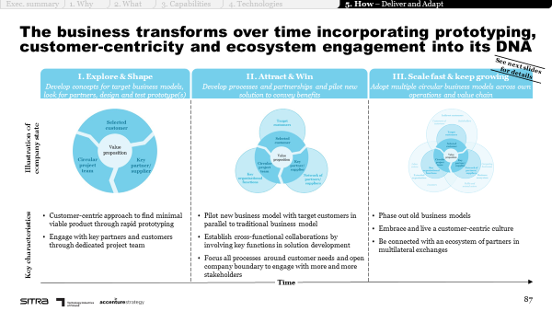
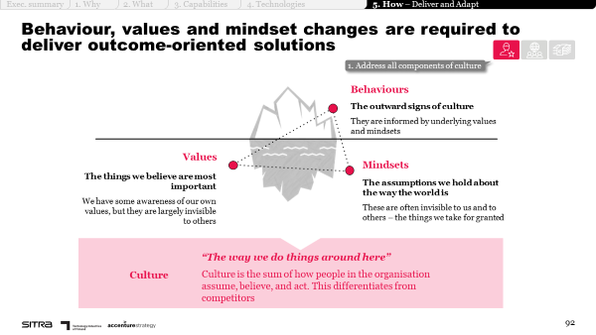
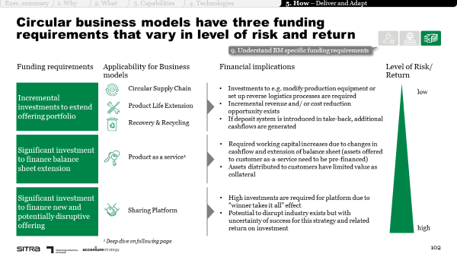
Roadmap development
INTRODUCTION
Purpose
The purpose of the roadmap development tool is to support you in planning the first steps on your circular transformation journey on a high-level, through listing key activities, estimating the time to complete them and prioritising them into short, medium and long-term.
Illustration of the tool
Instructions
Summarise key activities required in terms of technologies, capabilities, culture, ecosystem and finance based on your earlier assessments to the ‘List of activities’ sheet.
Write key functions contributing to the implementation of your circular idea to the ‘Responsibilities and timing’ sheet
Define a timeline for your transformation journey
Define responsible functions (and if possible, name people to approach) and appropriate phase for each activity
Tip: Use sticky notes to list the activities – it saves time and allows flexibility!
Supporting materials
Chapter 5:
How to design the transformation journey?
Three phases of the transformation journey
Key barriers and ways to overcome them
Illustrative playbook pages – please refer to the entire chapter for support.

Slide 3
Roadmap development
EXAMPLE
Example
Roadmap development – Responsibilities and timing
Define your time line– depending on the pace you chose
I. Explore & Shape
II. Attract & Win
III. Scale fast & keep growing
Develop concepts for target business models, look for partners, design and test prototype(s)
Develop processes and partnerships and pilot new solution to convey benefits
Adopt multiple circular business models across own operations and value chain
6 months
12 months
Time
__________
__________
Function 1:
Design + R&D
Develop circular design criteria and guide
Collect and map customer needs & pain points (input from sales)
Design and test prototype with customers in workshops
Develop final product concept based on customer input
Start designing service concept for new product
Scale modular design for other product categories
Finalise and validate service concept with customers
Develop final service concept based on customer input
Illustrative example for Build to last business model with consecutive development of Repair & Maintain
Function 2:
Sourcing & Procurement
Screen and assess new material suppliers
Establish supplier agreements
Perform supplier assessment
Engage with supplier to trigger changes
Change supplier base/ deselect supplier as required
Reassess suppliers
Implement continuous supplier scoring and engagement
Function 3:
Manufacturing
Assess required changes in production
Screen and assess potential technology providers
Implement required changes in production
Prepare scale up of production
Implement required changes in production
Function 4:
Marketing & Sales
Develop pricing models for new modular offering
Participate in sales training on modular product sales
Prepare pilot launch activities
Promote pilot offering
Develop pricing models for new modular offerings
Screen technology partners for service concept
Promote new modular offerings
Develop pricing models for new service offerings
Participate in training on service sales
Prepare service launch activities
Promote new service offering
Function 5:
Leadership
Communicate transformation kick-off and define targets and incentives
Select pilot product(s)
Secure funding: contact bank to get credit
Organise training on modular product sales
Approve launch of pilot
Hire new staff
Monitor pilot results and decide on next steps
Launch new modular product categories
Organise training on service sales
Hire new staff for service sales
Launch service concept

Slide 4
ROADMAP DEVELOPMENT
Tool

Slide 5
Roadmap development – List of activities (1/2)
List key activities with estimate of required time (think about short- and long-term)
Technologies
Capabilities
Culture

Slide 6
Roadmap development – List of activities (2/2)
List key activities with estimate of required time (think about short- and long-term)
Ecosystem
Finance

Slide 7
Roadmap development – Responsibilities and timing
I. Explore & Shape
II. Attract & Win
III. Scale fast & keep growing
Define your timeline– depending on the pace you choose
Develop concepts for target business models, look for partners, design and test prototype(s)
Develop processes and partnerships and pilot new solution to convey benefits
Adopt multiple circular business models across own operations and value chain
Time
__________
__________
Function 1:
Function 2:
Function 3:
Function 4:
Function 5:

