Slide 1
VALUE CASE TOOL
User guide

Slide 2
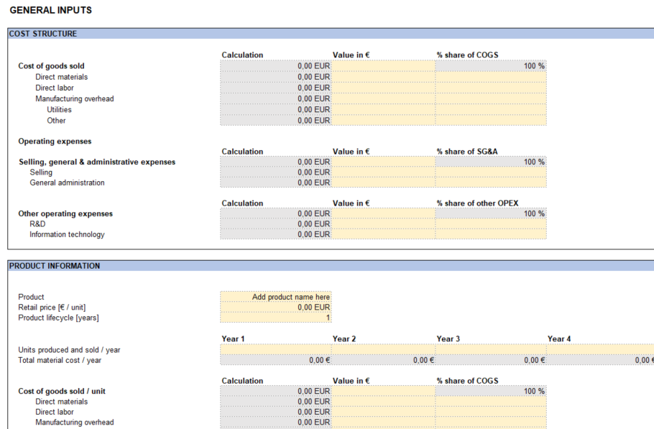
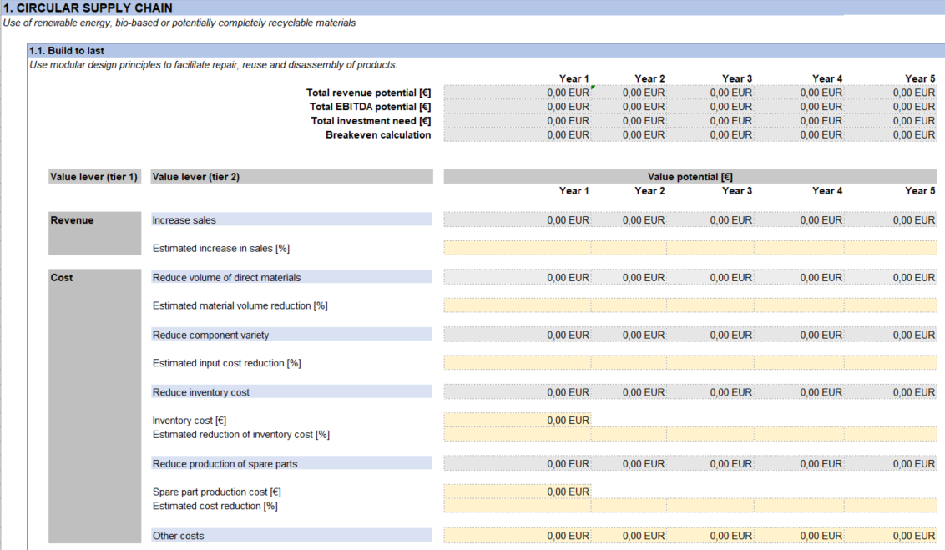
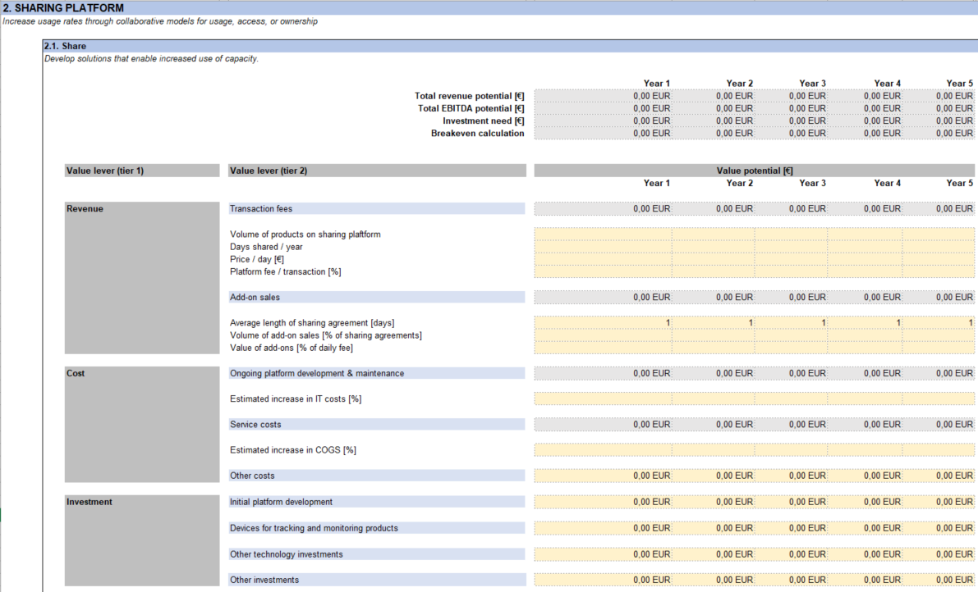
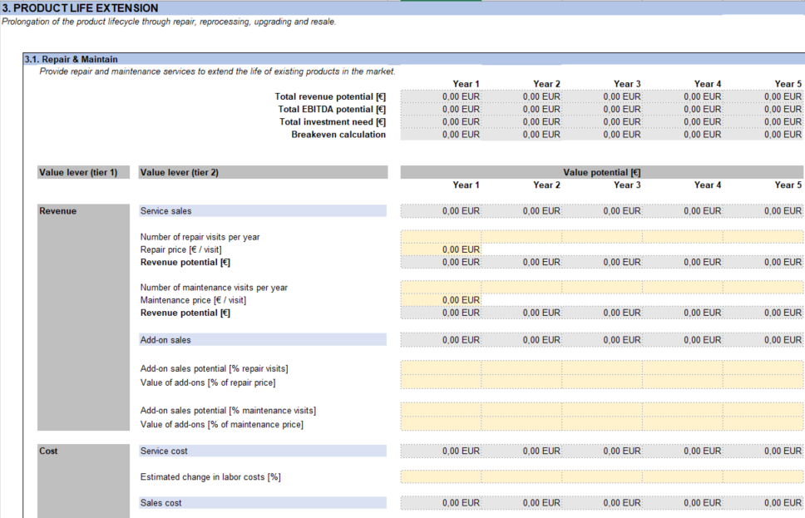
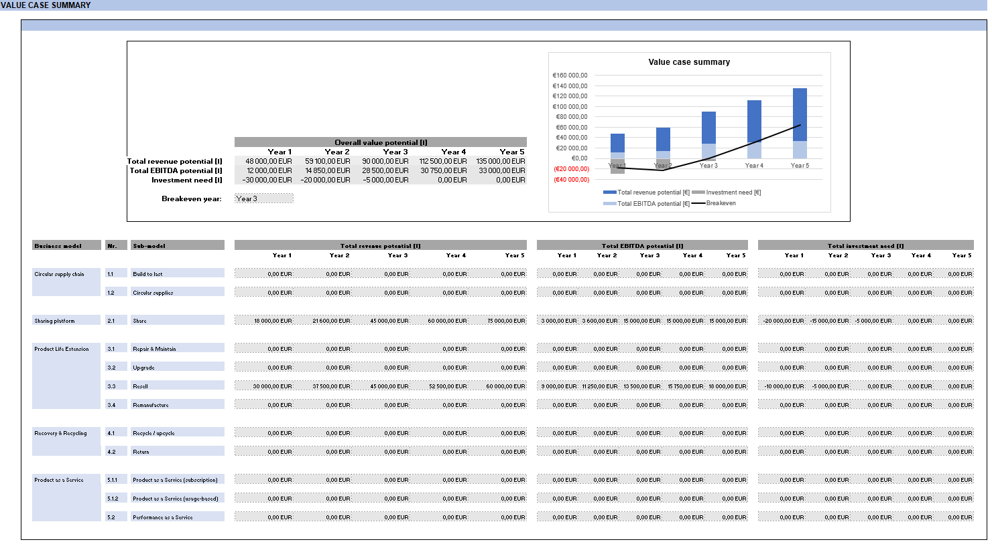
Introduction
Introduction
Value case summary
General inputs
Business model inputs
The purpose of the value case tool is to give you a high-level understanding of the value potential of circular economy business models for your company.
In other words, it is not a comprehensive business case tool, but rather a tool to help you
understand the value levers of circular business models and their sub-models
estimate revenue potential, cost impact and investment need for your company through simple calculations
identify the most promising circular business models from a financial perspective
Please note that the tool should be used only for one product, meaning that you should create a separate copy of the Excel file for each product you want to assess.
How it works
Enter your company data in the ’General inputs’ sheet.
1
Enter data on the business model specific tabs for the sub-models that you have identified as relevant for your company.
2
Review overall value potential in the ’Value case summary’ sheet.
3

Slide 3
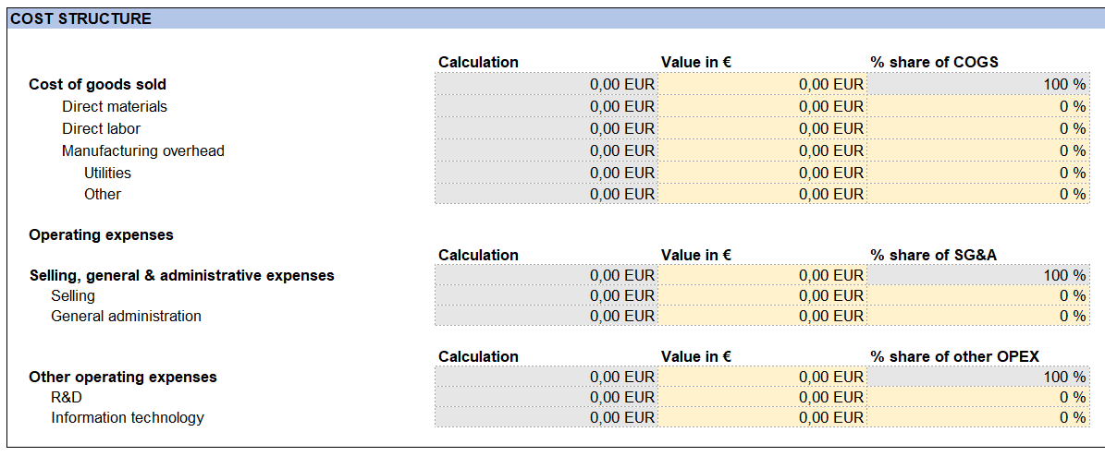
General inputs
Introduction
Value case summary
General inputs
Business model inputs
Before starting the business model specific calculations, enter generic cost and product-related data on the ’General inputs’ sheet. All figures should be added for the latest financial year you have data for (=Year 0).
These values should be on overall company level
Enter value either in € or as a share [%] of the overall figure (COGS, SG&A, other OPEX)
These values should be on product level
Enter value either in € or as a share [%] of COGS
These values should be on overall company level

Slide 4
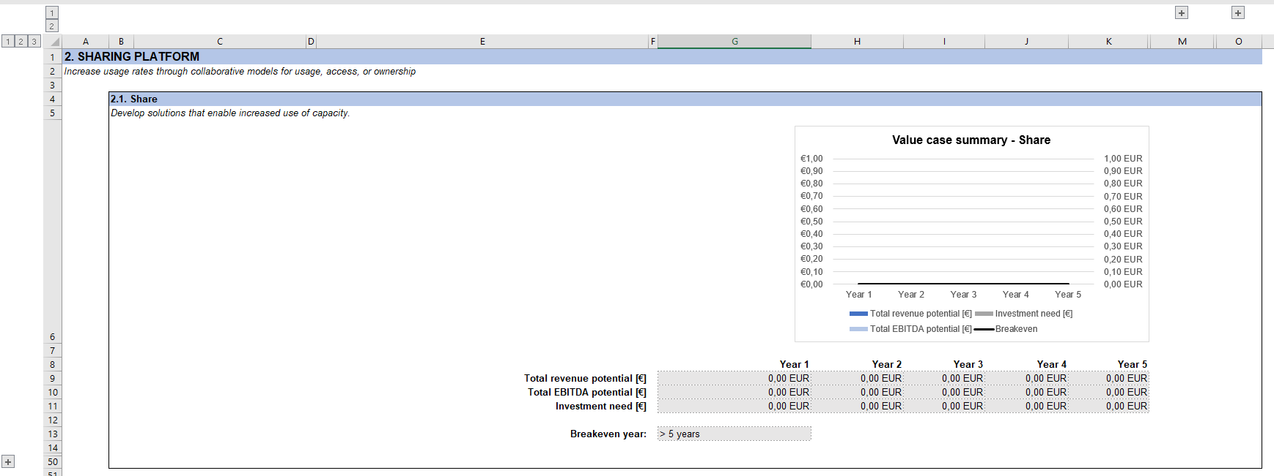
Business model inputs
Introduction
Value case summary
General inputs
Business model inputs
After you have filled in the general inputs, start entering data in the business model specific sheets for those sub-models that you have identified as most relevant for your company.
When you open a business model specific sheet, you will first see a summary view of the calculations. To view more information, press the [+] signs at the top and left side of the sheet.
View more information on the calculation parameters.
View calculation formulas.
View value levers and cells for calculation input data.

Slide 5
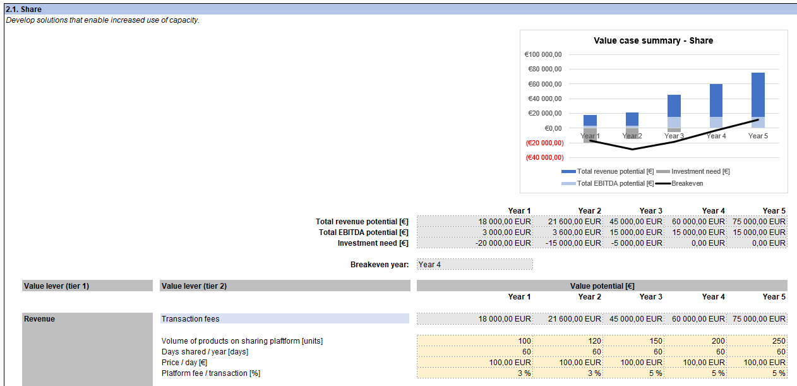
Business model inputs
Introduction
Value case summary
General inputs
Business model inputs
Enter data for calculations in the yellow cells below each value lever. If you feel that some value lever is not relevant for your company, you can leave the row empty.
Your calculations are immediately reflected in the sub-model specific summary section.
If you want, you can either keep the values constant or change them over time.

Slide 6
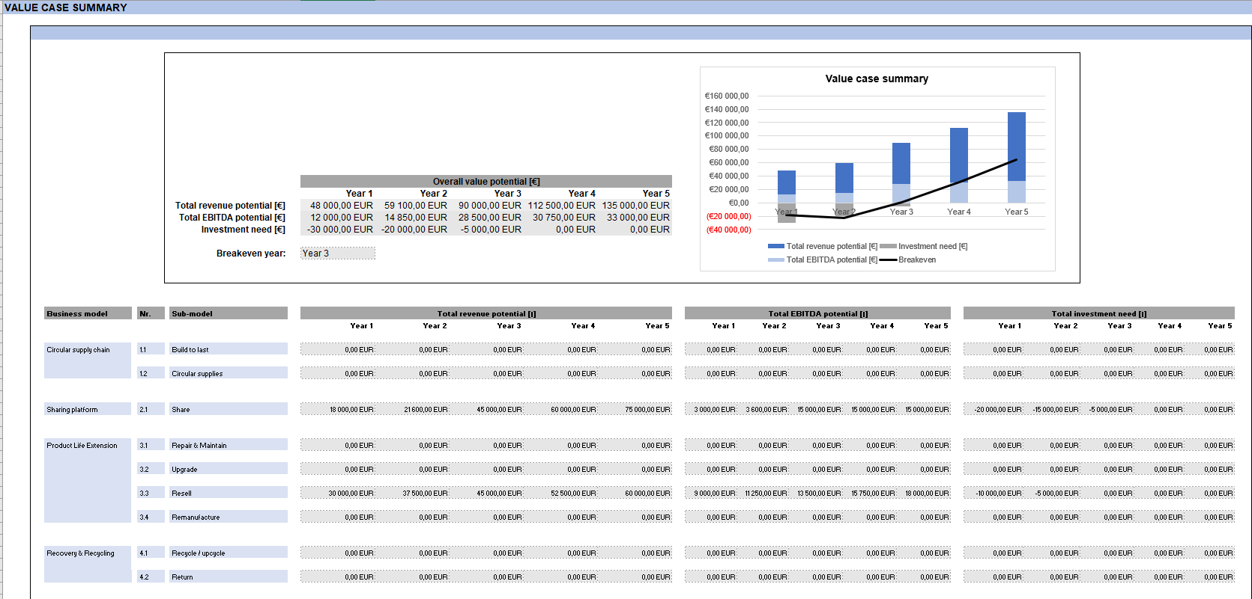
Value case summary
Introduction
Value case summary
General inputs
Business model inputs
When you have completed calculations for all relevant sub-models, you can view a summary of the overall value potential in the ’Value case summary’ sheet.
Summary of overall value potential, including all sub-models
Total revenue and EBITDA potential, and investment need for each sub-model

