Slide 1
Chips from the North
Semiconductor Strategy for Finland

Slide 2

2024
2035
Chips from the North: Semiconductor Strategy for Finland
€1,6B industry revenue
€5B to €6B in industry revenue
90 companies across value chain
Finland’s six growth opportunities
€90B to €180B indirect value
7.000 direct employees
20.000 direct employees
Leading positions
in Europe
Leading talent and startup clusters
Competitive advantages
Enabling outcomes
Materials
Societal predictability and infrastructure
1
Advanced materials
Industry-academia-public collaboration
Effective collaboration structures and resources
Mobile network expertise
Equipment
2
Process technologies
Photonic
technologies
5
Competitive R&D ecosystem
System chip design
Joint R&D funding of €5B over ten years
Design
3
Chips design
Quantum
technologies
Over 15.000 new employees
Sensors and MEMS
6
Elevated education output and talent attraction
Fabrication
Process and material technologies
MEMS and sensors
New established R&D and design centers
4
Promotion of talent, startup and technology clusters
Photonic technologies
Assembly
Over €1B manufacturing site investments
Quantum technologies
Public-private collaboration and public instruments

Slide 3
Chips from the North – Semiconductor Strategy for Finland report is an industry-led effort to commit to identified growth opportunities and actions
Why was the growth strategy developed?
How was the strategy developed?
Objectives of the strategy work:
Commit semiconductor industry and stakeholders to common goals
Create a strong and sustainable network for industry and stakeholder collaboration in implementing the strategy
Convince international investors and experts of the opportunities and ambition within the Finnish semiconductor industry and ecosystem
Persuade national decision-makers of the sector's opportunities and ambitions and provide goals and measures to key parties.
Semiconductors are the basis of society's essential devices, from smartphones to computers, and from health technology to energy systems. Without innovations in semiconductors, many societal goals (such as those related to the environment, artificial intelligence, and automation) cannot be achieved
The significance of the sector to the economy and national security is substantial, which is why many countries (and regions) have sought to strengthen their semiconductor sectors by creating national strategies and supporting measures
Finland can be a significant player in the semiconductor industry by leveraging its strong expertise and increasing collaboration within Europe. This requires Finland to invest in education, collaboration, attractiveness, and innovation infrastructure
The strategy was industry-led – over 200 industry experts had the opportunity to influence the strategy through various methods:
Survey (~100 responses): A survey focusing on Finland's strengths, opportunities, and support pillars, covering representatives from companies, academics, organizations, public institutions, and investors
Interviews (20-30 interviews): Selected interviews to map out Finland's strengths and growth opportunities
Focus group discussions (+25 participants in four discussions): Discussions on Finland's growth opportunities and actions related to the workforce and educations, geopolitics, and collaboration
Strategy and industry group meetings (11-30 participants): Alignment of growth opportunities and actions
Additionally, the report utilized numerous different sources, including the "Microelectronics in Finland" report by academics and the results of TIF's APR workshop in 2022

Slide 4

Global opportunities in semiconductors
Finland as part of the global industry
Agenda
Finland’s six growth opportunities
What can government and industry do
4

Slide 5
Growth opportunities in semiconductors

Slide 6
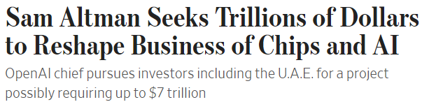
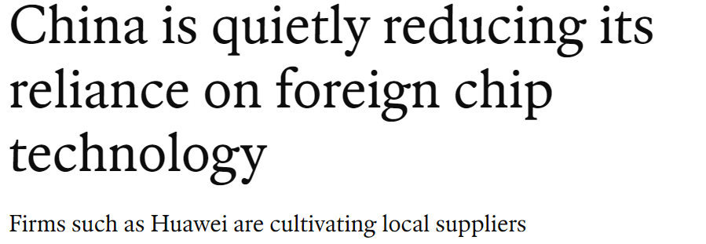
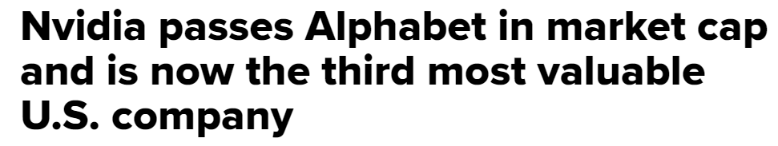
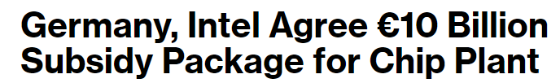
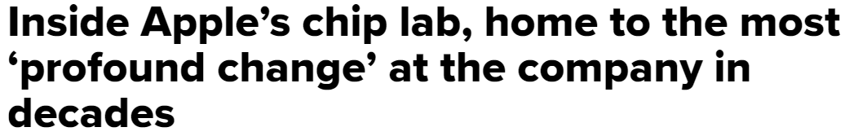
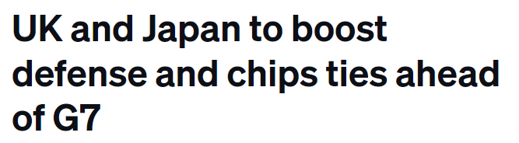
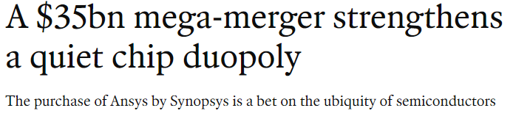
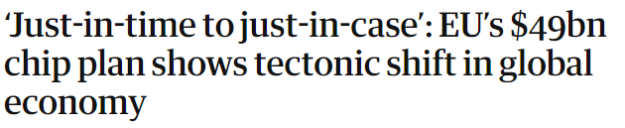

The semiconductor industry has outperformed the general economy over the past 10 years, with interest and importance set to increase
The PHLX Semiconductor Index¹ has grown ~6x, compared to the S&P 500's 2x, since 2013
Interest in semiconductors continues to increase, with significant attention from governments and businesses
Daily prices indexed, between 2013 and 2023 (2013 = 100)
Indexed price
800
PHLX
600
400
200
S&P 500
0
2014
2016
2018
2020
2022
2024
1. Tracks largest 30 companies involved in semiconductor production and equipment
Source: NYSE and NASDAQ price data, Capital IQ, BCG

Slide 7
The semiconductor industry offers numerous growth opportunities: Slowing Moore's Law spurs innovation and demand increases across sectors
Continuous demand for improved performance drives need for continuous semiconductor innovations
The demand for semiconductors is growing across end-users
Maintaining Moore's Law¹ is becoming increasingly difficult and costly due to physical and size limitations. The importance of alternative performance improvements is being highlighted by the limitations of Moore's Law:
"Beyond Moore" refers to technologies that are not related to the scaling of transistors but rather develop computing power through innovations such as quantum technology or neuromorphic computing
"More Than Moore" (MtM) refers to the diversification of the functionality of integrated circuits, for example, through new materials and components (such as MEMS, photonics). MtM devices are designed for various industries, including automotive, telecommunications, entertainment, and energy
Semiconductor demand by end-use sector
(€Billion)
CAGR
2022-2030
1,000
933
900
7%
84
Consumer
electronics
4%
800
137
9%
714
711
Industrial
700
668
70
70
600
586
68
95
157
Automotive
12%
556
558
64
87
102
Moore's Law: Number of transistors in chips has doubled every two years
500
63
62
496
107
61
69
55
78
97
114
100 Billion
400
51
63
69
83
269
Communication
9%
300
74
198
210
206
1 Billion
178
179
176
200
145
1 Million
286
Data
processing
9%
100
204
185
153
185
218
232
219
1 Thousand
1980
1990
2000
2010
2020
0
2021
2022
2023E
2024E
2025E
2026E
2027E
2030E
Technology Industries of Finland

Slide 8
Increasing demand visible in the semiconductor industry market (€560 billion in 2022) growth projections across different device/end-use segments
Circle size = 2022 revenue
DEVICES
 | Logic €210B 6% CAGR | Memory €135B 7% CAGR | Discrete, Analog, Other €215B 7% CAGR
Data processing (compute, storage) €185B 6% CAGR
Communications Incl. smartphones €180B 4% CAGR
Automotive €65B 12% CAGR
Industrial Incl. healthcare, military €70B 9% CAGR
Consumer €60B 4% CAGR
CAGR, 2022-30
1-5%
Moderately¹ concentrated market (HHI Index 1000-1800)
Highly¹ concentrated market (HHI Index 2300)
Unconcentrated¹ market (HHI Index <1000)
5-10%
+10%
Use case drivers: Datacenters, edge computing
Technological drivers: AI chips, SoCs, chiplets, advanced packaging, quantum tech, photonic chips
Big data analytics, high performance computing,
Energy efficient, fast and scalable new memory technologies, advanced packaging (e.g., 3D stacking)
Power management for data centers, environmental monitoring sensors, discrete components
High-efficiency power components, specialized sensors (e.g., MEMS)
USERS
€90B
€65B
€30B
Smartphones, 5G/6G infrastructure (base stations, network processors), satellite communication
SoCs, low-power chips, photonics, high-speed signal processing
Smartphones, high-speed network equipment, 5G.
Advanced materials, low-latency, energy-efficient design
IoT, enhanced wireless comms bandwidth, signal processing, communication infrastructure.
RF components, analog, power amplifiers, and mixers
€50B
€45B
€85B
Autonomous vehicles (e.g., ADAS, LiDAR systems), electric vehicles (e.g., battery management systems)
Automotive SoCs, chiplets, AI chips, low-latency, photonic interconnections (high data outputs)
Infotainment systems, control units, storage for AI and sensor data
High-performance reliable memory
Autonomous and electric vehicles
Imaging, power mgmt., compound materials, analog ICs, photonics
€20B
€5B
€35B
Robotics, automation, surveillance systems, secure communications
Low-energy SoCs, chiplets, AI chips, advanced packaging
Control systems, military computing, solutions for harsh conditions.
High-endurance storage
Automation, robotics, military, security, healthcare equipment
High-precision analog devices, high-reliability discrete components, power semiconductors, MEMS sensors, optoelectronics
€20B
€5B
€45B
Smart home devices, wearables, personal electronics, extended reality (XR, VR, AR)
Low-power SoCs, advanced packaging, integrated connectivity, user interface enhancements
Media storage, consumer electronics, gaming
Non-volatile memory, fast and high-capacity memory, multi-tasking
Home entertainment, personal electronics, XR, VR and AR
Low-cost sensors, advanced photonics and optoelectronics solutions for displays and interfaces
€25B
€15B
€25B

Slide 9
Changing demand drives evolutions across the highly fragmented semiconductor value chain create additional opportunities for plays
Design
Fabrication
Assembly, testing,
and packaging
Distribution
Design (fabless)
€170B, 6% CAGR
Foundries
€120B, 7% CAGR
OSAT
€45B, 6% CAGR
Distributors
€205B, 7% CAGR
  Increased service outsourcing
  OEM in-sourcing of chip design
  Lower barriers for entry due to AI
  Geopolitics drive capacity expansion
  Partnerships with OEMs
  Rising costs favor larger foundries
  Advanced packaging methods
  Foundries and IDMs entering
  Complexity of testing increasing
  Efficient distribution drives growth
  Development and evolution in service and commerce platforms
  Fabless-foundry model dominant for leading edge chips, only few large IDMs remain on the market
  IDMs increasingly offer IoT security and PaaS services
IDMs
€370B, -
EDA & IP
€20B, 9% CAGR
Material suppliers
€65B, 5% CAGR
Equipment suppliers
€100B, 8% CAGR
Second-highest R&D spend per revenue compared with other industries
  AI enhances EDA tooling
  High performance demands
  Novel material innovations
  Compound semiconductors
  Manufacturing capacity expansion globally drives demand growth
  Advances in processes equipment
R&D: Universities and research institutions
Technology Industries of Finland

Slide 10







Governments globally are focusing on strategic technology autonomy in semiconductors due to security concerns and economic growth potential
EU Chips Act aims to increase self-reliance on chips by mobilizing €43 billion in investments
Countries around the world support their domestic semiconductor industry through varying strategies
The main goal of the EU Chips Act is to improve the EU's self-reliance by increasing the union's global semiconductor market share from 9% to 20% by 2030. The Act is based on three pillars: the Chips for Europe Initiative, a framework for supply security, and a mechanism for crisis management. The EU aims to mobilize €43 billion in public and private investments through the regulation.
Examples of economies' actions
PERTE Chip strategy allocates €12 billion by 2027 into the industry, focusing on chip design, quantum chips, and photonics
Chips for Europe Initiative: Aims to facilitate and accelerate the industrial utilization of R&D activities in the sector by increasing pilot lines and design platforms, and by supporting startups and SMEs, among other measures
Supply Security: Attracts manufacturing investments and capacity increases by using subsidies and simplifying licensing processes
Crisis Management: Strengthens cooperation in monitoring and managing crises in the semiconductor sector through early warning indicators and crisis measures.
Electronique 2030 strategy allocates approximately €5 billion into the industry, focusing on production, R&D activities, and education
No national strategy, but have supported an Intel factory with €10 billion and other factories and design centers with over €6 billion
National strategy allocates £1 billion by 2034 int to the industry focusing on chip design and materials (especially compound semiconductors).
Released the CHIPS Act (€52 billion) and the Inflation Reduction Act (€71 billion), focusing on supporting advanced semiconductor manufacturing capacity
"Chips are essential for our green and digital transitions, and for our economies. Our economy would not function without chips ... We need to promote the design, testing and production here in Europe. For that, the Chips Act is a game changer."
Approximately €75 billion 'Electronics Fund,' of which about 70% is focused on supporting semiconductor manufacturing facilities. However, it is uncertain how much money is actually invested
- Ursula von der Leyen, President of the European Commission

Slide 11
Finland as part of the global industry

Slide 12
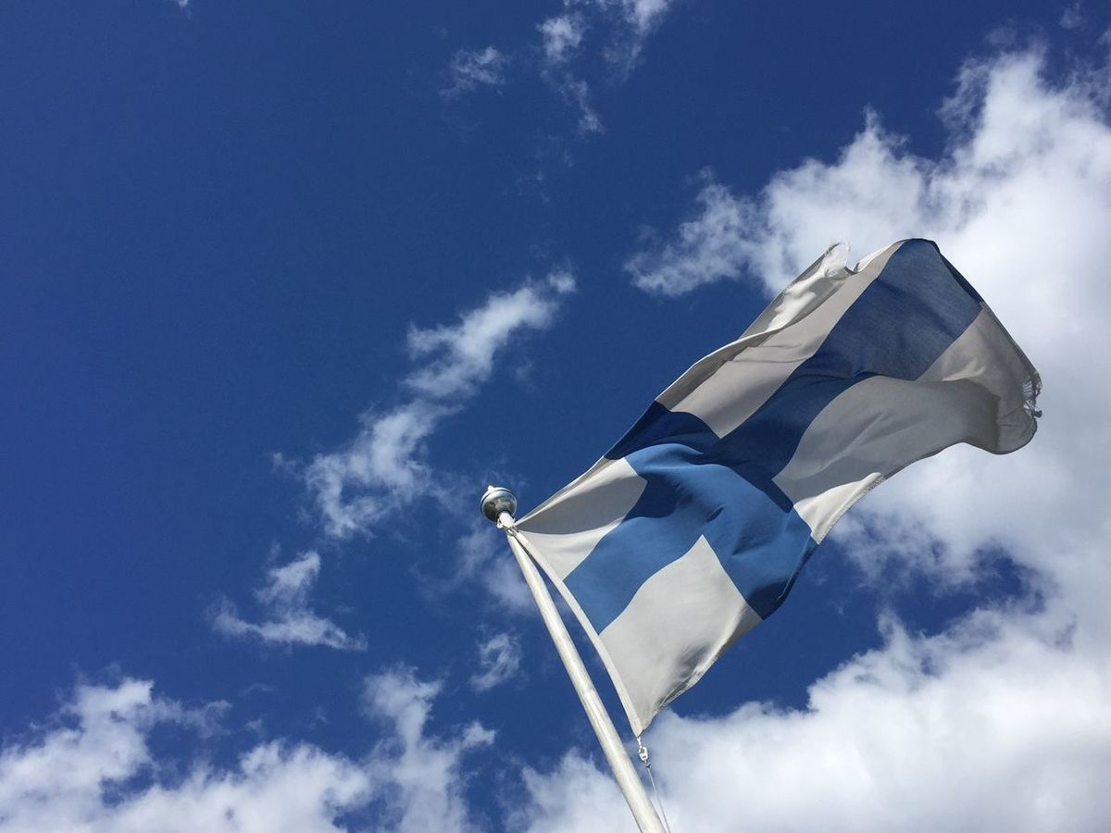















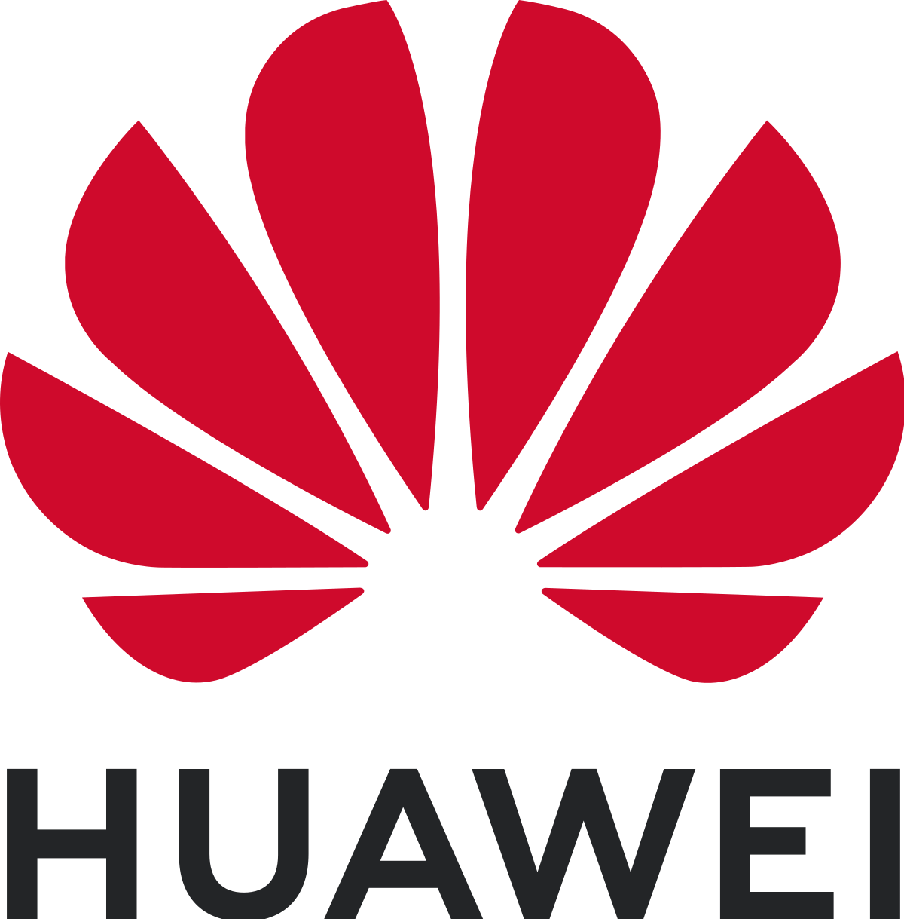





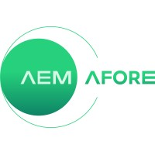
















Finnish semiconductor industry in numbers
excl. Nokia and Microsoft
Finland is strong in specific semiconductor segments, supported by research, education, and infrastructure
Finnish semiconductor industry companies, products and employees
€1,6B revenues
Finnish semiconductor industry total revenue in 2022
Companies in the industry are mostly IDMs¹, Fabless, Equipment, and Material suppliers
Approx. 45% (€700M) of revenue comes from ASICs, ~30% (€500M) of revenue from MEMS and sensors, and ~25% (€400M) of revenue comes from optoelectronics and photonics
Companies in the industry primarily supply to end-users in telecommunications, industrial automation, healthcare, and automotive sectors
Foreign companies have targeted Finnish expertise and technologies, either through acquisitions (e.g., Picosun by Applied Materials, Minima by Bosch) or by establishing offices in Finland (e.g., Huawei, MediaTek)
90 companies
The industry is comprised of roughly 90 companies of which ~60% are SMEs²
7.000 employees
The industry directly employs almost 7000 professionals
Example of companies operating in semiconductor industry in Finland
Finnish semiconductor industry is spread out over regions
The Helsinki region is strong in ALD, quantum, sensors, RF, materials, in addition to significant research infrastructure (1100M€ in revenues, ~4500 employees)
The Oulu region's expertise is focused on communications technologies, driven by the historical position of Nokia (250M€ in revenues, ~1500 employees)
The Tampere region has strong presence of chip design and photonics expertise (150M€ in revenues, ~500 employees)
The Turku region hosts a medical technology cluster, and accompanying imaging expertise (50M€ in revenues, ~200 employees)
The Joensuu region is home to a photonics hub (10M€ in revenues, ~100 employees)
Research institutions support world-class semiconductor innovation
Finland is home to multiple renowned research institutions (universities, research centers) dedicated to advancing semiconductor technology
Universities offer specialized semiconductor programs directly aligned with the needs of the industry, ensuring a supply of skilled professionals (though the quantity should be increased)
Driven by high-quality research and education, Finland is a pioneer in many critical innovations, such as mobile networks and ALD
Example of research institutions (universities, research centers) in semiconductor field in Finland
1. IDM = Integrated Design Manufacturer 2. SME = Defined as companies that employ less than 250 persons and has annual revenues below 50M€. Companies which fulfill the criteria in Finland, but are subsidiaries of larger companies which don't full the criteria are not counted (e.g., Nvidia, ASM Microchemistry, etc.)
Source: Statistics Finland, BCG

Slide 13

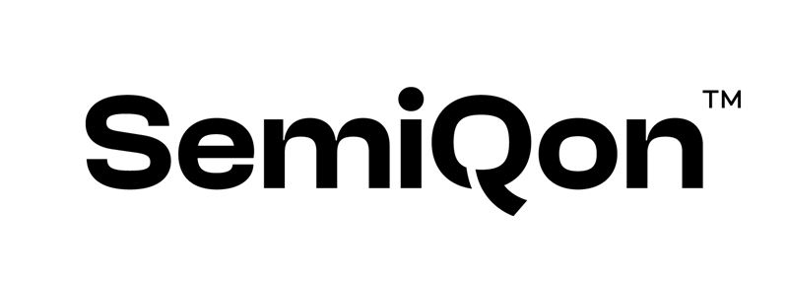



























Finland's semiconductor industry is spread over regions, with clusters situated around universities
Example companies in Finland
 | Networks
 | R&D and design
 | Sensors and MEMS
 | MEMS
 | Networks
 | Cryogenic equipment
 | Silicon wafers
 | X-ray detectors
 | ALD
 | Wireless connectivity
 | Testing equipment
 | ALD
 | Optronic solutions
 | IC design
 | Sensors
 | SW, RF circuits
 | Quantum processors
 | Wireless connectivity
 | SoC software
 | Lasers and optics
 | Power, climate and drives
 | XR waveguides
 | PCBs
 | ALD
 | Analog, power and wireless
 | Quantum computers
 | Nanomaterials
 | Nanomaterials
Companies' turnover: Number of companies and employees (2022)
Excl. Nokia and Microsoft revenue and employee figures
Oulu region
€260M
14 companies
1400 employees
Wireless and sensor cluster
Supercomputer
Joensuu region
€10M
5 companies
90 employees
Photonics cluster
Tampere region
€130M
17 companies
550 employees
Chip R&D and design hub
Capital region
^{(Helsinki, Espoo, Vantaa)}
€1130M
43 companies
4400 employees
Broad research and expertise cluster
Turku region
€45M
9 companies
200 employees
Medical cluster

Slide 14
Finnish semiconductor industry generates €1.6B in annual revenues with revenue coming mainly from MEMS and sensors, optoelectronics and wireless
Companies' turnover in Finland 2022, Global market size and growth 2022-2030
 | Logic €85M €210B, 6% CAGR | MEMS & Sensors €515M MEMS: €12B, 8% CAGR | Optoelectronics €365M €34B, 8% CAGR | RF and baseband €425M €19B, 7% CAGR | Other €180M €170B, 5% CAGR | Opportunities
Fabless €360M €170B, 6% CAGR |  |  |  |  |  | Mobile SoC design Edge AI chip design Ultra-low power design Power management RF MEMS components
IDMs €670M €370B |  |  |  |  |  | Mobile network SoC design Edge AI chip design Ultra-low power design Power management RF MEMS components
OSAT €50M €45B, 6% CAGR
Equipment €310M €100B, 8% CAGR |  |  |  |  |  | Atomic layer deposition Flexible microelectronics Sustainable process technologies
Materials €180M €65B, 5% CAGR |  |  |  |  |  | Specialized wafer production Next generation advanced materials
Opportunities |  | Communication, healthcare, automotive RF MEMS components Multifunctional sensors Quantum sensors | Photonic solutions and photonic chips SiP design Photonic-quantum technologies |  | Quantum technology research, design, and fabrication
DEVICES
VALUE CHAIN
Key competences: SoC design
Wireless communications, chips, modems
Analog devices, power management
€15M
€325M
€20M
MEMS and sensors
Imaging, optics, detectors
Quantum technologies
€410M
€240M
€5M
€10M
Testing equipment
€5M
€45M
ALD processes and equipment
Cooling for quantum technologies
ALD processes and equipment
ALD processes, equipment, lasers
€55M
€20M
€70M
€20M
€150M
Photonic materials, nanomaterials
Silicon wafers
Photonic materials
Silicon wafers
€15M
€80M
€10M
€75M
Technology Industries of Finland
Notes:
Deep-dive

Slide 15

































Semiconductor companies in Finland are mostly IDMs, fabless, and equipment players supported by advanced R&D expertise
! Based on company's operational focus in Finland.
Design
Manufacturing
Assembly, testing,
and packaging
Distribution
End users
Fabless
Foundries
OSAT²
Distributors
OEMs
Illustrative
No major pure distributors in Finland
No major pure foundries in Finland
Whilst Finland has domestic OEMs, +95% of semiconductors are exported
Integrated Device Manufacturers (IDMs)
EDA & IP¹
Material suppliers
Equipment suppliers
The semiconductor industry spends the most money on R&D relative to turnover after the pharmaceutical industry
R&D: Universities & other research institutions
Supercomputer
Technology Industries of Finland

Slide 16
The Finnish semiconductor industry has numerous societal and technological competitive advantages supporting long-term growth in semiconductors
Low cost of innovation: Finland has a strong education system, low white-collar labor costs, company-academic collaborations support low cost to innovate
  Survey: White-collar labor costs mentioned as the top one strength in Finland, followed closely by education system and workforce expertise
  Engineers in Finland earn 20-30% less than the average in benchmark countries
Societal stability and predictability: Finland is the most stable country and business environment globally with predictable public policy and services
  Ranked as the world's most stable country and most stable business environment by the Global Innovation Index
Societal
Well-functioning infrastructure: Relatively low risk from natural disasters and moderate climate supports stable electricity production
  Finland's electricity production is stable and less impacted by extreme weather
  90% of electricity generation is carbon neutral, with about 50% coming from renewables
Natural resources: Water richness combined with abundance of land and affordable energy makes an attractive destination for semiconductor fabrication
  Finland is ranked as the world's water-richest country.
  Natural resources cited as strengths by the surveyed industry stakeholders.
Mobile network expertise: Finland has leading expertise in 5G/6G system circuit design and research, attracting global companies.
  Survey: 5G/6G mentioned as #1 technological strength in Finland, vast majority of respondents said industry is best positioned to serve telecommunications sector
  Nokia is the leading provider of network infra and mobile networks in the world
System chip design: Strong competences in SoCs due to Nokia and Tampere ecosystems for 5G and research for 6G, ultra-low power SoC design and AI chips
  Survey: a high share of respondents commented Finland has strong competences in SoCs due to Nokia and the unique SOC hub in Tampere
  Per capita, Finland is 2nd in SoC patents per capita in Europe
Sensors: Finland holds strong EMEA market share in inertial/environmental sensors and specialized wafers for automotive and industrial end uses
  Sensors/MEMS received 2nd most mentions on strengths in the industry survey
  Large leading players, such as Vaisala and Murata, present in country, supported by MEMS and sensoring specific research and education programs
Technological
Photonics and optoelectronics: Finland has one of Europe's most concentrated knowledge base of photonics expertise attracting global companies
  Dense research and company clusters in optical sensing, detectors, imaging, and XR.
  Photonic firms are expected to grow 30% in turnover and 18% in workforce YoY
Process, material technologies: Finland stands out on advanced material and process technology expertise with decades expertise
  Survey: Highlighted that Finland has decades research and business experience in ALD, and additional clear competitive advantages in material niches
  Per capita, top 5 for patents and citations for advanced materials in Europe
Quantum technologies: One of Europe’s densest expertise clusters formed by leading companies, Aalto University, VTT, and other institutions
  Survey: 2nd most mentions in survey question about industry product strengths
  Per capita, 1st in quantum computing related patents and 2nd in citations in Europe
Technology Industries of Finland

Slide 17
The Finnish industry is export-heavy, internationally connected but susceptible to geopolitical tensions with considerable exposure to mainland China
The Finnish industry's direct geographical connections
Survey results^{1:} Share of 'Direct Connection' selections by economy or region
USA (All respondents)
Europe (All respondents)
Asia (All respondents)
Other (All respondents)
USA (Private sector respondents)
Europe (Private sector respondents)
Asia (Private sector respondents)
Other (Private sector respondents)
73%
73%
67%
58%
52%
52%
58%
52%
48%
42%
39%
36%
39%
24%
21%
21%
6%
0%
US
Germany
France
Japan
Nordic
Benelux
South Korea
Taiwan
Austria, Switzerland
China
Italy
Other European countries
Singapore
India
Australia
Other Asian countries
South America
Africa
Other
Middle East
Technology Industries of Finland

Slide 18
Finland’s six growth opportunities

Slide 19
Finland to surpass global market growth, yielding significant job creation and indirect economic impact over the next decade
+10% annual revenue growth¹
The Finnish semiconductor industry projects to outpace the global average growth of 7-8% over the next 10 years, tripling Finnish revenue to €5-6B by 2035
Most Finnish semiconductor companies and research are focused on above-market growth segments, such as wireless connectivity, SoC chip design, quantum technologies – and serve customers in growing end use segments
Finnish semiconductor industry emphasizes that growth cannot be sustained without skilled resources, long-term investments and collaboration in R&D
15.000 new jobs
The number of employees needs to increase from 7.000 to 20.000 by 2035
Over 50% of new jobs require an MSc degree, 20% a BSc and 10% a PhD or DSc.
Significant indirect economic impacts
R&D investments into semiconductors are expected to create €90B to €180B indirect value to other sectors – and each euro invested in the sector's R&D is estimated to increase the gross domestic product of Finland by €16,5²
1. Average and median responses from a Finnish semiconductor industry survey: 'What is your estimate for an annual growth rate of Finland Microelectronics & Semiconductor industry until 2035?' (Global market expected to grow ~7-8% YoY, Gartner) 2. Based on the SIA report 'How Federal Investment in Semiconductor R&D Spurs U.S. Economic Growth and Job Creation

Slide 20

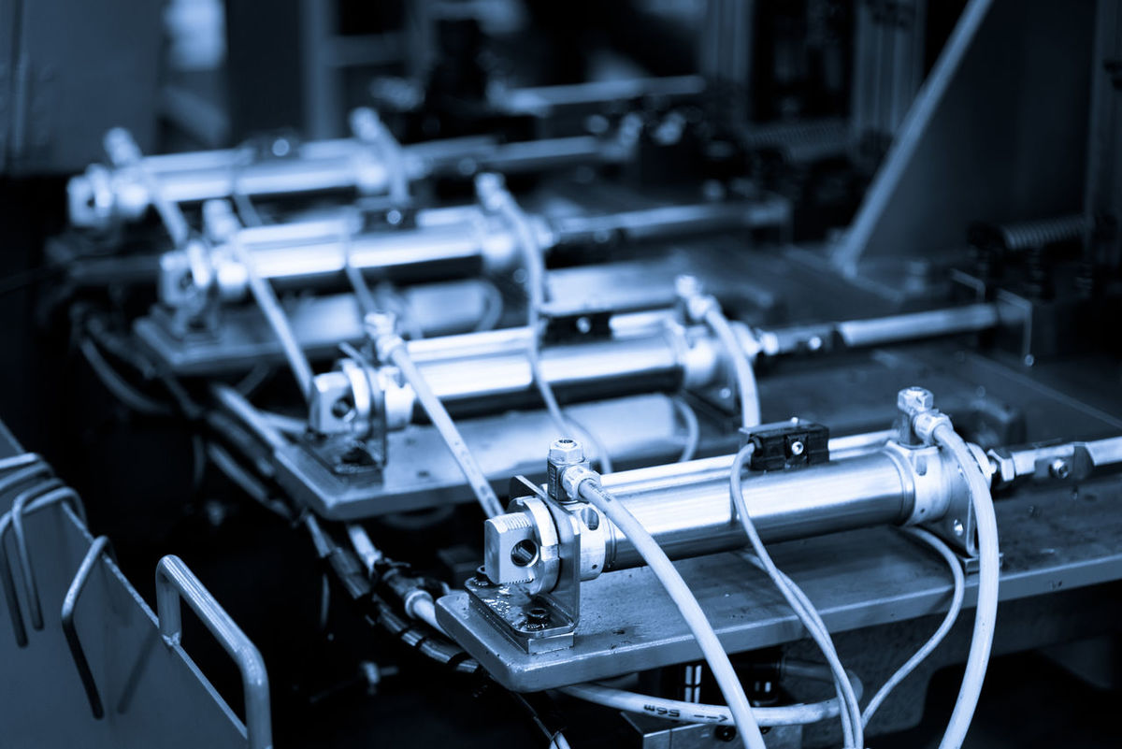




Finland has six growth opportunities, which are based on its competitive strengths and increasing demand
Leading positions in Europe
Leading talent and startup clusters
1
2
3
4
5
6
Advanced materials
Process technologies
Chip design
MEMS and sensors
Photonics
Quantum tech
Finland has reinforced specialized wafer production capabilities and manufactures world-leading specialized wafer
Finland leads design and manufacturing of novel high-performance semiconductor materials
Finland leads in research, development and productization of thin films for novel applications
Finland develops leading flexible and biodegradable process and manufacturing technologies
Finland designs leading next-generation mobile network chips
Finland is integrated deeply with Europe’s industrial demand for automation, AI, and robotics
Finland breaks new grounds with energy-efficient, ultra-low power chips
Finland leads in design and manufacturing of MEMS solutions for communications, industrial, automotive, and healthcare sectors
Finland leads in innovations for next generation advanced sensor solutions
Finland has a reinforced domestic photonics end-to-end value chain to design and manufacture world-leading photonic solutions
Finland leads globally in photonics-microelectronic SiP design capabilities
Finland breaks new grounds in healthcare, silicon-photonics, and quantum integration
Finland has technological and export superiority in Europe in designing and manufacturing quantum technologies
Finland has an end-to-end value chain with state-of-the-art quantum infrastructure
Finland is Europe’s leading quantum ecosystem for academia-industry collaboration
Vision
Note: SoC = System-on-Chip; SiP = System-in-Package; MEMS = Microelectromechanical systems; HF/HV = High-frequency/High-voltage; ALD = Atomic layer deposition
Source: BCG

Slide 21
The success in growing Finnish semiconductor industry is highly dependent on the supply of workforce and research from higher education institutions
The industry perceives that workforce and education are the most critical enablers for industry growth
Industry is estimated to need over 15.000 mostly highly educated professionals
Survey results^{1:} The lower the average rank, the more critical the enabler is
Total number of employees, by education level, in 2022-2035
15 660
Workforce and Education
2.11
RDI
2.22
Ecosystem and collaboration
3.44
Private international investments
4.02
PhD
Master’s
Government support
4.24
Bachelor’s
High school/Vocational
EU funding (e.g., Chips Act)
4.89
Retirement
Total
Private national investments
4.90
2022
Retirement
Gap
2035E
1. Q: Rank the following enablers from most critical to least critical for the success of the Finnish Microelectronics and Semiconductor industry 2. Based on estimates without productivity growth assumptions, i.e., static revenue per employee. Education data based on estimates from Norwegian semiconductor industry report. Retirement estimates based on EU figures
Source: Orbis, Company reports, Industry reports, Gartner, Industry survey, BCG

Slide 22
Finland should aim for five outcomes across the six growth opportunities and set up efficient public-private collaboration to coordinate supporting actions
1
Competitive R&D ecosystem
Five enabling outcomes
Workforce growth
2
1
2
Alleviate industry talent gap by educating and attracting 15.000 new employees
Increase R&D investments, international collaborations and R&D infrastructure
Pilot lines operating model
R&D collaboration
Education and attraction
Investments in education quantity and quality
Joint R&D funding of €5B over ten years
Funding mechanisms and tenure tracks
Coordinated EU funding tracking
Materials
Multi-year flagship research program
Scalable programs for upskilling and reskilling
Closer non-EU bilateral relationships
Equipment
Campaigns to promote industry attractiveness
Investment attraction
R&D and
design site investments
Coordinated international talent pipelines
3/4
3
Attract significant R&D, design and manufacturing site investments
Design
Industry-public collaboration
Industry-public collaboration
5
5
Enable long-term collaboration among industry, academia, and government
Promotion of talent and startup clusters
Fabrication
Manufacturing site investments
6G EU Design Center of Excellence
4
Effective industry collaboration structure
Broad range of public instruments
Assembly
Geopolitical monitoring and coordinated response
Public-private collaboration
EU policy and funding influence

Slide 23
What can government and industry do?

Slide 24
What government and industry can do (1/2)
Outcome |  | Action | Responsible
1 | Finland should increase R&D investments, secure international R&D collaborations and build infrastructure to rapidly commercialize innovations. | 1.1 Finland needs a total funding of €5B for semiconductor R&D over the next ten years, focused on the six opportunity areas. The majority of this will be carried out by the industry, with the government providing significant leverage through increased funding. | Industry, Government
 |  | 1.2 Finland needs to create an operating model for pilot lines that builds and operates them, funds necessary equipment, attracts customers, and interacts with leading European research and technology organizations. The government should also pledge matching funds for these pilot lines and associated projects under the EU Chips Act and similar initiatives. | Government, Industry, Academia
 |  | 1.3 Finland should establish and track a plan to gain the most benefit from semiconductor-related EU funding programs. The plan should include building networks to European research and technology organizations and global companies, enabling participation in multi-party funding calls and helping to attract international customers. | Industry, Government
 |  | 1.4 Finland should establish closer bilateral relationships on semiconductor technologies and related trade and R&D initiatives with partners beyond the EU: in particular the US, the UK, Canada, Japan, South Korea, India, and Taiwan. | Government
2 | Finland should aim to alleviate the talent gap to support growth and industry competitiveness. | 2.1 Finland should commit to raising the quality and quantity of microelectronics higher education. This means significantly increased student intake and adequate output of MSc and DSc graduates. Industry and academia should co-create degree programs that funnel new talent into the field. | Government, Academia, Industry
2 | Finland should aim to alleviate the talent gap to support growth and industry competitiveness. | 2.2 Postdocs and professors should be attracted through innovative research funding mechanisms and world-class tenure tracks and campaigns. Additionally, research and industry should collaborate on further developing leading semiconductor publications, aiming to gain international visibility and attract top talent. | Academia, Industry, Government
 |  | 2.3 Finland should foster vocational education and training in microelectronics through degree programs and short courses with appropriate use of on-the-job learning and apprenticeships to meet the growing demand for manufacturing staff. | Government, Industry
 |  | 2.4 Scalable programs for upskilling and reskilling the current workforce should be put in place, enabling smooth career transitions within the semiconductor industry and building a talent pipeline from declining industries. | Government, Industry, Academia
 |  | 2.5 Finland should launch campaigns to promote the attractiveness of semiconductor-related studies and careers among students. There should be internships and other efforts to provide practical work-related engagements during studies and communicate clear paths towards industry employment. | Industry, Academia
 |  | 2.6 Finland should establish coordinated international talent pipelines to Finland from abroad, ease immigration policies with targeted measures for critical talent, support pathways to industry jobs, and define joint actions to retain foreign students and talent in Finland. | Government, Industry, Academia

Slide 25
What government and industry can do (2/2)
Outcome |  | Action | Responsible
3 | Finland should aim to attract significant semiconductor R&D and design sites from foreign companies. | 3.1 Finland must prioritize long-term initiatives to promote its design-related talent, startup, and technology clusters. This involves enhancing research-industry collaboration through forums, showcasing innovations at international trade shows, executing targeted marketing campaigns, and leveraging diplomatic channels to bolster visibility among large design companies. | Government, Industry, Academia
 |  | 3.2 A comprehensive set of public instruments should be developed and put forth, tailored to attracting specific design sites. | Government
 |  | 3.3 Finland should establish an EU-labeled 6G and Edge AI Design Center of Excellence under the EU Chips Act. | Industry, Government, Academia
4 | Finland should aim to attract significant (>€1B) semiconductor manufacturing site investments from foreign companies. | 4.1 Public-private partnerships should be established to jointly attract manufacturing site investments. These partnerships should consistently promote Finland’s manufacturing capabilities at research-industry forums, international trade shows, and through diplomatic channels. | Government, Industry
 |  | 4.2 Finland should establish and employ a comprehensive set of public instruments specifically designed to appeal to and secure specific manufacturing sites. | Government
5 | Finland should enable long-term collaboration among industry, academia, and government to support the execution of the strategy, and to maintain situational awareness on geopolitical, technological, and economic developments that affect the execution. | 5.1 Finland should establish an effective collaboration structure for the implementation of the national semiconductor strategy that enables tracking of key outcomes and actions. | Government, Industry, Academia
 |  | 5.2 There should be an active process for sharing key developments in geopolitics and industrial and trade policies. The industry and government should define and support proactive industry activities that would address key challenges in the operating environment. | Industry, Government
 |  | 5.3 Finland should bolster the cooperation and resources needed to influence EU semiconductor-related policies, objectives, and funding instruments. | Industry, Government

