Slide 1
TechnoBaro
Results, December 2025

Slide 2
What is TeknoBaro?
TeknoBaro is a regular survey conducted by Technology Industries of Finland. Its results are widely used in advocacy, policy formation, and member services development.
Conducted four times a year (March, June, September, December)
Two sections in each survey:
Economic section – maps out the economic situation and future expectations of member companies.
Rotating theme(s) – this time: investments.

Slide 3
Background
Survey period: Mon 8 December – Fri 12 December 2025
Respondents: CEOs of Technology Industries of Finland’s member companies
1,707 recipients → 356 responses (response rate 21%)

Slide 4
The respondent group is representative in terms of size and sector.
Technology Industries of Finland Source: TechnoBaro – The Technology Industry Barometer, December 2025, number of respondents 356.

Slide 5
Time series
Balance figure: The balance figure is calculated as the share of respondents reporting positive development minus the share reporting negative development. For example, if 30% of respondents said new orders have increased, 50% remained unchanged, and 20% decreased, the balance figure is 30 – 20 = +10.

Slide 6
How has the situation developed from June to September?

Slide 7
How would you describe your company’s situation now in the following areas compared to about three months ago?

Slide 8
How do you expect your situation to develop over the next three months?

Slide 9
The next 3 months, i.e. September–December

Slide 10
How would you describe your company’s situation now in the following areas compared to about three months ago?
Balance figure
6
5
12
7
% of respondents
Source: TechnoBaro – The Technology Industry Barometer, December 2025, number of respondents 356.

Slide 11
How would you describe your company’s situation now in the following areas compared to about three months ago? Manufacturing industry, 275 respondents
% of respondents
Balance figure
4
3
10
4
Source: TechnoBaro – The Technology Industry Barometer, December 2025, number of respondents 356.
Manufacturing industry = Metals industry, Mechanical engineering and Electronics industry; Services = Consulting engineering and Information technology

Slide 12
How would you describe your company’s situation now in the following areas compared to about three months ago? Services, 81 respondents
% of respondents
Balance figure
10
12
16
17
Source: TechnoBaro – The Technology Industry Barometer, December 2025, number of respondents 356.
Manufacturing industry = Metals industry, Mechanical engineering and Electronics industry; Services = Consulting engineering and Information technology

Slide 13
How would you describe your company’s situation now in the following areas compared to about three months ago?

Slide 14
How would you describe your company’s situation now in the following areas compared to about three months ago? Companies with fewer than 150 employees, 280 respondents
% of respondents
Balance figure
4
5
9
5
Source: TechnoBaro – The Technology Industry Barometer, December 2025, number of respondents 356.

Slide 15
How would you describe your company’s situation now in the following areas compared to about three months ago? Companies with more than 150 employees, 76 respondents
% of respondents
Balance figure
11
4
21
1
Source: TechnoBaro – The Technology Industry Barometer, December 2025, number of respondents 356.
.

Slide 16
How would you describe your company’s situation now in the following areas compared to about three months ago? Company´s size

Slide 17
How would you describe your company’s situation now in the following areas compared to about three months ago?
% of respondents

Slide 18
How would you describe your company’s situation now in the following areas compared to about three months ago? Company´s size, % of respondents

Slide 19
How would you describe your company’s situation now in the following areas compared to about three months ago?
If the balance figure is positive, inventories have decreased (demand is increasing).
If the balance figure is positive, delivery times increased (demand is increasing).

Slide 20
The next 3 months, i.e. September–December?

Slide 21
How do you expect your situation to develop over the next three months?
% of respondents
Balance figure
15
24
Source: TechnoBaro – The Technology Industry Barometer, December 2025, number of respondents 356.

Slide 22
How do you expect your situation to develop over the next three months? Balance figure

Slide 23
How do you expect your situation to develop over the next three months?

Slide 24
How do you expect your situation to develop over the next three months? Manufacturing industry vs. Services

Slide 25
How do you expect your situation to develop over the next three months?

Slide 26
How do you expect your situation to develop over the next three months? Company´s size, % of respondents

Slide 27
Investments

Slide 28
How do you expect your investments to develop in 2025 compared to 2024?
% of respondents
Balance figure
2
-3
19
28
Source: TechnoBaro – The Technology Industry Barometer, December 2025, number of respondents 356.

Slide 29
How do you expect your investments to develop in 2025 compared to 2024? Balance figure
Source: TechnoBaro – The Technology Industry Barometer, December 2025, number of respondents 356.
.

Slide 30
How do you expect your investments to develop in 2025 compared to 2024?
Manufacturing industry, 275 respondents
% of respondents
Source: TechnoBaro – The Technology Industry Barometer, December 2025, number of respondents 356.
Manufacturing industry = Metals industry, Mechanical engineering and Electronics industry; Services = Consulting engineering and Information technology

Slide 31
How do you expect your investments to develop in 2025 compared to 2024?
Services, 81 respondents
% of respondents
Source: TechnoBaro – The Technology Industry Barometer, December 2025, number of respondents 356.
Manufacturing industry = Metals industry, Mechanical engineering and Electronics industry; Services = Consulting engineering and Information technology

Slide 32
How do you expect your investments to develop in 2025 compared to 2024?
Companies with less than 150 employees, 280 respondents
% of respondents
Source: TechnoBaro – The Technology Industry Barometer, December 2025, number of respondents 356.

Slide 33
How do you expect your investments to develop in 2025 compared to 2024?
Companies with more than 150 employees, 76 respondents
% of respondents
Source: TechnoBaro – The Technology Industry Barometer, December 2025, number of respondents 356.

Slide 34
Investments in Artificial Intelligence
Source: TechnoBaro – The Technology Industry Barometer, December 2025, number of respondents 356.

Slide 35
Investments in AI: responses other than “we do not invest in AI” → invests in AI in some form.
Source: TechnoBaro – The Technology Industry Barometer, December 2025

Slide 36
Investments in Artificial Intelligence,
Manufacturing industry vs. Services, % of respondents
Source: TechnoBaro – The Technology Industry Barometer, December 2025, number of respondents 356.
Manufacturing industry = Metals industry, Mechanical engineering and Electronics industry; Services = Consulting engineering and Information technology

Slide 37
Investments in Artificial Intelligence,
Company´s size, % of respondents
Source: TechnoBaro – The Technology Industry Barometer, December 2025, number of respondents 356.

Slide 38
Investments in 2026

Slide 39
How do you expect your investments to develop in 2026 compared to 2025? NEXT YEAR
Balance figure
16
-2
21
34
Source: TechnoBaro – The Technology Industry Barometer, December 2025, number of respondents 356.

Slide 40
How do you expect your investments to develop in 2026 compared to 2025? Balance figure
Source: TechnoBaro – The Technology Industry Barometer, December 2025, number of respondents 356.

Slide 41
Rotating theme: Investments
We examine companies’ views on a rotating topical theme, and this time we want to gain a broader understanding of investments.

Slide 42

What types of investments have you made this year?
Source: TechnoBaro – The Technology Industry Barometer, December 2025, number of respondents 356.

Slide 43
How are the fixed investments you made in 2025 divided between growth-enhancing investments and replacement investments?
The averages for both replacement and growth investments are over 50%. In other words, on average investments are split roughly 50–50, but when looking at whether the share of replacement or growth is larger, replacement comes out ahead.
Source: TechnoBaro – The Technology Industry Barometer, December 2025, number of respondents 356.

Slide 44
How do you assess the impact of different factors on your willingness to invest in Finland compared with other potential investment countries?
Source: TechnoBaro – The Technology Industry Barometer, December 2025, number of respondents 356.

Slide 45
Open comments about economic situation

Slide 46
Uncertainty and a negative situation
Slowness in customers’ decision-making…
In submitted bids, there is still significant uncertainty among customers in their decision-making.
An extremely foggy outlook. Industrial investments are being delayed, and maintenance customers are cutting back.
Order books are at a good level, but customers’ procurement and investment decisions are cautious and delayed.
Markets are highly polarized by segment and geography: part of the market is developing well, while another part is still in decline. As a result, the overall picture is unclear.
The business cycle situation is reasonably good, but there is a great deal of uncertainty looking ahead.
Export orders have decreased. Obtaining financing is difficult.
The start of growth has been continuously postponed. At present, expectations are for H2/2026.

Slide 47
Positive signals
Growth is visible in international sales.
Expectations for 2026 are positive. We have received indications from our customers that investments in R&D will remain at least at the current level or preferably increase. Our own budget for next year has been prepared with growth in mind.
A clear turning point in market decision-making is noticeable.
The number of large project orders received for the coming year has increased significantly compared with 3 months ago and 12 months ago.
The situation is stable and employment is secured for more than 6 months. The order backlog and demand are at an excellent level. Challenges include financing and personnel capacity.
Our global market is strong. Challenges include production capacity and competitiveness.
The outlook for export markets is good, but the domestic market remains quiet.

Slide 48
Investments
Our investments in developing AI capabilities, deployment, application areas, and the necessary tools have been significant.
The reduction in corporate tax is a positive development. However, the cost of employment is high, and under Finland’s tax system it is in practice very difficult or expensive to attract international talent to Finland. It is indicative that an increasing share of the management and supervisory roles across our operations are now located outside Finland.
In 2026, investments will likely be made once the worst downturn has been overcome. No investments – a “valley of death” year.
Small fish for Christmas. We invested heavily just as the market started to plunge. The situation is now improving, but in 2026 we will only make mandatory or, at most, replacement investments if absolutely necessary. Cash flow must now be restored.
The cost of financing has increased, which is slowing down investments.
In 2025, all investments have been put on hold due to the difficult market situation.
The government’s unpredictable actions regarding electricity and mining taxation significantly weaken the outlook.

Slide 49
TechnoBaro – The Technology Industry Barometer available online
A more extensive analysis by TeknoBaro is available online:
https://teknologiateollisuus.fi/en/economic-outlook/technobaro/

Slide 50
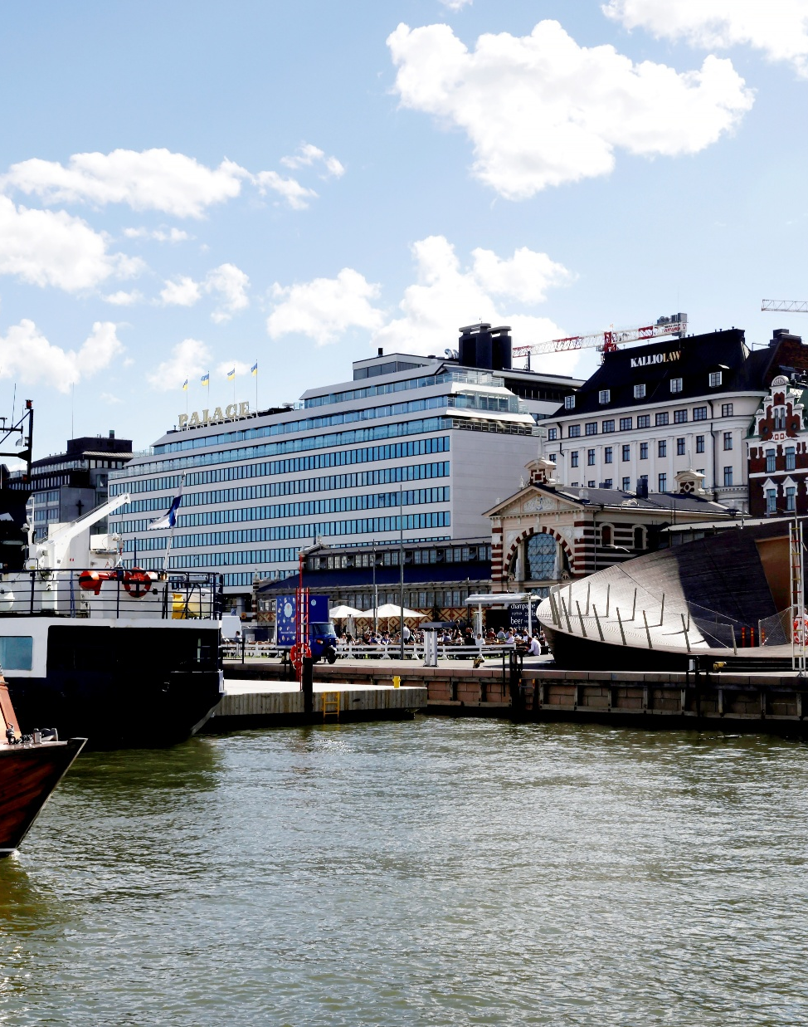
Contact
Hanne Mikkonen
Senior Economist
Economy and Sustainable Growth Technology Industries of Finland
+358 440 296 152
hanne.mikkonen@teknologiateollisuus.fi

