Slide 2
Workforce needs survey 2025 – Technology Industries of Finland

Slide 3
Background

Slide 4

Technology Industries of Finland is the national advocacy association of technology companies
50% of total Finnish exports
338,000 employed directly, over 720,000 indirectly
This industry brings in annual tax revenues of 23 billion euros to Finland
€6bn annual investment in Finland
65% of total private-sector R&D investments

Slide 5

Technology Industries’ five sub-sectors
Electronics and electro- technical industry
telecoms equipment, electric machines, health technology
turnover (2023): €21bn
workforce (2023): 43,800
Metals
industry
steel products, non-ferrous metals, casting, metalliferous ore mining
turnover (2023): €14bn
workforce (2023): 16,100
Mechanical engineering
machines, metal products, vehicles
turnover (2023): €40bn
workforce (2023): 136,700
Information technology
IT services, software
turnover (2023): €20bn
workforce (2023): 85,900
Consulting engineering
specialist services for industry, society and construction
turnover (2023): €8bn
workforce (2023): 55,000
Tieto-
tekniikka-ala
AFRY, A-insinöörit, Citec, Elomatic, Etteplan, FCG, Granlund, Neste Engineering, Ramboll, Rejlers, Sitowise, Sweco, WSP...

Slide 6
How the survey was conducted
The skills needs of the technology industry were assessed based on companies’ estimates of their workforce growth over the next four years, combined with a forecast from statistics on replacing retirees. The result was then scaled to a 10-year period.
451 member companies of Technology Industries of Finland responded to the survey. The responding companies represent about 59% of the total workforce of the association’s member companies. The survey was conducted in September 2025.
The survey asked about:
Estimated change in workforce size over the next four years
How potential workforce growth would be distributed across different education levels
Replacement of skilled professionals retiring
Willingness to recruit international talent, current recruitment challenges, and external training needs for personnel

Slide 7
Results

Slide 8
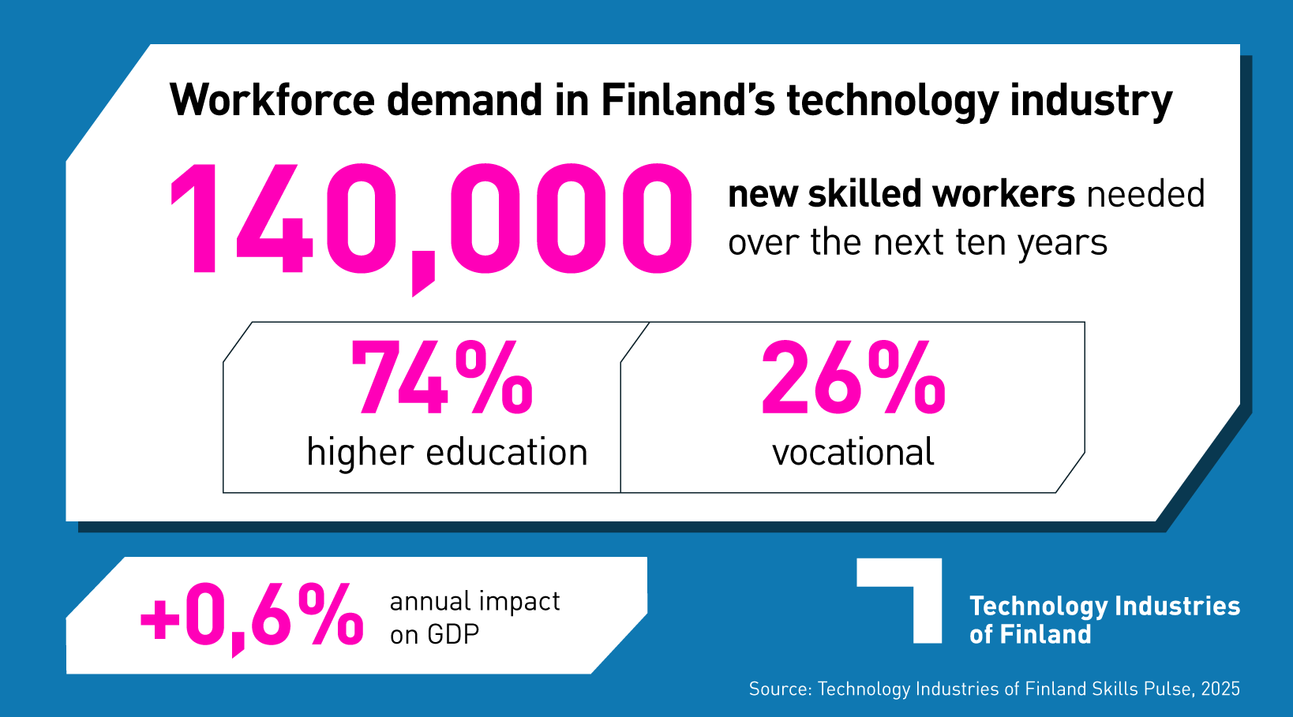


Slide 9
74 000 out of the 140 000 need comes from manufacturing industry*
*Manufacturing industry: Mechanical engineering and metal products, Electronics and electrotechnical industry, Metals refining
Source: Technology Industries of Finland Skills Pulse 2025

Slide 10
Half of the need is due to growth, half due to retiree replacements
Source: Technology Industries of Finland Skills Pulse 2025

Slide 11
74% of the need is for higher education
Source: Technology Industries of Finland Skills Pulse 2025

Slide 12
Need for higher education varies between branches but is over 50% for almost all
Source: Technology Industries of Finland Skills Pulse 2025

Slide 13
One in five retirees with vocational education will be replaced by an employee with higher education
Source: Technology Industries of Finland Skills Pulse 2025

Slide 14
Share of employees with higher education has risen steadily and is still rising
Source: Statistics Finland and Technology Industries of Finland Skills Pulse 2025
Source:

Slide 15
Higher-educated workforce growing, vocational workforce steady
Source: Statistics Finland

Slide 16
Economic impact

Slide 17
Tech industry workforce supply matters for the whole Finnish economy
Finland’s economic growth has been modest in recent years. In 2024, Finland’s GDP grew by 0.4%. This year, the Bank of Finland forecasts GDP growth of 0.3%.
A study conducted by ETLA for Technology Industries of Finland assessed how Finland’s GDP and total exports would be affected if the sector’s estimated labour-force needs could not be met. Technology Industries’ annual need for new skilled workers is 14,000 people.
If none of this need were met, Finland’s GDP would decline by 0.6% per year compared to a situation in which the labour need is fully met.
If only retiring employees can be replaced, but the additional labour required for growth cannot be secured, GDP would contract by 0.3% per year.
In the extreme, insufficient availability of skilled labour in the technology industries could eliminate Finland’s entire current economic growth. However, the scenario in which the sector receives no new workers is hypothetical.
ETLA’s estimate of GDP impact illustrates the scale: meeting the labour-force needs of Finland’s largest export sector is essential to the performance of the Finnish economy.
https://www.etla.fi/julkaisut/erikoisartikkelit/teknologiateollisuuden-osaajatarpeen-taloudellisten-vaikutusten-arviointi/

Slide 18
International workforce

Slide 19
82% of companies are interested in hiring international workforce
Source: Technology Industries of Finland Skills Pulse 2025

Slide 20
Skills needs at the moment

Slide 21
Which positions are hardest to fill at the moment?
Specific design roles (e.g. artificial intelligence, power electronics, analog/digital design, marine electrical design, cloud engineering, cybersecurity).
Skilled workers in manufacturing with sufficiently high competence (e.g. robotic welders, plate/steel welders, CNC machinists, press brake operators, foundry work).
Slightly more mentions of tasks requiring higher-education than of vocationally trained workers.
Source: Technology Industries of Finland Skills Pulse 2025

Slide 22
Competence development needs relate particularly to artificial intelligence
”What kinds of external training needs do you currently have?”
AI and digital capabilities: machine learning, computer vision, generative AI, AI in daily work, AI-based software development, data skills, cloud services and cybersecurity, automation systems.
Leadership and supervisory skills: change management, leading remote work, project management, strategic business development, cross-cultural leadership.
Technical and production skills: welding, machining, CNC programming, robotics, hydraulics, electrical qualifications, machine safety, power semiconductors, statutory safety cards and certifications.
Sales and customer work: solution sales, project sales, customer service and interaction skills, international marketing.
Language training and communication: Finnish and English for international staff, communication and presentation skills.
Source: Technology Industries of Finland Skills Pulse 2025

