Slide 1
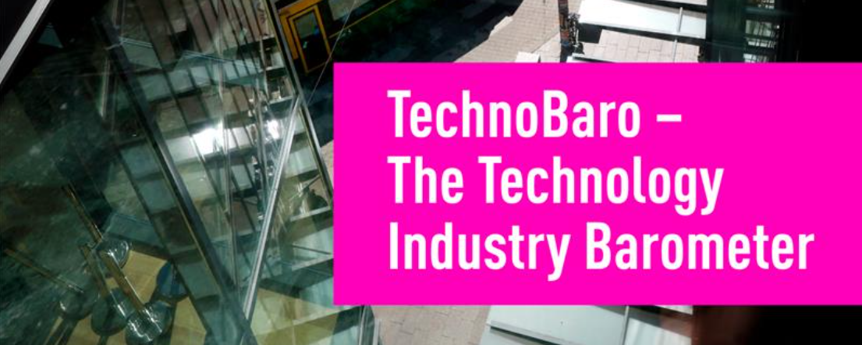
Results, March 2026

Slide 2
What is TechnoBaro?
TechnoBaro is a regular survey conducted by the Technology Industries of Finland. Its results are widely used in the association’s advocacy work, policy positions, and the development of member services.
Conducted four times a year (March, June, September, December)
Two sections in each survey:
Economic section – maps out the economic situation and future expectations of member companies.
Rotating theme(s) – this time: new technologies and technology policy.

Slide 3
Background
Survey period: Mon 9 March – Fri 13 March 2026
Respondents: CEOs of Technology Industries of Finland’s member companies
1,693 recipients → 340 responses (response rate 20%)

Slide 4
The respondent group is representative in terms of size and sector.
Technology Industries of Finland Source: TechnoBaro – The Technology Industry Barometer, March 2026, number of respondents 340.

Slide 5
Challenging to conduct analysis by company size, as there are not enough companies employing over 250 people. In the material, the analysis is currently divided into companies employing fewer than 150 and more than 150 people.
Number of respondents
Technology Industries of Finland Source: TechnoBaro – The Technology Industry Barometer, March 2026, number of respondents 340.

Slide 6
Time series
Balance figure: The balance figure is calculated as the share of respondents reporting positive development minus the share reporting negative development. For example, if 30% of respondents said new orders have increased, 50% remained unchanged, and 20% decreased, the balance figure is 30 – 20 = +10.

Slide 7
How would you describe your company’s current situation now in the following areas compared to approximately three months ago? Balance figure

Slide 8
How would you describe your company’s situation now in the following areas compared to about three months ago? Balance figure

Slide 9
How do you expect your situation to develop over the next three months? Balance figure
When the balance figure is positive, the majority of respondents who assessed the change expect the situation to improve in the coming months.

Slide 10
Past 3 months, i.e. December-March

Slide 11
How would you describe your company’s situation now in the following areas compared to about three months ago?
Balance figure
17
14
22
20
% of respondents
Source: TechnoBaro – The Technology Industry Barometer, March 2026, number of respondents 340.

Slide 12
How would you describe your company’s situation now in the following areas compared to about three months ago? Manufacturing industry, 257 respondents
% of respondents
Balance figure
18
14
17
16
Source: TechnoBaro – The Technology Industry Barometer, March 2026, number of respondents 340. Manufacturing industry = Metals industry, Mechanical engineering and Electronics industry; Services = Consulting engineering and Information technology

Slide 13
How would you describe your company’s situation now in the following areas compared to about three months ago? Services, 75 respondents
% of respondents
Balance figure
15
13
39
33
Source: TechnoBaro – The Technology Industry Barometer, March 2026, number of respondents 340.
Manufacturing industry = Metals industry, Mechanical engineering and Electronics industry; Services = Consulting engineering and Information technology

Slide 14
How would you describe your company’s situation now in the following areas compared to about three months ago?

Slide 15
How would you describe your company’s situation now in the following areas compared to about three months ago? Companies with fewer than 150 employees, 274 respondents
% of respondents
Balance figure
15
12
21
15
Source: TechnoBaro – The Technology Industry Barometer, March 2026, number of respondents 340.

Slide 16
How would you describe your company’s situation now in the following areas compared to about three months ago? Companies with more than 150 employees, 58 respondents
% of respondents
Balance figure
26
19
26
26
Source: TechnoBaro – The Technology Industry Barometer, March 2026, number of respondents 340.

Slide 17
How would you describe your company’s situation now in the following areas compared to about three months ago? Company´s size

Slide 18
How would you describe your company’s situation now in the following areas compared to about three months ago? Company´s size, % of respondents

Slide 19
How would you describe your company’s situation now in the following areas compared to about three months ago?
Note: In the current global situation, this reflects increasing challenges in logistics rather than necessarily indicating demand, as it usually would.
If the balance figure is positive, inventories have decreased (demand is increasing).
If the balance figure is positive, delivery times increased (demand is increasing).

Slide 20
The next 3 months, i.e. March–June?

Slide 21
How do you expect your situation to develop over the next three months?
% of respondents
Balance figure
18
33
Source: TechnoBaro – The Technology Industry Barometer, March 2026, number of respondents 340.

Slide 22
How do you expect your situation to develop over the next three months? Balance figure

Slide 23
How do you expect your situation to develop over the next three months?

Slide 24
How do you expect your situation to develop over the next three months? Manufacturing industry vs. Services

Slide 25
How do you expect your situation to develop over the next three months?

Slide 26
How do you expect your situation to develop over the next three months? Company´s size, % of respondents

Slide 27
Investments

Slide 28
How do you expect your investments to develop in 2026 compared to 2025?
% of respondents
Balance figure
10
-1
20
32
Source: TechnoBaro – The Technology Industry Barometer, March 2026, number of respondents 340.

Slide 29
How do you expect your investments to develop in 2026 compared to 2025? Balance figure
When the balance figure is positive, the majority of those who assessed the change report that investments are increasing.
Source: TechnoBaro – The Technology Industry Barometer, March 2026, number of respondents 340.
.

Slide 30
How do you expect your investments to develop in 2026 compared to 2025?
Source: TechnoBaro – The Technology Industry Barometer, March 2026, number of respondents 340.
.

Slide 31
How do you expect your investments to develop in 2026 compared to 2025? Balance figure
Source: TechnoBaro – The Technology Industry Barometer, March 2026, number of respondents 340.
.

Slide 32
How do you expect your investments to develop in 2026 compared to 2025?
Manufacturing industry, 257 respondents
% of respondents
Source: TechnoBaro – The Technology Industry Barometer, March 2026, number of respondents 340.
Manufacturing industry = Metals industry, Mechanical engineering and Electronics industry; Services = Consulting engineering and Information technology

Slide 33
How do you expect your investments to develop in 2026 compared to 2025?
Services, 75 respondents
% of respondents
Source: TechnoBaro – The Technology Industry Barometer, March 2026, number of respondents 340.
Manufacturing industry = Metals industry, Mechanical engineering and Electronics industry; Services = Consulting engineering and Information technology

Slide 34
How do you expect your investments to develop in 2026 compared to 2025?
Companies with less than 150 employees, 274 respondents
% of respondents
Source: TechnoBaro – The Technology Industry Barometer, March 2026, number of respondents 340.

Slide 35
How do you expect your investments to develop in 2026 compared to 2025?
Companies with more than 150 employees, 58 respondents
% of respondents
Source: TechnoBaro – The Technology Industry Barometer, March 2026, number of respondents 340.

Slide 36
Investments in Artificial Intelligence
Source: TechnoBaro – The Technology Industry Barometer, March 2026, number of respondents 340.

Slide 37
Investments in AI: responses other than “we do not invest in AI” → invests in AI in some form.
Source: TechnoBaro – The Technology Industry Barometer, March 2026, number of respondents 340.

Slide 38
Investments in Artificial Intelligence,
Manufacturing industry vs. Services, % of respondents
Source: TechnoBaro – The Technology Industry Barometer, March 2026, number of respondents 340.
Manufacturing industry = Metals industry, Mechanical engineering and Electronics industry; Services = Consulting engineering and Information technology

Slide 39
Investments in Artificial Intelligence,
Company´s size, % of respondents
Source: TechnoBaro – The Technology Industry Barometer, March 2026, number of respondents 340.

Slide 40
Open comments on your company’s current economic situation and outlook. If you wish, you may also describe the effects of the Iran war on your company’s business.

Slide 41
Open comments
"The year has started better than expected. There has been no significant change in the number of requests for quotations, but their value is higher. The outlook for 2027 is clearly better than it was a year ago for this year. The Iran war has had no impact at the moment."
"So far there have been no major changes and we continue to grow. The global situation may of course affect things in the future, but cybersecurity and automation will be needed regardless."
"There is still instability in the market and although the trend seems positive, there have also been unpleasant surprises along the way, and there will certainly be more ahead."
"Due to the geopolitical situation, it is extremely difficult to assess future prospects even in the short term. The situation will likely become more difficult, causing logistics costs to rise and inflationary pressures to tighten. Interest rates may also increase, and the end of the year could be challenging. A rapid end to both the situation in the Middle East and the war in Ukraine would create a completely different outlook."
"The Iran war does not directly affect our business other than through a general rise in costs in the near term. Uncertainty pushes prices up and thereby makes it more difficult to maintain profitability."
"Raw material prices are rising and had already been increasing before the Iran war. So far sales and order books remain unchanged and at a good level."
"The Iran war brings uncertainty to short-term operations, weakening customers’ willingness to invest and potentially disrupting international transport, with transport prices increasing. In the longer term, disruptions in oil and gas will strengthen the relative position of renewables and electrification."

