Slide 1
Economic Outlook 2/2026
Technology Industries of Finland
Graphs from the report

Slide 2
Economic Outlook 2/2026
Technology Industries of Finland
The whole report: https://teknologiateollisuus.fi/en/economic-outlook/
Information based on the situation on 6 May 2026

Slide 3
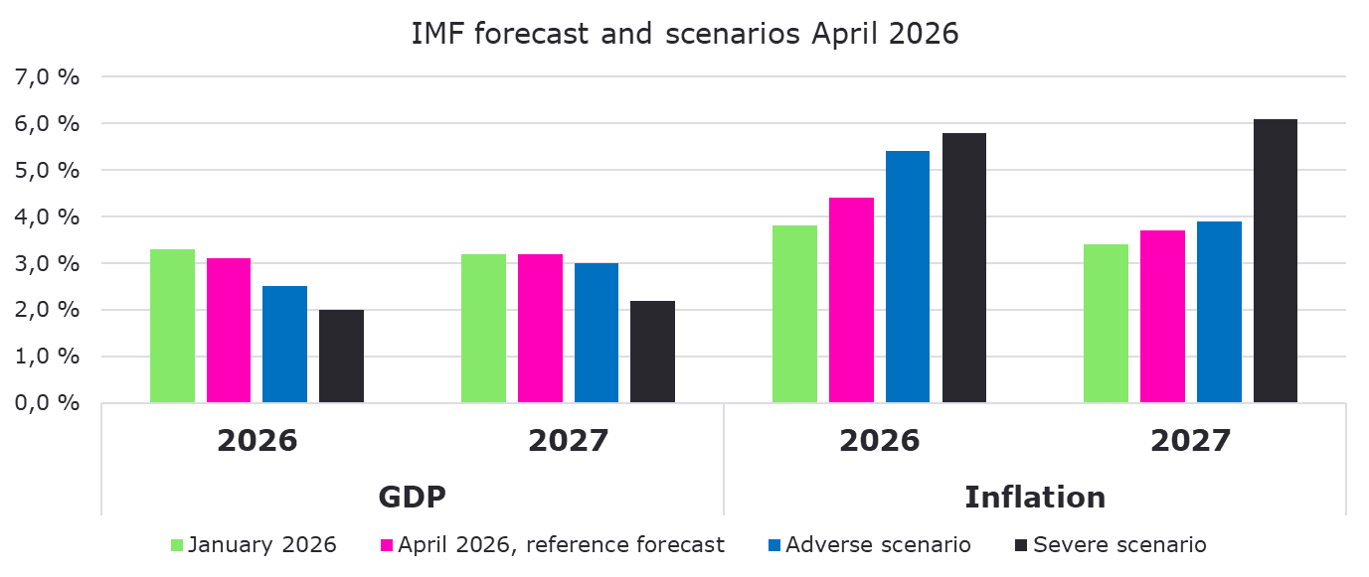
For now, the IMF is still using its April reference forecast, but the risks of weaker economic growth are increasing if the war involving Iran continues
Source: IMF.

Slide 4
The global economy has shown remarkable resilience during recent crises, but the war involving Iran is now weighing on the outlook
GDP Forecasts, April 2026*
 | 2024 | 2025 | 2026
USA | 2,8 | 2,0 | 2,1
Eurozone | 0,9 | 1,2 | 1,1
Source: S&P Global, IMF, Macrobond. IMF reference forecast.

Slide 5
In the United States, growth is slowing while inflationary pressures are increasing
Source: S&P Global, Macrobond.

Slide 6
In euroarea inventory rebuilding is supporting industrial activity, while the service sector is already showing significant weakening
Source: S&P Global, Macrobond

Slide 7
Purchasing Managers' Index (PMI) for the manufacturing sector
Source: S&P Global, Macrobond

Slide 8
Signs of improvement in the industrial business cycle have emerged during the autumn
Manufacturing business situation and outlook, seasonally adjusted balance figure
2008 | 2009 | 2010 | 2011 | 2012 | 2013 | 2014 | 2015 | 2016 | 2017 | 2018 | 2019 | 2020 | 2021 | 2022 | 2023 | 2024 | 2025
Source: EK Business Tendency Survey

Slide 9
Inflation and key central bank interest rates in the USA, eurozone and Finland
Source: Macrobond, FED, EKP

Slide 10
Turnover of the Technology Industry in Finland
Seasonally adjusted turnover index
Shares of turnover in 2023: mechanical engineering 39 %, electronics and electrotechnical industry 20 %,
information technology 19 %, metals industry 14 %, consulting engineering 7 %.
Source: Macrobond, Statistics Finland

Slide 11
Value of new orders in the technology industry* in Finland
Change: | I,2026 / I,2025 | I,2026 / IV,2025
Export: | 11 % | -30 %
Domestic: | 12 % | 14 %
Combined: | 11 % | -23 %
*) Excl. metals industry, game industry and data center companies
Source: The Federation of Finnish Technology Industries’ order book survey’s respondent companies, latest observation January-March 2026.

Slide 12
Value of order books in the technology industry* in Finland
Change: | 30.3.2026 / 30.3.2025 | 30.3.2026 / 31.12.2025
Export: | 24 % | -4 %
Domestic: | 1 % | 3 %
Combined: | 18 % | -2 %
*) Excl. metals industry, game industry and data center companies
Source: The Federation of Finnish Technology Industries’ order book survey’s respondent companies, latest observation 30th March 2026.

Slide 13
Tender requests* received by the technology industry companies in Finland
Balance figure
*) ”Have you experienced a notable increase or decrease in the number of requests for tenders in recent weeks in comparison to the situation three months ago.” Balance figure = the share of companies receiving more requests - the share of companies receiving less requests. Negative balance figure indicates that demand has weakened when compared to a situation three months ago.
Source: The Federation of Finnish Technology Industries’ order book survey’s respondent companies
The latest questionnaire in April 2026.

Slide 14
Development of personnel numbers and recruitments in the technology industry in Finland
10 800 employees affected by temporary lay-offs 30th March 2026
Source: The Federation of Finnish Technology Industries’ labour force survey.

Slide 15
Value of new orders in the electronics and electrotechnical industry in Finland
Change: | I,2026 / I,2025 | I,2026 / IV,2025
Export: | -5 % | -28 %
Domestic: | 19 % | 20 %
Combined: | -1 % | -21 %
Source: The Federation of Finnish Technology Industries’ order book survey’s respondent companies, latest observation January-March 2026.

Slide 16
Value of order books in the electronics and electrotechnical industry in Finland
Change: | 30.3.2026 / 30.3.2025 | 30.3.2026 / 31.12.2025
Export: | 19 % | -11 %
Domestic: | 17 % | 9 %
Combined: | 18 % | -8 %
Source: The Federation of Finnish Technology Industries’ order book survey’s respondent companies, latest observation 30th March 2026.

Slide 17
Value of new orders in the mechanical engineering in Finland
Change: | I,2026 / I,2025 | I,2026 / IV,2025
Export: | 26 % | -32 %
Domestic: | 8 % | 24 %
Combined: | 22 % | -25 %
Source: The Federation of Finnish Technology Industries’ order book survey’s respondent companies, latest observation January-March 2026.

Slide 18
Value of order books in the mechanical engineering in Finland
Change: | 30.3.2026 / 30.3.2025 | 30.3.2026 / 31.12.2025
Export: | 26 % | -1 %
Domestic: | 0 % | 3 %
Combined: | 21 % | 0 %
Source: The Federation of Finnish Technology Industries’ order book survey’s respondent companies, latest observation 30th March 2026.

Slide 19
Turnover of the metals industry in Finland
Seasonal adjusted turnover index
Shares of turnover 2023: iron and steel products, non-ferrous metals and castings 91 %, mining of metal ores 9 %
Source: Statistics Finland

Slide 20
Production volume of the metals industry in Finland
Seasonal adjusted volume index
Shares of turnover 2023: iron and steel products, non-ferrous metals and castings 91 %, mining of metal ores 9 %
Source: Statistics Finland

Slide 21
Value of new orders in the consulting engineering in Finland
Change: | I,2026 / I,2025 | I,2026 / IV,2025
Export: | -63 % | -29 %
Domestic: | 11 % | 3 %
Combined: | 7 % | 3 %
Source: The Federation of Finnish Technology Industries’ order book survey’s respondent companies, latest observation January-March 2026.

Slide 22
Value of order books in the consulting engineering in Finland
Change: | 30.3.2026 / 30.3.2025 | 30.3.2026 / 31.12.2025
Export: | -6 % | -2 %
Domestic: | 4 % | 4 %
Combined: | 3 % | 4 %
Source: The Federation of Finnish Technology Industries’ order book survey’s respondent companies, latest observation 30th March 2026.

Slide 23
Value of new orders in the information technology* in Finland
Change: | I,2026 / I,2025 | I,2026 / IV,2025
Combined: | 15 % | -10 %
*) Excl. game industry and data center companies
Source: The Federation of Finnish Technology Industries’ order book survey’s respondent companies, latest observation January-March 2026.

Slide 24
Value of Order Books in the Information Technology* in Finland
*) Excl. game industry and data center companies
Change: | 30.3.2026 / 30.3.2025 | 30.3.2026 / 31.12.2025
Combined: | -4 % | 0 %
Source: The Federation of Finnish Technology Industries’ order book survey’s respondent companies, latest observation 30th March 2026.

Slide 25
Questions?
Director, Chief Economist Petteri Rautaporras
+358 50 304 2220
petteri.rautaporras@teknologiateollisuus.fi
Senior Economist Hanne Mikkonen
+358 44 0296 152
hanne.mikkonen@teknologiateollisuus.fi

