Slide 1
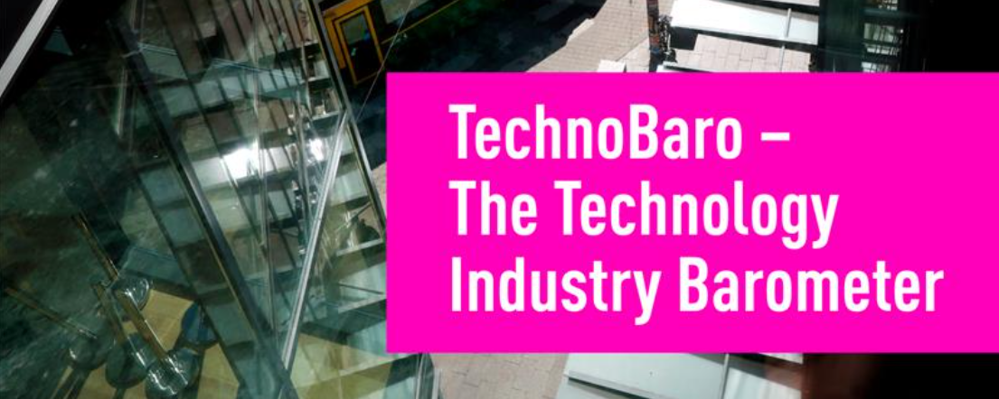
Results, March 2026
Results, June 2026

Slide 2
What is it about?
What is it about?
Have your say and make an impact: TechnoBaro – The Technology Industry Barometer is a quarterly survey conducted by Technology Industries of Finland. The results are widely used to support advocacy, policy development and the continuous improvement of member services. The survey is conducted in March, June, September and December.
Survey content:
The survey always consists of two sections:
TechnoBaro economic outlook section: These standard questions are designed to assess the current business conditions of Technology Industries of Finland member companies and their expectations for the future.
TechnoBaro special topic section: We explore companies’ views on a topical theme that varies from survey to survey. This time, the theme is resilience.

Slide 3
Background
The survey was conducted from Monday, 8 June 2026, to Friday, 12 June 2026.
The survey recipients included CEOs of member companies of Technology Industries of Finland.
The survey was sent to 1,697 recipients, and 304 responses were received, resulting in a response rate of 18%.

Slide 4
The respondent group is representative in terms of size and sector.
Technology Industries of Finland
Source: TechnoBaro – The Technology Industry Barometer, June 2026, number of respondents 304.

Slide 5
In the material, the analysis is currently divided into companies employing fewer than 150 and more than 150 people.
Number of respondents
Technology Industries of Finland
Source: TechnoBaro – The Technology Industry Barometer, June 2026, number of respondents 304.

Slide 6
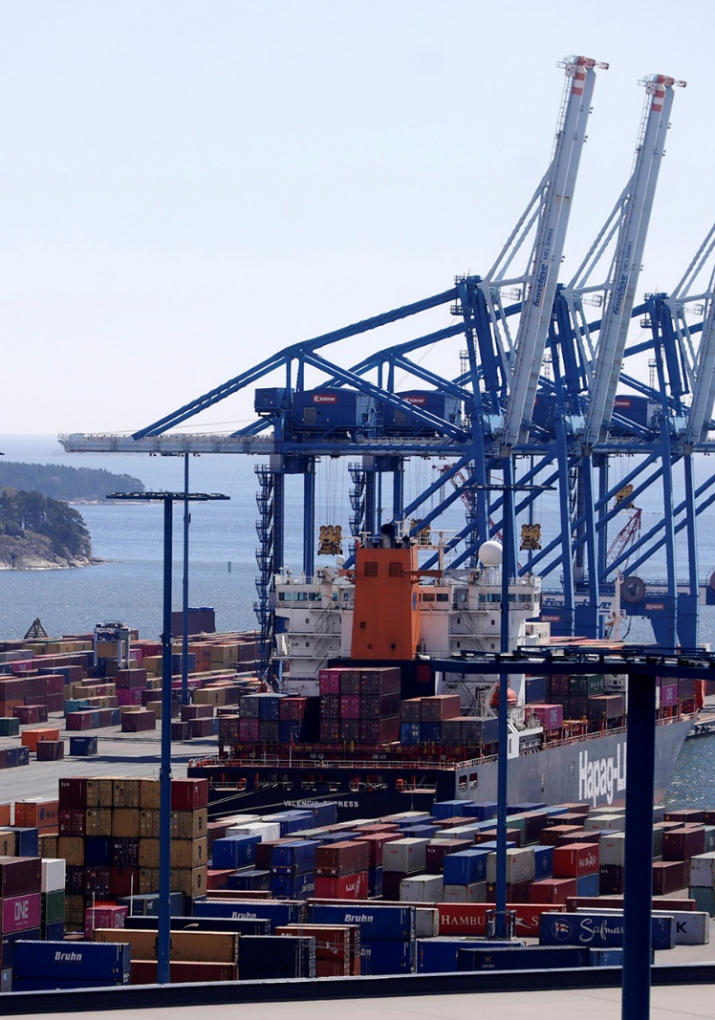
Time series
Balance figure: The balance figure is calculated as the share of respondents reporting positive development minus the share reporting negative development. For example, if 30% of respondents said new orders have increased, 50% remained unchanged, and 20% decreased, the balance figure is 30 – 20 = +10.

Slide 7
How would you describe your company’s current situation now in the following areas compared to approximately three months ago? Balance figure
Technology Industries of Finland
Source: TechnoBaro – The Technology Industry Barometer, June 2026, number of respondents 304.

Slide 8
How would you describe your company’s situation now in the following areas compared to about three months ago? Balance figure
When the balance figure is positive, the majority of respondents who assessed the change report that the situation has improved.
Technology Industries of Finland
Source: TechnoBaro – The Technology Industry Barometer, June 2026, number of respondents 304.

Slide 9
How do you expect your situation to develop over the next three months? Balance figure
When the balance figure is positive, the majority of respondents who assessed the change expect the situation to improve in the coming months.
Technology Industries of Finland
Source: TechnoBaro – The Technology Industry Barometer, June 2026, number of respondents 304.

Slide 10
Business conditions
How would you describe your company's current situation in the following areas compared with approximately three months ago?

Slide 11
How would you describe your company’s situation now in the following areas compared to about three months ago?
Balance figure
27
22
24
24
% of respondents
Source: TechnoBaro – The Technology Industry Barometer, June 2026, number of respondents 304.

Slide 12
How would you describe your company’s situation now in the following areas compared to about three months ago? Manufacturing industry, 244 respondents
% of respondents
Balance figure
29
25
25
25
Source: TechnoBaro – The Technology Industry Barometer, June 2026, number of respondents 304.
Manufacturing industry = Metals industry, Mechanical engineering and Electronics industry; Services = Consulting engineering and Information technology

Slide 13
How would you describe your company’s situation now in the following areas compared to about three months ago? Services, 60 respondents
% of respondents
Balance figure
18
10
20
22
Source: TechnoBaro – The Technology Industry Barometer, June 2026, number of respondents 304.
Manufacturing industry = Metals industry, Mechanical engineering and Electronics industry; Services = Consulting engineering and Information technology

Slide 14
How would you describe your company’s situation now in the following areas compared to about three months ago?
Source: TechnoBaro – The Technology Industry Barometer, June 2026, number of respondents 304.

Slide 15
How would you describe your company’s situation now in the following areas compared to about three months ago? Companies with fewer than 150 employees, 243 respondents
% of respondents
Balance figure
23
21
22
22
Source: TechnoBaro – The Technology Industry Barometer, June 2026, number of respondents 304.

Slide 16
How would you describe your company’s situation now in the following areas compared to about three months ago? Companies with more than 150 employees, 61 respondents
% of respondents
Balance figure
41
26
31
33
Source: TechnoBaro – The Technology Industry Barometer, June 2026, number of respondents 304.

Slide 17
How would you describe your company’s situation now in the following areas compared to about three months ago? Company´s size
Source: TechnoBaro – The Technology Industry Barometer, June 2026, number of respondents 304.

Slide 18
The next 3 months , i.e. June-September?
How do you expect your company's situation to develop over the next three months?

Slide 19
How do you expect your situation to develop over the next three months?
% of respondents
Balance figure
15
23
Source: TechnoBaro – The Technology Industry Barometer, June 2026, number of respondents 304.

Slide 20
How do you expect your situation to develop over the next three months? Balance figure
Source: TechnoBaro – The Technology Industry Barometer, June 2026, number of respondents 304.

Slide 21
How do you expect your situation to develop over the next three months?
Source: TechnoBaro – The Technology Industry Barometer, June 2026, number of respondents 304.

Slide 22
How do you expect your situation to develop over the next three months? Manufacturing industry vs. Services
Source: TechnoBaro – The Technology Industry Barometer, June 2026, number of respondents 304.
Manufacturing industry = Metals industry, Mechanical engineering and Electronics industry; Services = Consulting engineering and Information technology

Slide 23
How do you expect your situation to develop over the next three months?
Source: TechnoBaro – The Technology Industry Barometer, June 2026, number of respondents 304.

Slide 24
How do you expect your situation to develop over the next three months? Company´s size, % of respondents
Source: TechnoBaro – The Technology Industry Barometer, June 2026, number of respondents 304.

Slide 25
Investments

Slide 26
How do you expect your investments to develop in 2026 compared to 2025?
% of respondents
Balance figure
11
0
14
32
Source: TechnoBaro – The Technology Industry Barometer, June 2026, number of respondents 304.

Slide 27
How do you expect your investments to develop in 2026 compared to 2025? Balance figure
When the balance figure is positive, the majority of those who assessed the change report that investments are increasing.
Source: TechnoBaro – The Technology Industry Barometer, June 2026, number of respondents 304.

Slide 28
How do you expect your investments to develop in 2026 compared to 2025?
Source: TechnoBaro – The Technology Industry Barometer, June 2026, number of respondents 304.

Slide 29
How do you expect your investments to develop in 2026 compared to 2025? Balance figure
Source: TechnoBaro – The Technology Industry Barometer, June 2026, number of respondents 304.

Slide 30
How do you expect your investments to develop in 2026 compared to 2025? Manufacturing industry, 244 respondents
% of respondents
Source: TechnoBaro – The Technology Industry Barometer, June 2026, number of respondents 304.
Manufacturing industry = Metals industry, Mechanical engineering and Electronics industry; Services = Consulting engineering and Information technology

Slide 31
How do you expect your investments to develop in 2026 compared to 2025? Services, 60 respondents
% of respondents
Source: TechnoBaro – The Technology Industry Barometer, March 2026, number of respondents 304.
Manufacturing industry = Metals industry, Mechanical engineering and Electronics industry; Services = Consulting engineering and Information technology

Slide 32
How do you expect your investments to develop in 2026 compared to 2025? Companies with less than 150 employees, 243 respondents
% of respondents
Source: TechnoBaro – The Technology Industry Barometer, March 2026, number of respondents 304.

Slide 33
How do you expect your investments to develop in 2026 compared to 2025? Companies with more than 150 employees, 61 respondents
% of respondents
Source: TechnoBaro – The Technology Industry Barometer, June 2026, number of respondents 304.

Slide 34
Investments in Artificial Intelligence
Source: TechnoBaro – The Technology Industry Barometer, June 2026, number of respondents 304.

Slide 35
Investments in AI: responses other than “we do not invest in AI” → invests in AI in some form.
Source: TechnoBaro – The Technology Industry Barometer, June 2026, number of respondents 304.

Slide 36
Investments in Artificial Intelligence,
Manufacturing industry vs. Services, % of respondents
Source: TechnoBaro – The Technology Industry Barometer, June 2026, number of respondents 304. Manufacturing industry = Metals industry, Mechanical engineering and Electronics industry; Services = Consulting engineering and Information technology

Slide 37
Investments in Artificial Intelligence,
Company´s size, % of respondents
Source: TechnoBaro – The Technology Industry Barometer, June 2026, number of respondents 304.

Slide 38
Open comments on your company’s current economic situation and outlook.

Slide 39
Open comments on your company’s business conditions and outlook
Business conditions now appear to be improving compared with earlier periods. Requests for quotations are coming in, but customers remain hesitant to place orders.
We have received a satisfactory number of new orders during the first half of the year. However, visibility into future demand remains limited.
The start of the year has been very positive, and as a result we have increased our sales forecasts for the second half of the year.
There are some signs of light at the end of the tunnel.
Demand clearly increased during the first four months of the year, but since May uncertainty has returned due to factors such as rising interest rates, higher fuel prices and the Iran crisis.
Our order book has declined, and new orders are coming in slowly. However, we are submitting a record number of quotations.
The already weak situation has not deteriorated any further.
Our order book has declined, and new orders are coming in slowly. We are submitting a record number of quotations. We will most likely have to begin temporary layoffs in the near future.

Slide 40
Open comments on your company’s business conditions and outlook
From a broader perspective, market conditions for engineering and design consultancies remain weak and largely unchanged. However, demand related to data centre projects has increased significantly over the past nine months and is the main reason why the situation has improved compared with a year ago. Some modest improvement has also been seen in the growing number of requests for quotations in renovation and refurbishment design. Competition in this segment remains extremely intense, however, as the amount of available work is still generally lower than the resources available in the market.
In the B2B IT sector, artificial intelligence has had a clear impact on the SaaS business. Customers are taking a wait-and-see approach regarding AI opportunities and their implications for existing solutions and usag
It is extremely difficult to assess the direction of the market, as crises, political developments and geopolitical issues have a major impact on customers’ ordering activity.
Uncertainty in the sector appears to be continuing, and industrial customers’ willingness to invest remains relatively low.
Significant increases in the prices of materials and raw materials are being observed.

Slide 41
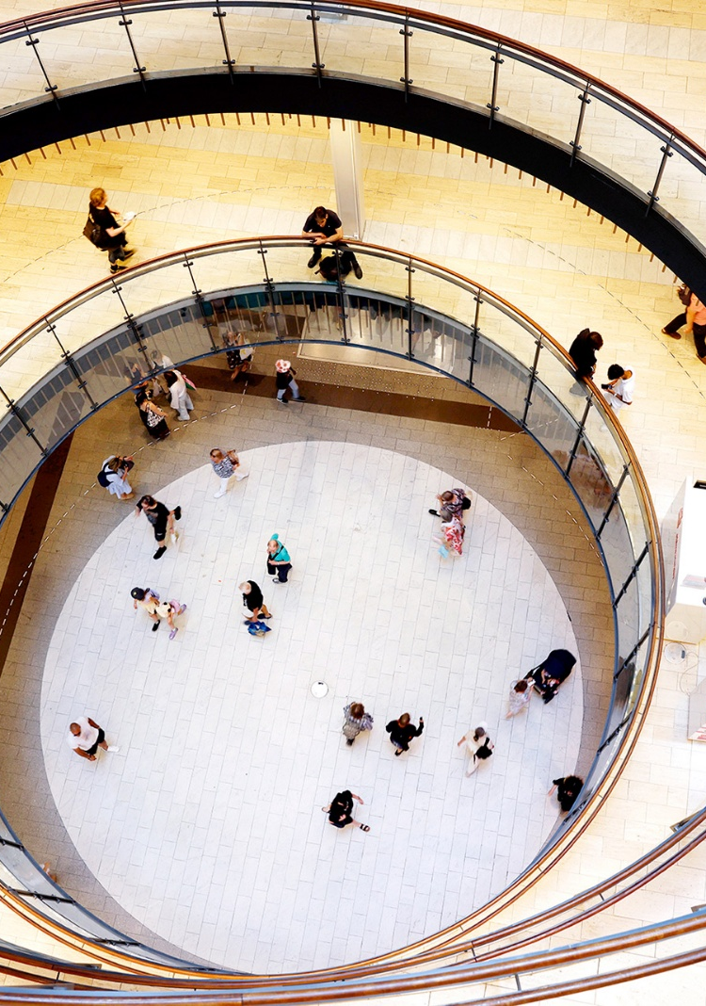
Changing theme: resilience
The global environment is currently undergoing rapid and continuous change, and companies are increasingly facing geopolitical risks, supply chain disruptions and economic uncertainty. Resilience and the ability to adapt to crises have become essential prerequisites for competitiveness and business continuity. Technology Industries of Finland is surveying the experiences and preparedness measures of its member companies to gain a better understanding of the challenges they face.

Slide 42
Have you already experienced concrete impacts due to the geopolitical situation, including trade policy uncertainty?
Source: TechnoBaro – The Technology Industry Barometer, June 2026, number of respondents 304.

Slide 43
How has your organisation prepared for disruptions and ensured business continuity?
Source: TechnoBaro – The Technology Industry Barometer, June 2026, number of respondents 304.

Slide 44
Which areas has your company invested in over the past year to improve its resilience to disruptions and crises?sen vuoden aikana?
Source: TechnoBaro – The Technology Industry Barometer, June 2026, number of respondents 304.

Slide 45
Do you see new business or growth opportunities for your company arising from the current global situation and ongoing transformations?
Source: TechnoBaro – The Technology Industry Barometer, June 2026, number of respondents 304.

Slide 46
In which areas do you see growth opportunities? (Select all that apply.)
% of companies, who see growth opportunities
Source: TechnoBaro – The Technology Industry Barometer, June 2026, number of respondents 304.

Slide 47
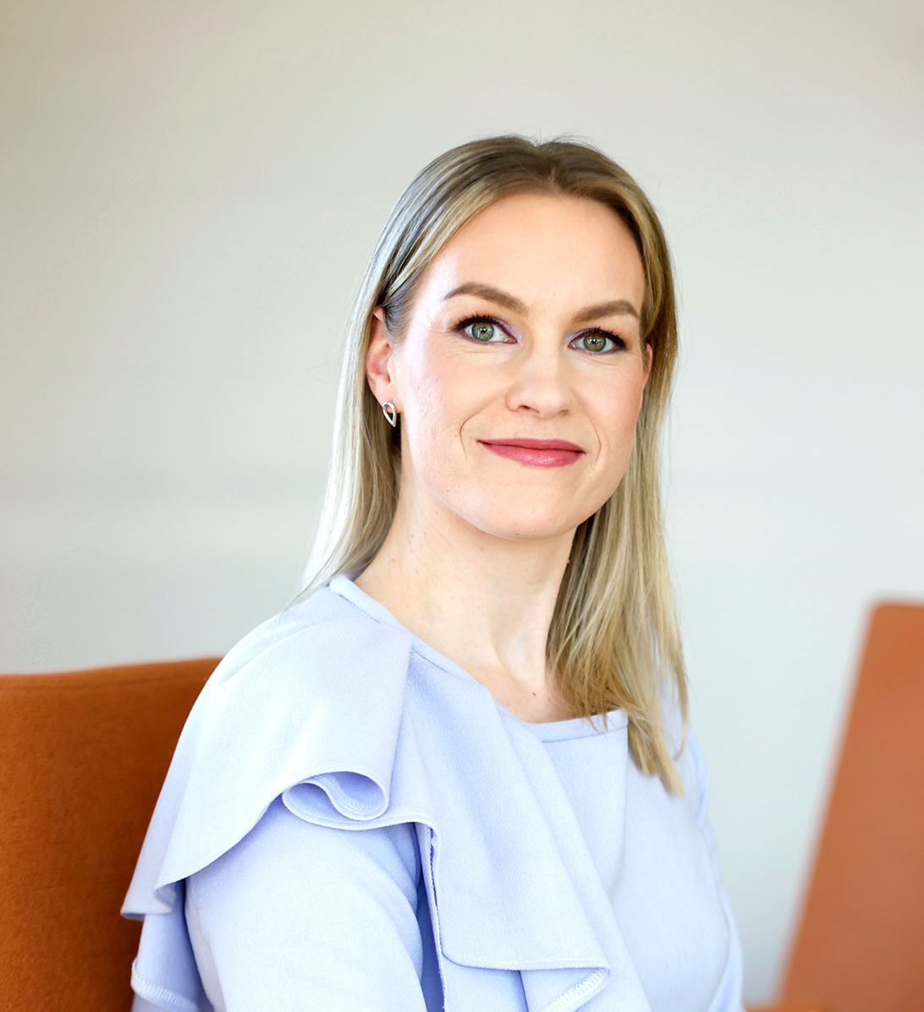
Questions? Get in touch!
Hanne Mikkonen
Senior Economist
Economic Development and Investment
Technology Industries of Finland
+358 440 296 152
hanne.mikkonen@teknologiateollisuus.fi

