Slide 1
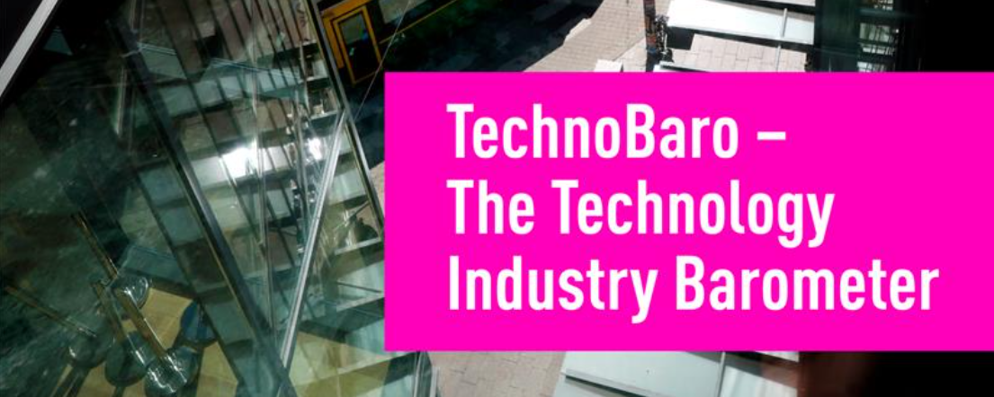
Results, September 2026

Slide 2
What is it about?
What is it about?
Answer and influence: TeknoBaro is a regular survey conducted by Technology Industries of Finland, the results of which are widely utilised in Technology Industries of Finland's advocacy work, position formation and the development of member services. The survey is carried out four times a year (March, June, September and December).
Content of the survey
The survey always includes two sections:
TeknoBaro's financial section: The purpose of these standard questions is to map the economic situation of the member companies of Technology Industries of Finland and their views on the future.
TeknoBaro's changing theme(s): We are surveying companies' views on the changing topical theme, which this time is growth.

Slide 3
Background
The survey was carried out Mon 7.9.2026 – Fri 11.9.2026
The survey recipients include the CEOs of the member companies of Technology Industries of Finland.
With a survey of 1696 recipients, we received 308 responses, i.e. the response rate was 18%.

Slide 4
Based on their size and industry, the respondent group is well representative of the members of Technology Industries of Finland
The report has been examined by industry with the division Industry & Services.
Source: Technology Industries of Finland's TeknoBaro, September 2026, 308 respondents.

Slide 5
Number of respondents
With the report, a size category review has been made with a division of over and under 150 employ.
Source: Technology Industries of Finland's TeknoBaro, September 2026, 308 respondents.

Slide 6
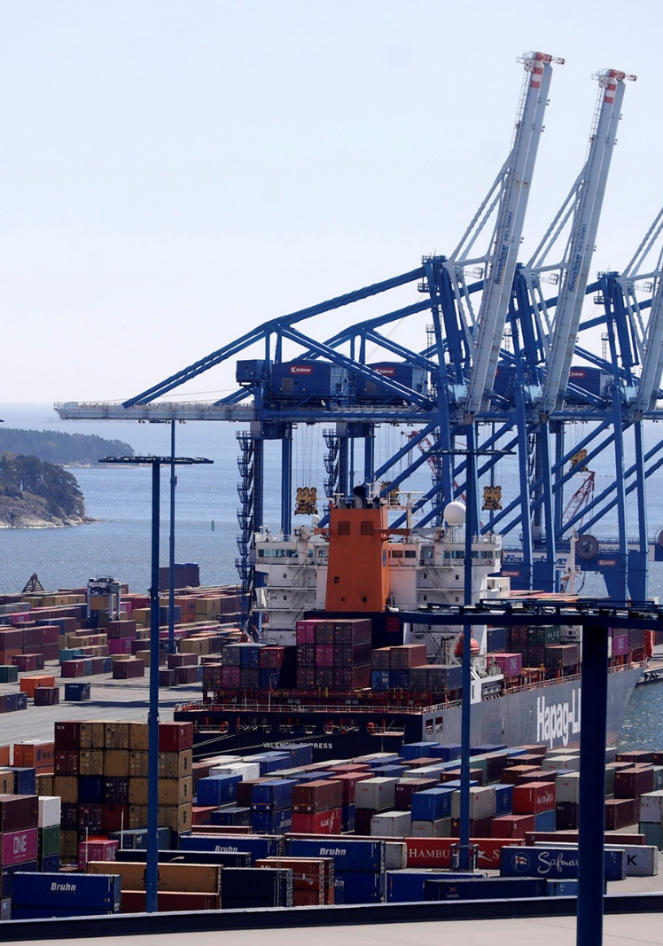
Time series
Balance figure: The balance figure is the proportion of those who have shown a positive development minus the share of those who have shown a negative development. For example, if 30% of the respondents have responded that new orders have increased, 50% have remained unchanged and 20% have decreased, the balance figure is 30–20, i.e. +10.

Slide 7
How would you describe your company's situation now in the following areas compared to the situation about three months ago? Balance figure
When the balance figure is positive, the majority of those who have assessed the change say that the situation has improved.
Source: Technology Industries of Finland's TeknoBaro surveys.

Slide 8
How would you describe your company's situation now in the following areas compared to the situation about three months ago? Balance figure
Source: Technology Industries of Finland's TeknoBaro surveys.

Slide 9
How do you expect your situation to develop over the next three months? Balance figure
Source: Technology Industries of Finland's TeknoBaro surveys.

Slide 10
Cyclical situation
How would you describe your company's situation now in the following areas compared to the situation about three months ago?

Slide 11
How would you describe your company's situation now in the following areas compared to the situation about three months ago?
% of respondents
Balance figure
26
22
29
23
Source: Technology Industries of Finland's TeknoBaro, September 2026, 308 respondents.

Slide 12
How would you describe your company's situation now in the following areas compared to the situation about three months ago? Manufacturing, 236 respondents
% of respondents
Balance figure
30
24
31
26
Source: Technology Industries of Finland's TeknoBaro, September 2026, 308 respondents.
Industry includes the processing of metals, the machinery and metal products industry, and the electrical and electronics industry. The services include the design and consulting sector and the information technology service sector.

Slide 13
How would you describe your company's situation now in the following areas compared to the situation about three months ago? Services, 72 respondents
% of respondents
Balance figure
15
17
22
13
Source: Technology Industries of Finland's TeknoBaro, September 2026, 308 respondents.
Industry includes the processing of metals, the machinery and metal products industry, and the electrical and electronics industry. The services include the design and consulting sector and the information technology service sector.

Slide 14
How would you describe your company's situation now in the following areas compared to the situation about three months ago?
Source: Technology Industries of Finland's TeknoBaro, September 2026, 308 respondents.

Slide 15
How would you describe your company's situation now in the following areas compared to the situation about three months ago? Less than 150 employed, 249 respondents
% of respondents
Balance figure
24
20
27
23
Source: Technology Industries of Finland's TeknoBaro, September 2026, 308 respondents.

Slide 16
How would you describe your company's situation now in the following areas compared to the situation about three months ago? More than 150 employing, 59 respondents
% of respondents
Balance figure
36
31
36
24
Source: Technology Industries of Finland's TeknoBaro, September 2026, 308 respondents.

Slide 17
How would you describe your company's situation now in the following areas compared to the situation about three months ago? Company size
Source: Technology Industries of Finland's TeknoBaro, September 2026, 308 respondents.

Slide 18
How would you describe your company's situation now in the following areas compared to the situation about three months ago? Company size, % of respondents
Source: Technology Industries of Finland's TeknoBaro, September 2026, 308 respondents.
*Note! Removed from the responses are those engineering & consulting and IT companies that have stated that finished product stocks and suppliers' delivery times do not apply to them.

Slide 19
How would you describe your company's situation now in the following areas compared to the situation about three months ago?
Note! In this global situation, this also indicates the growing challenges of logistics, not necessarily related to demand.
If the balance figure is positive, then inventories have decreased (demand increases)
If the balance figure is positive, delivery times have lengthened (demand increases)
Source: Technology Industries of Finland's TeknoBaro surveys.

Slide 20
The next three months, expectations Septeber-December?
How do you estimate your situation will develop over the next three months?

Slide 21
How do you estimate your situation will develop over the next three months?
Balance figure
24
36
% of respondents
Source: Technology Industries of Finland's TeknoBaro, September 2026, 308 respondents.

Slide 22
How do you expect your situation to develop over the next three months? Balance figure
When the balance figure is positive, the majority of those who estimated the change estimated that the situation will improve in the coming months.
Source: Technology Industries of Finland's TeknoBaro surveys.

Slide 23
How do you estimate your situation will develop over the next three months?
Source: Technology Industries of Finland's TeknoBaro, September 2026, 308 respondents.

Slide 24
How do you expect your situation to develop over the next three months? Industry vs. services
Source: Technology Industries of Finland's TeknoBaro, September 2026, 308 respondents.
Industry includes the processing of metals, the machinery and metal products industry, and the electrical and electronics industry. The services include the design and consulting sector and the information technology service sector.

Slide 25
How do you estimate your situation will develop over the next three months?
Source: Technology Industries of Finland's TeknoBaro, September 2026, 308 respondents.

Slide 26
How do you think your situation will develop over the next three months? Company size, % of respondents
Source: Technology Industries of Finland's TeknoBaro, September 2026, 308 respondents.

Slide 27
Investments

Slide 28
How do you expect your investment to develop in 2026 compared to 2025?
% of respondents
Balance figure
13
5
22
39
Source: Technology Industries of Finland's TeknoBaro, September 2026, 308 respondents.

Slide 29
How do you expect your investment to develop in 2026 compared to 2025? Balance figure
When the balance figure is positive, the majority of those who estimated the change say that investments will increase.
Source: Technology Industries of Finland's TeknoBaro, September 2026, 308 respondents.

Slide 30
How do you expect your investment to develop in 2026 compared to 2025?
Source: Technology Industries of Finland's TeknoBaro, September 2026, 308 respondents.

Slide 31
How do you expect your investment to develop in 2026 compared to 2025? Balance figure
Source: Technology Industries of Finland's TeknoBaro, September 2026, 308 respondents.

Slide 32
How do you estimate your investment will develop in 2026 compared to 2025? Manufacturing, 236 respondents
% of respondents
Balance figure
15
8
20
36
Source: Technology Industries of Finland's TeknoBaro, September 2026, 308 respondents.
Industry includes the processing of metals, the machinery and metal products industry, and the electrical and electronics industry. The services include the design and consulting sector and the information technology service sector.

Slide 33
How do you estimate your investment will develop in 2026 compared to 2025? Services, 72 respondents
Balance figure
7
-4
26
47
% of respondents
Source: Technology Industries of Finland's TeknoBaro, September 2026, 308 respondents.
Industry includes the processing of metals, the machinery and metal products industry, and the electrical and electronics industry. The services include the design and consulting sector and the information technology service sector.

Slide 34
How do you expect your investment to develop in 2026 compared to 2025? Balance figure
Source: Technology Industries of Finland's TeknoBaro, September 2026, 308 respondents.

Slide 35
How do you estimate your investments will develop in 2026 compared to 2025? Less than 150 employing, 249 respondents
Balance figure
12
3
20
36
% of respondents
Source: Technology Industries of Finland's TeknoBaro, September 2026, 308 respondents.

Slide 36
How do you estimate your investment will develop in 2026 compared to 2025? More than 150 employing, 59 respondents
Balance figure
19
12
27
53
% of respondents
Source: Technology Industries of Finland's TeknoBaro, September 2026, 308 respondents.

Slide 37
Investments in artificial intelligence
Source: Technology Industries of Finland's TeknoBaro, September 2026, 308 respondents.

Slide 38
Investments in AI, other than "we don't invest in AI" -> invest in AI at least something
Source: Technology Industries of Finland's TeknoBaro surveys.

Slide 39
Investments in artificial intelligence, industry vs services, % of respondents
Source: Technology Industries of Finland's TeknoBaro, September 2026, 308 respondents.
Industry includes the processing of metals, the machinery and metal products industry, and the electrical and electronics industry. The services include the design and consulting sector and the information technology service sector.

Slide 40
Investments in AI, company size, % of respondents
Source: Technology Industries of Finland's TeknoBaro, September 2026, 308 respondents.

Slide 41
Time series with a more detailed breakdown
Balance figure: The balance figure is the proportion of those who have shown a positive development minus the share of those who have shown a negative development. For example, if 30% of the respondents have responded that new orders have increased, 50% have remained unchanged and 20% have decreased, the balance figure is 30–20, i.e. +10.

Slide 42
Manufacturing industry

Slide 43
How would you describe your company's situation now in the following areas compared to the situation about three months ago? Balance figure
Source: Technology Industries of Finland's TeknoBaro surveys.

Slide 44
How would you describe your company's situation now in the following areas compared to the situation about three months ago? Balance figure
Source: Technology Industries of Finland's TeknoBaro surveys.

Slide 45
How do you expect your situation to develop over the next three months? Balance figure
Source: Technology Industries of Finland's TeknoBaro surveys.

Slide 46
Services

Slide 47
How would you describe your company's situation now in the following areas compared to the situation about three months ago? Balance figure
Source: Technology Industries of Finland's TeknoBaro surveys.

Slide 48
How would you describe your company's situation now in the following areas compared to the situation about three months ago? Balance figure
Source: Technology Industries of Finland's TeknoBaro surveys.

Slide 49
How do you expect your situation to develop over the next three months? Balance figure
Source: Technology Industries of Finland's TeknoBaro surveys.

Slide 50
Companies with more than 150 employees

Slide 51
How would you describe your company's situation now in the following areas compared to the situation about three months ago? Balance figure
Source: Technology Industries of Finland's TeknoBaro surveys.

Slide 52
How would you describe your company's situation now in the following areas compared to the situation about three months ago? Balance figure
Source: Technology Industries of Finland's TeknoBaro surveys.

Slide 53
How do you think your situation will develop over the next three months? Balance figure
Source: Technology Industries of Finland's TeknoBaro surveys.

Slide 54
Companies with less than 150 employees

Slide 55
How would you describe your company's situation now in the following areas compared to the situation about three months ago? Balance figure
Source: Technology Industries of Finland's TeknoBaro surveys.

Slide 56
How would you describe your company's situation now in the following areas compared to the situation about three months ago? Balance figure
Source: Technology Industries of Finland's TeknoBaro surveys.

Slide 57
How do you think your situation will develop over the next three months? Balance figure
Source: Technology Industries of Finland's TeknoBaro surveys.

Slide 58
Free comments on your company's economic situation and outlook

Slide 59
Open comments:
Demand is stable and strong. Clearly better than 2025, but stable in 2026. The general development of the global economy (wars, the outbreak of the AI boom, inflation) is our biggest risk.
In information technology, the situation is twofold. In the longer term (approx. 1 - 2 years), we believe that AI will bring new growth and increasing demand. In the shorter time span, we will carry out an internal transformation in which new roles will be created and the job description will change. This will cause us to recruit new experts and reduce personnel at the same time. In net terms, we do not believe that the number of employees will increase significantly.
There has been a clear pick-up, but customers are still cautious.
Really good growth projects underway. These will primarily lead to automation investments and new expert recruitments.
We do not yet see a concrete change in the acquisitions of SMEs, and the decision times in groups are still long.

Slide 60
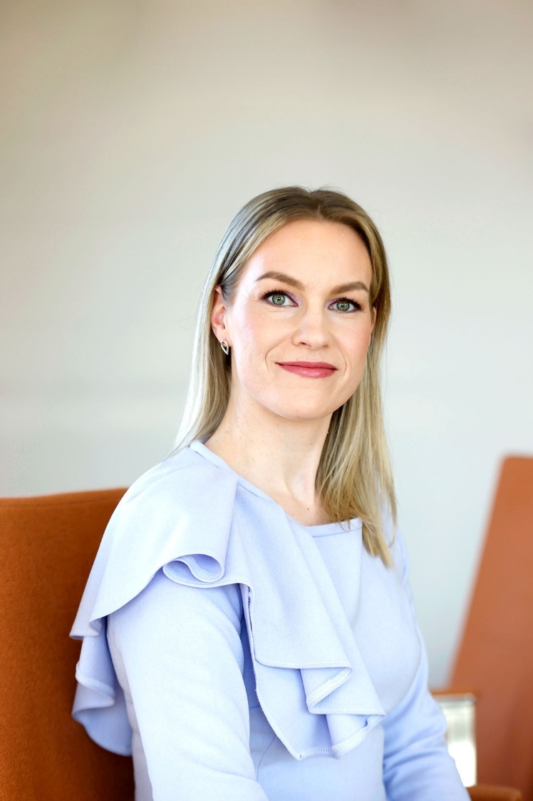
Any questions? Contact us!
Hanne Mikkonen
Senior Economist
Economy and sustainable growth
Technology Industries of Finland
0440 296 152
hanne.mikkonen@teknologiateollisuus.fi

